Slide 1
Matching a short vertical on 160 meters
Joe Purden
W6AYC
purden@verizon.net
July 24, 2018

Slide 2
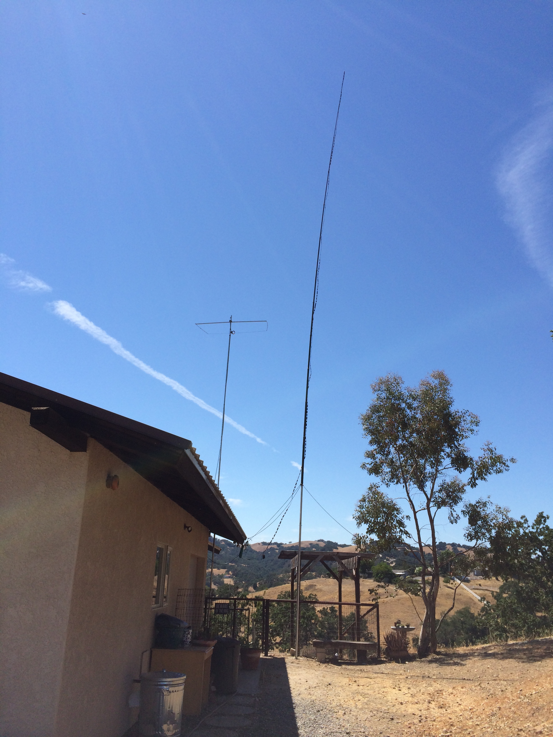
Objective: Use existing 50ft vertical on 160 meters to work Baker Island
Metal roof for
ground plane
40 foot fiberglass Spiderpole
15 foot aluminum tubing
Manual L-network tuner
for 80-15m
(under eaves)
450 Ohm ladder line taped to pole
(for increased radiator diameter)

Slide 3
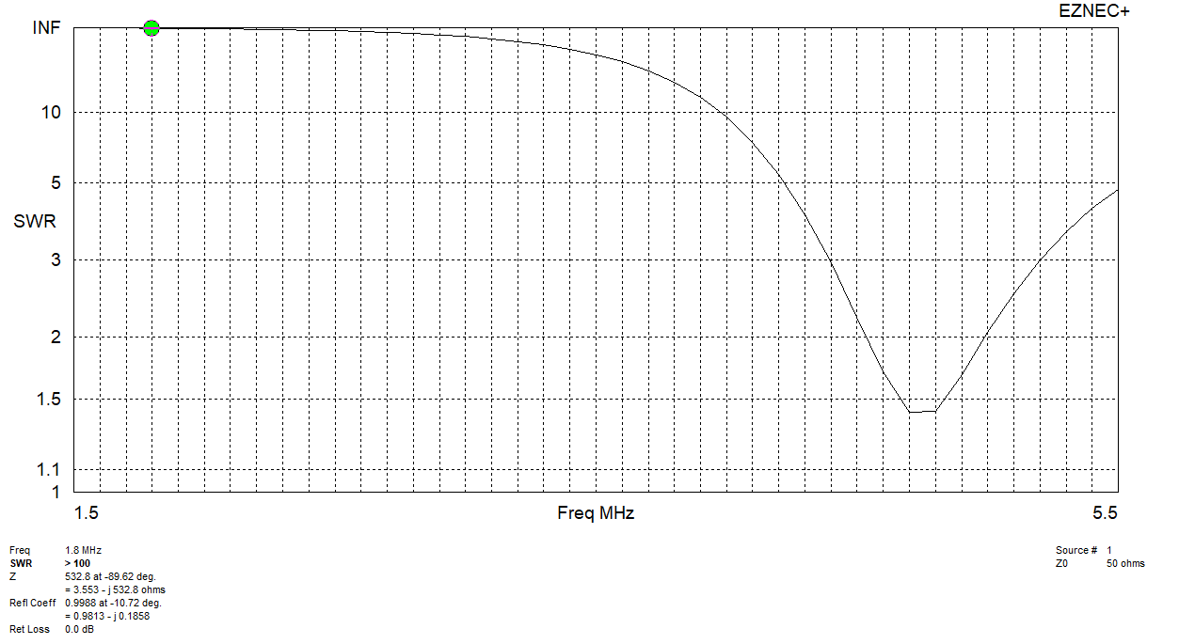
Rough EZNEC modelling predicts feed-point impedance of 3.6-j530 Ohms (3.6 Ohms is the radiation resistance)
Resonate at 4.7 MHz
Need to match to 50 Ohms with minimum losses

Slide 4
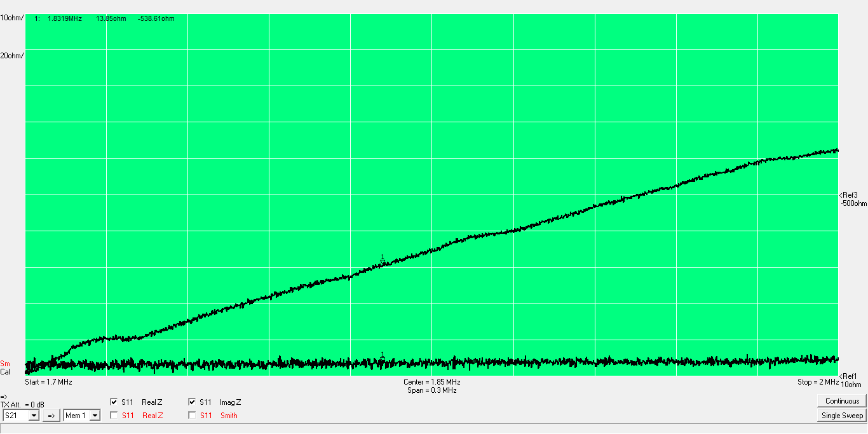
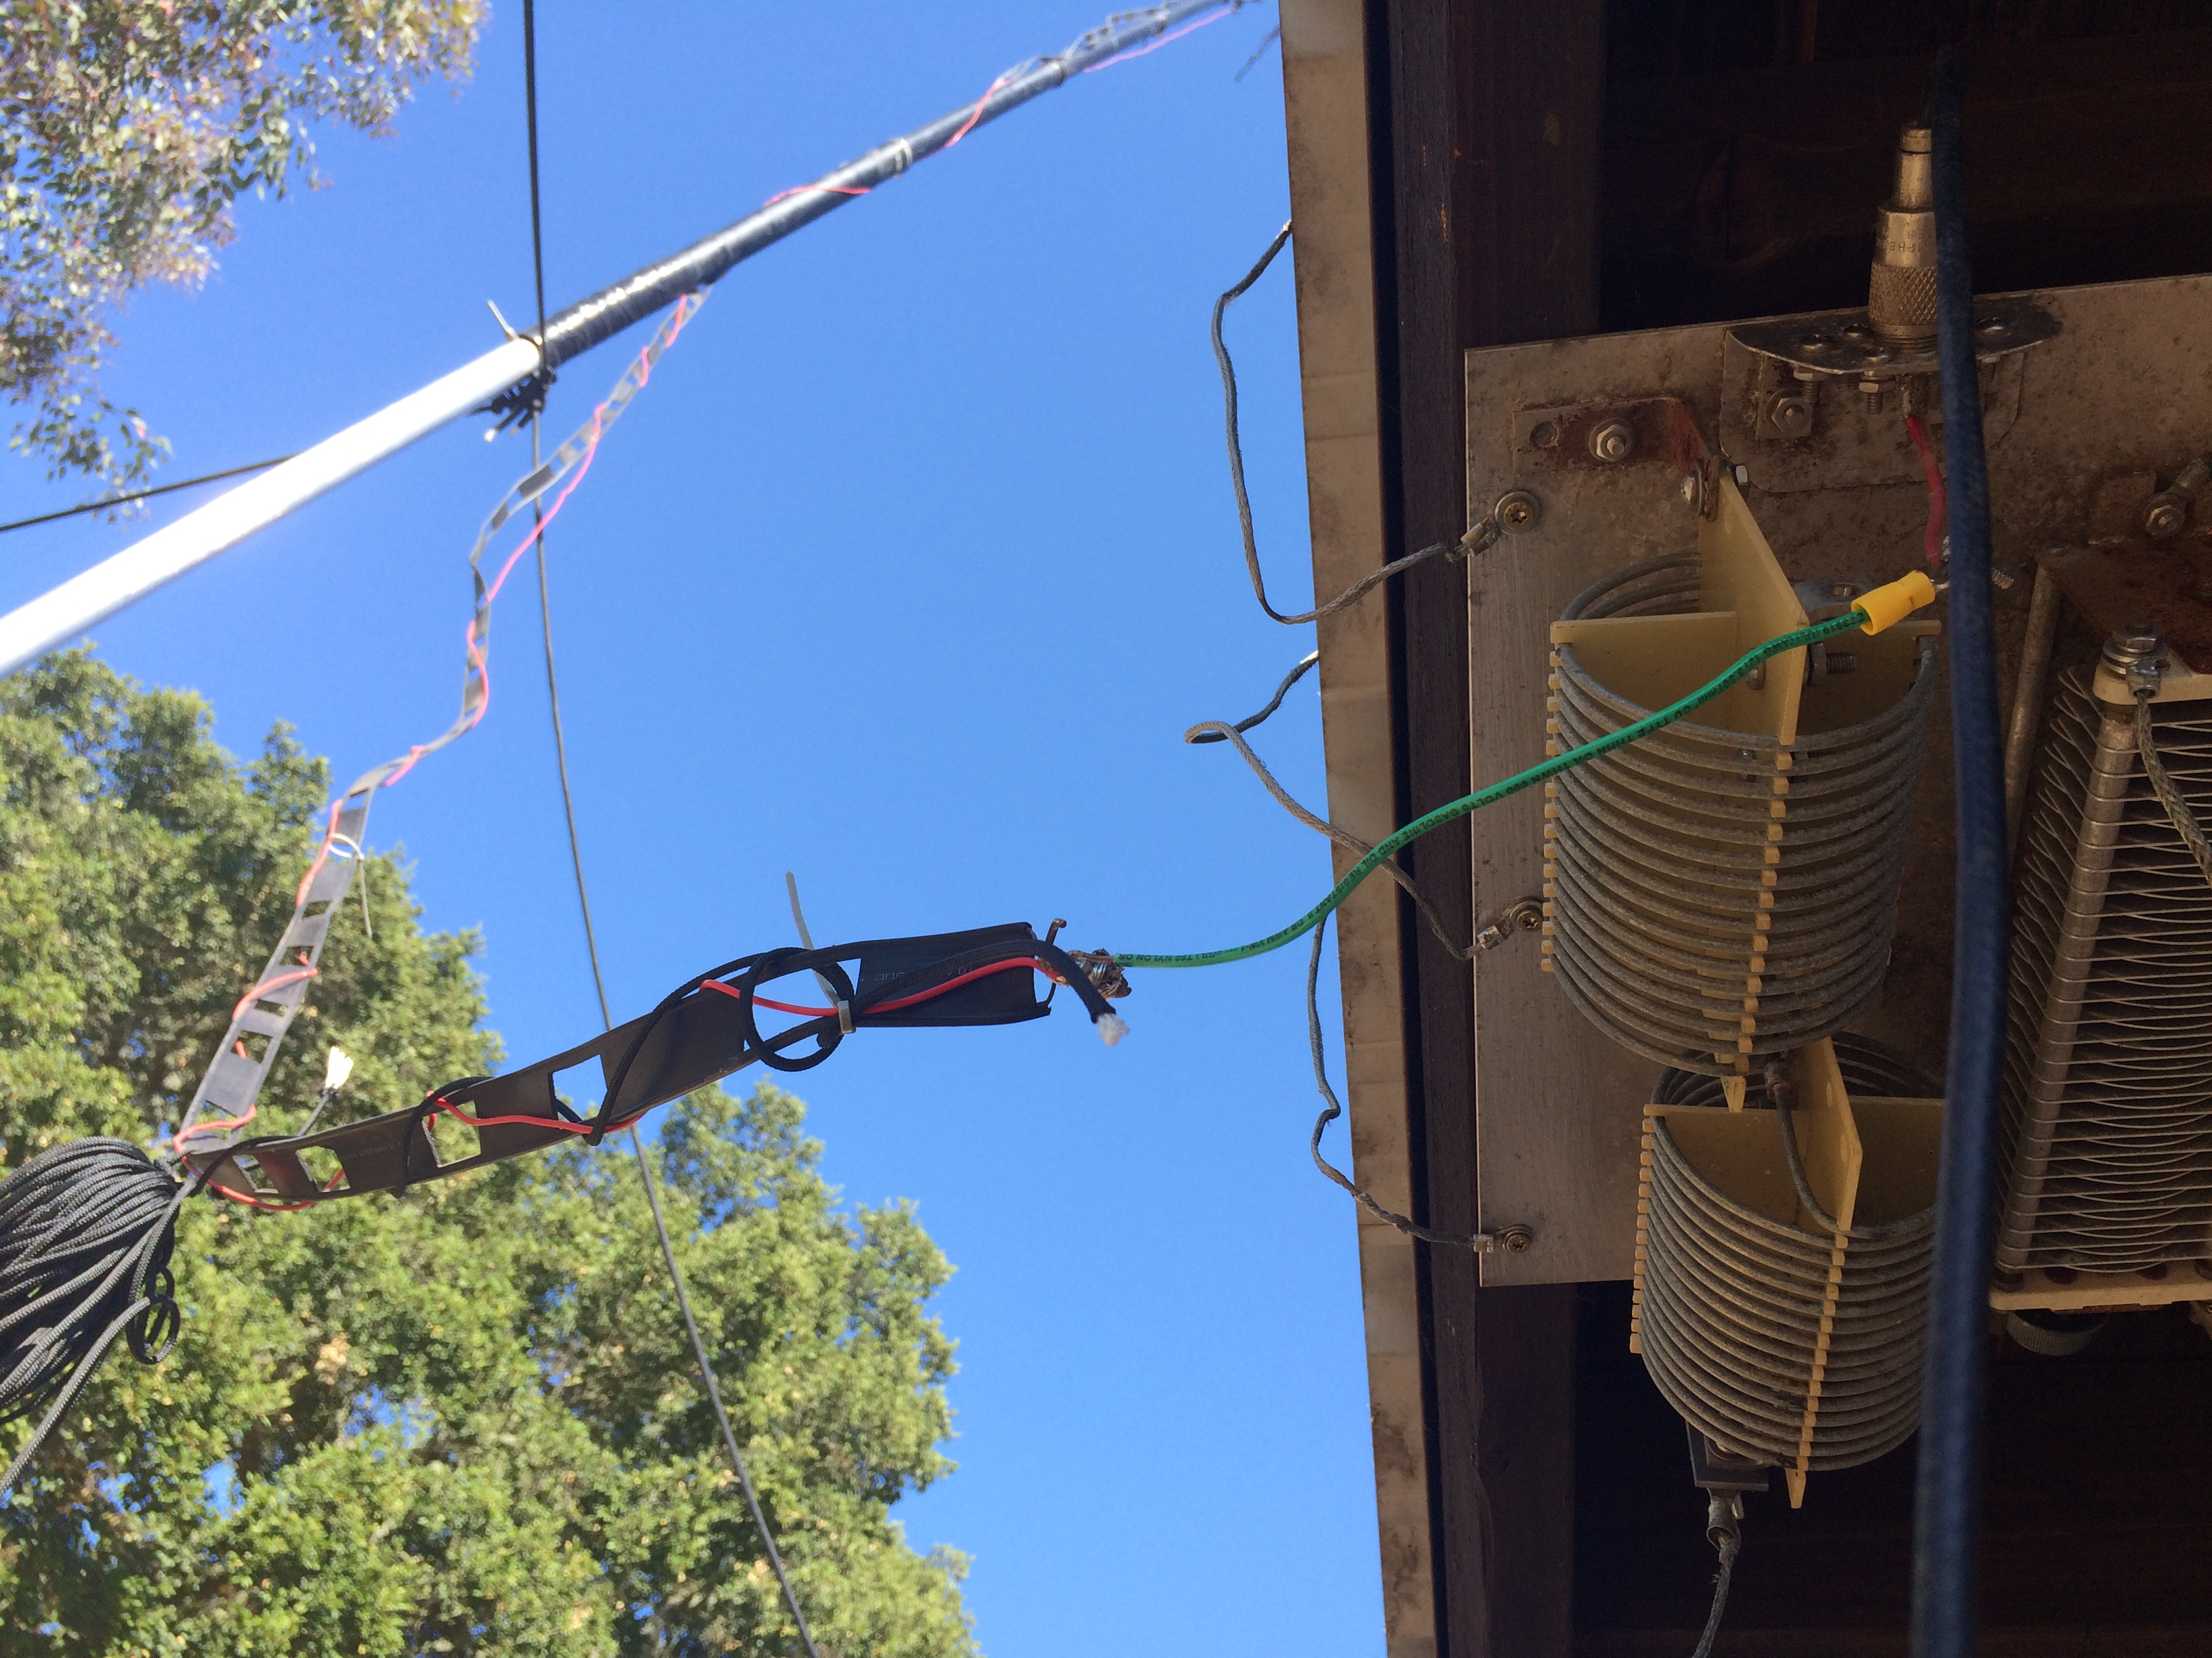
Measured input impedance of 50 foot vertical fed against metal roof: 14 – j540 Ohms

Slide 5
Matching approach:
Use loading coil to cancel 540 Ohm capacitive reactance
Inductance= 540/(2*pi*1.8e6)= 48 uH
Hi-Q to minimize losses (large diameter, thick wire)
Use on-hand materials (avoid trip to hardware store)
#12 THHN (solid copper wire)
2.3 inch diameter black PVC
Hairpin match to transform low feed point impedance to 50 Ohms
Microwave sample for 30 seconds to check for excessive loss tangent- barely warm-OK

Slide 6
Coil design
Air-coil: L(µH)=d² * n² / (18d + 40l) n²=L(18d+40l)/ d² Where: L = inductance in microhenrys d = coil diameter in inches(from wire center to wire center l = coil length in inches ( 1 inches = 25.4 mm) n = number of turns
Estimate 55 turns on a 10 inch long, 2.4 inch diameter coil
(start with 60 turns)

Slide 7
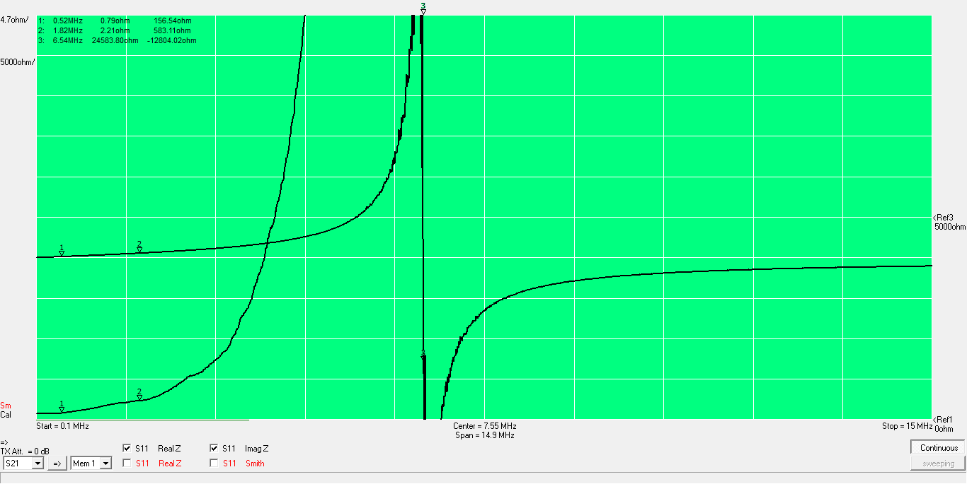
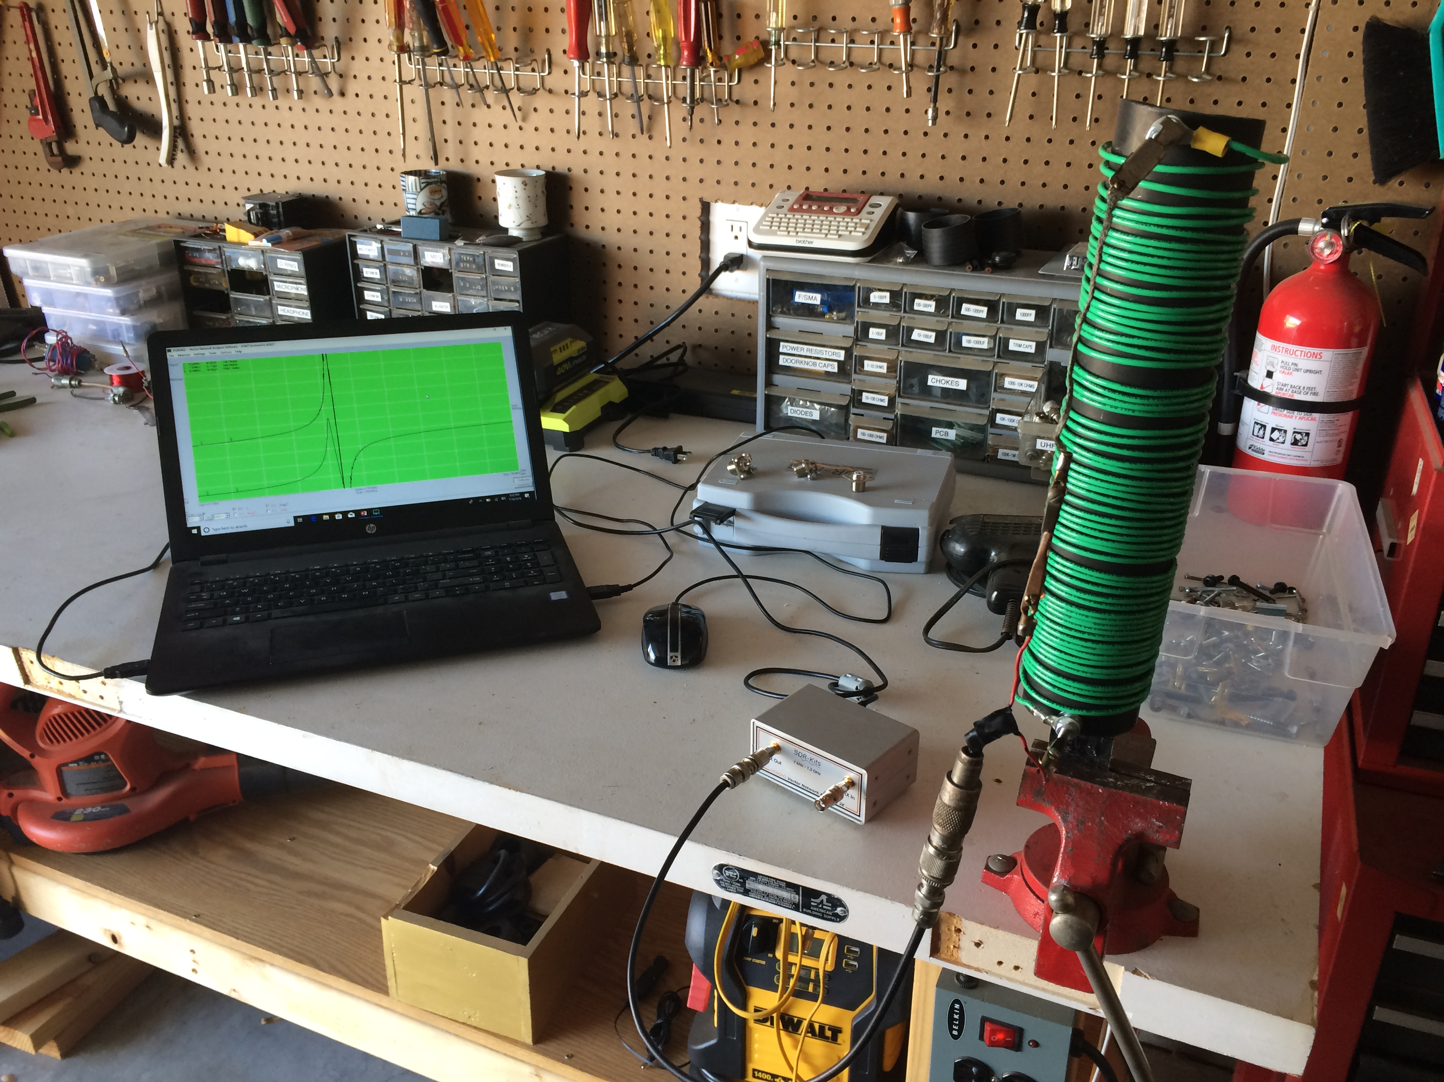
Measuring coil on network analyzer shows Q of 265 and 580 Ohms of reactance
60T, 10 inch, 2.4 inch diameter
Q= X/R=583/2.2= 265, SRF= 6.5 MHz

Slide 8
Coil Q determines losses
Q=X/R
R is effective RF resistance
It is not only wire resistance (even accounting for skin effect)
R is dominated by proximity to the self resonant frequency
Maximize Q by minimizing wire resistance and raising the self resonant frequency (SRF)
SRF is determined by inter-turn capacitance
Good: air cores, large diameter, wide turn spacing, no insulation, Q>250
Depending on application, maximizing Q may or may not be worthwhile
Everything’s a compromise

Slide 9
Some calculations:
Ground losses are total resistance minus radiation resistance
Rground= 14 -3.6= 10.4 Ohms
Efficiency= Radiation Resistance/Total Resistance
Total Resistance= Radiation Resistance + Ground Loss Resistance + Coil Resistance
Efficiency= 3.6/(3.6+10.4+2.2)= 0.22 or 22% or 6.5 dB down from a lossless system
Power dissipated in coil at 1500W is 1500 (2.2/(3.6+10.4+2.2)= 203W
Voltage across coil is peak current times the coil reactance
Peak current=1.414 SqRt (Power/Total Resistance)=1.414SqRt(1500/ 3.6+10.4+2.2)= 13.6A
Peak Voltage= 13.6(540)=7.4KV (need to be careful about area around coil so as not to have corona discharge)
If we made the best coil ever with a Q of 500 the coil resistance would be 1.1 Ohms and the efficiency, 3.6/(3.6+10.4+1.1)= 0.24 or 24%
When ground losses dominate, Q has little effect on efficiency
Power dissipated in coil would be half
For winter contests top loading (inverted L) and elevated radials are added. This substantially improves
efficiency (and bandwidth) by raising the radiation resistance and reducing ground losses.
Estimated efficiency is 60% or 4dB higher.

Slide 10
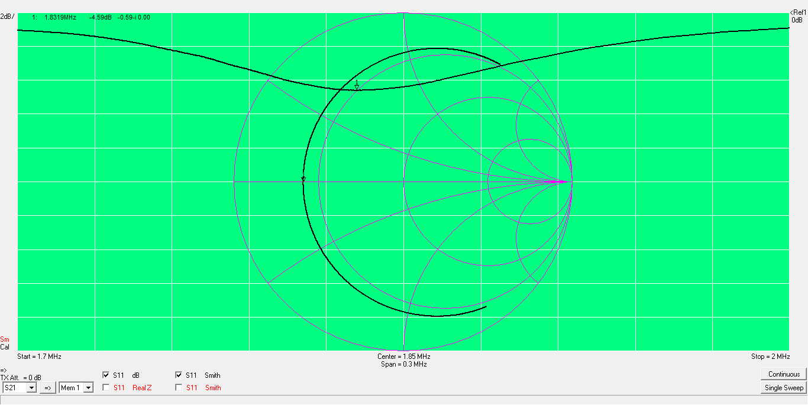
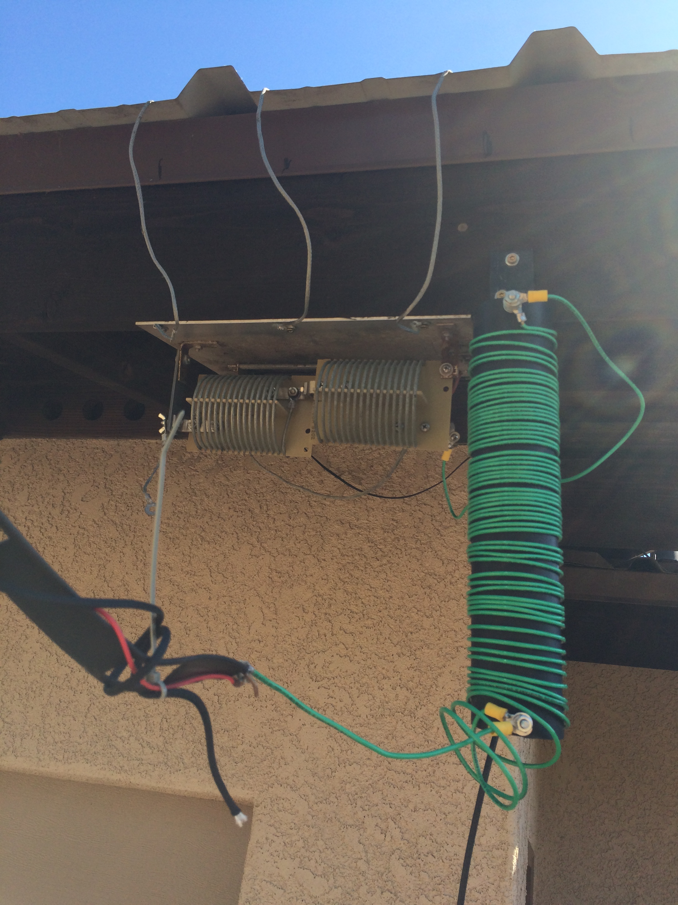
Adding loading coil: VSWR= 3.9:1, 1.83 MHz Expand /contract coil windings to adjust center frequency

Slide 11
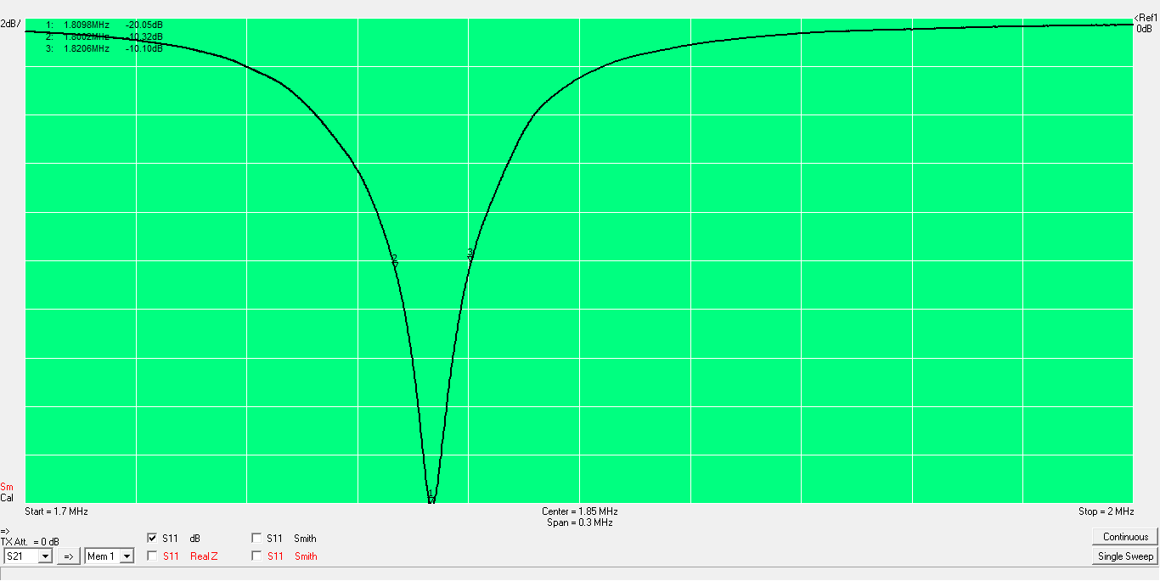
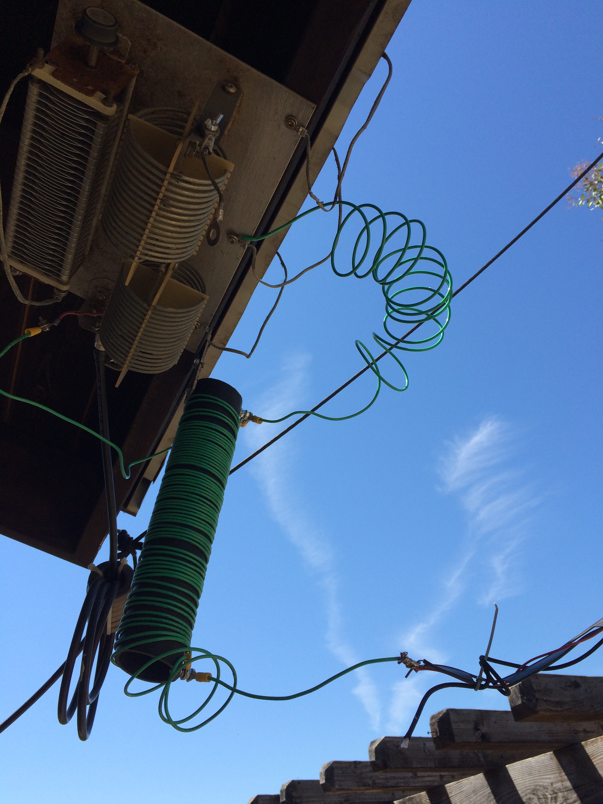
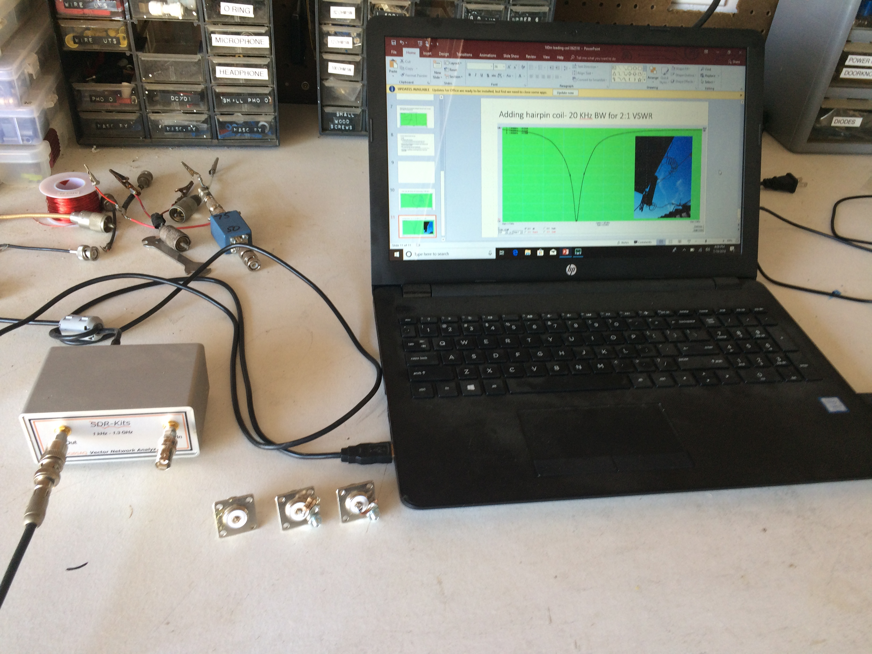
Adding hairpin coil- 20 KHz BW for 2:1 VSWR Expand/contract hairpin coil for best VSWR

Slide 12
Performance
Initial tests
String of dits while increasing power to 1.5 KW
No arcs
1.5 KW carrier for 30 seconds
Run around house from shack, climb step ladder r
Coil just warm
Finale
Worked KH1/KH7Z, 6/30/2018, 0930Z (2:30AM local) 3 calls

