Slide 1
Ferrite cores for transmitting chokes (baluns)
Joe Purden
W6AYC
purden@verizon.net
September 25, 2018

Slide 2
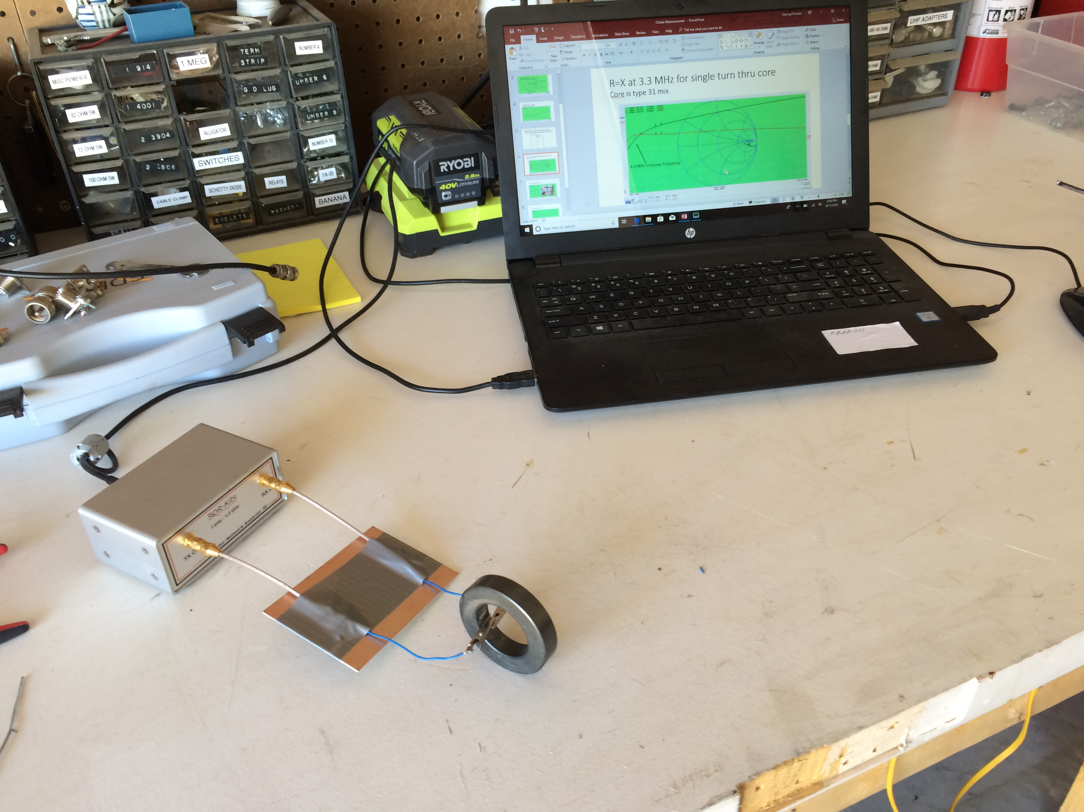
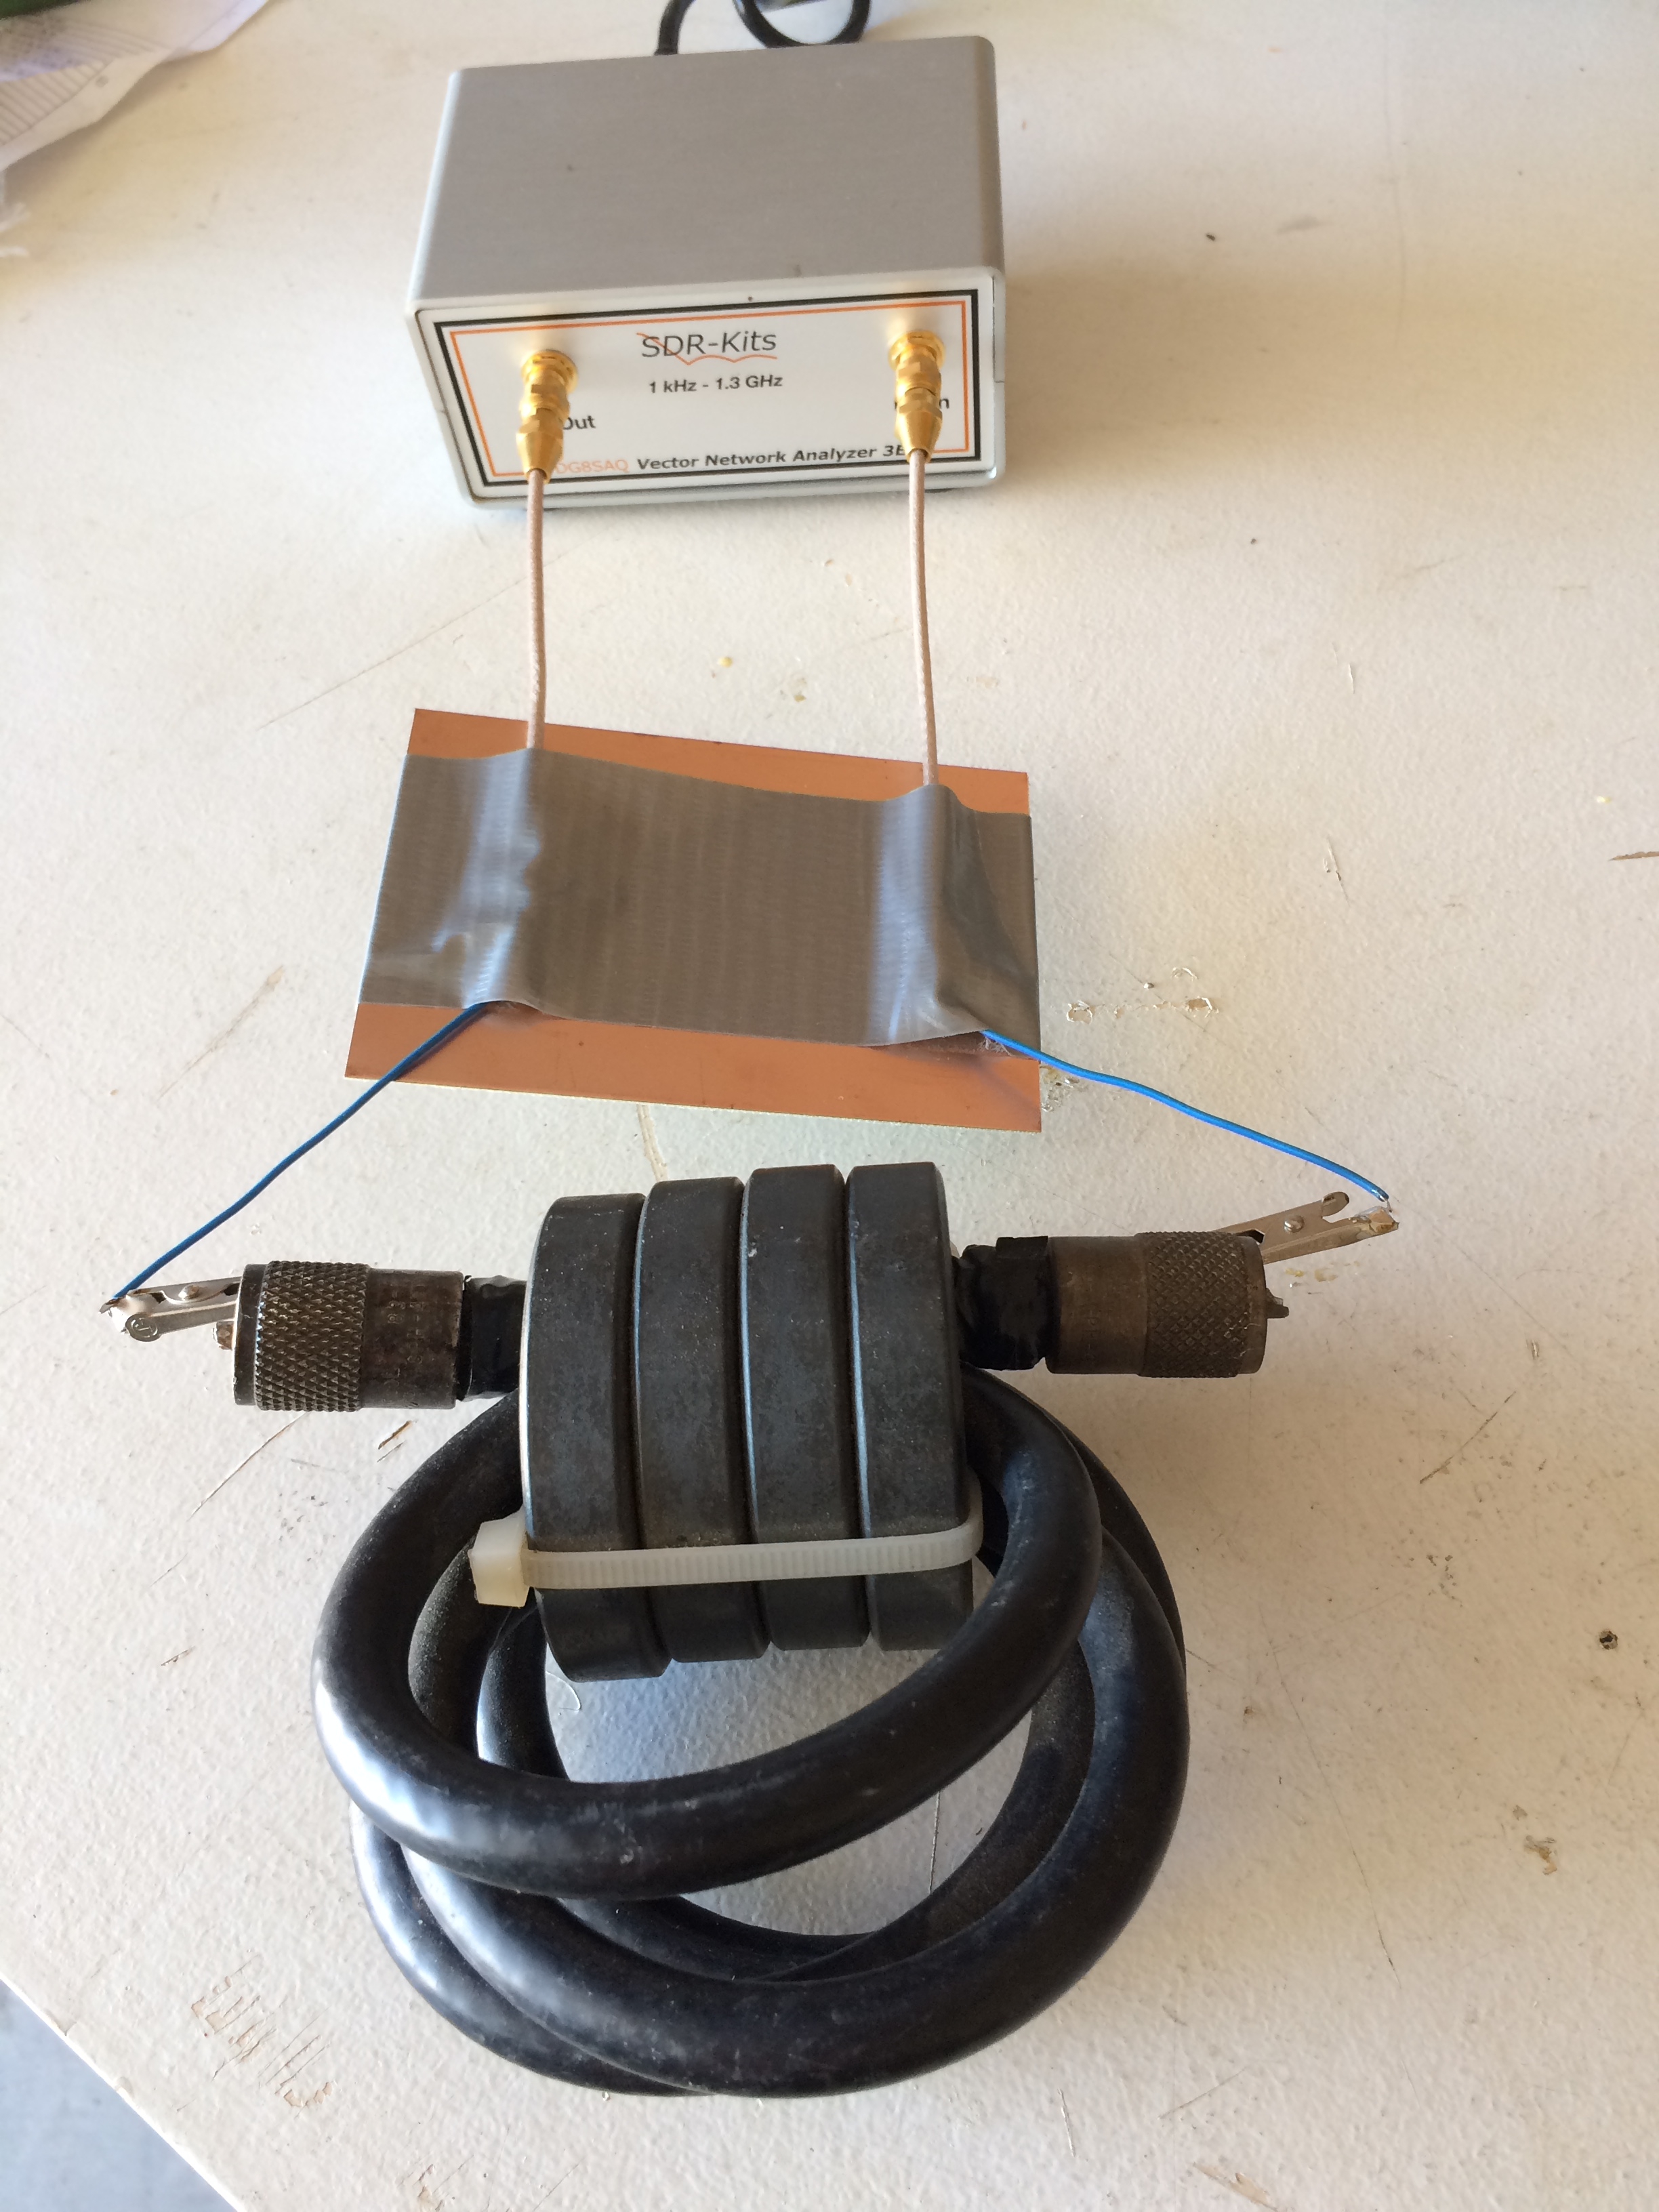
Agenda
Why use a choke on antenna feed?
What type ferrite cores (43 or 31 mix) did I buy several years ago?
What is the performance of my ferrite chokes?

Slide 3
The coax shield acts as two conductors (due to skin effect)
The inside of the shield and the center conductor carry the RF signal
The outside of the shield is susceptible to common mode currents
Current
Electric field
(Voltage)
RF current flows on outside of shield
(radiates)
TX
TX
Due to reciprocity RF radiation and RF reception are equivalent

Slide 4
Chokes at antenna feed eliminate coupling between coax shield and antenna elements
The shield of a coax acts as an antenna and both receives and radiates RF energy
By choking the antenna feed-point:
Reduce RFI and RF in the shack
Reduce local noise picked up by feedline
Some “antennas” depend on coax for radiation (Isoton, etc.)
Don’t put choke at feed-point of EFHW
Place high impedance between outer shield and antenna elements
TX

Slide 5
Choke resistance is the important parameter
High inductive reactance can be cancelled by capacitive reactance of the feedline shield which is difficult to predict
Coils of coax are just inductors and of limited use
½ wavelength feedlines are particularly bad
½ wavelength transforms low impedance ground to low impedance at feed-point allowing large outer shield currents
TX

Slide 6
How much choking resistance is enough?
Greater than 1000 Ohms is desirable
Depends on antenna mismatch and imbalance
Choking impedance increases as $N^{2}$
Power dissipation goes up for smaller choking resistances
Power in choke= Total Power * (Rant/Rchoke)
Example: 1000W * (50/1000)= 50W
Receive noise suppression is very roughly: S= 20 Log (Rant/Rchoke)
Example: S= 20 log (50/1000) = -26 dB
All this can be more accurately simulated in EZNEC

Slide 7
Measuring chokes with a VNA is tricky
Chokes have parallel C less than 1pF
Stray capacitance from test fixture can have a disastrous effect on measurements
S21 measurements minimize stray capacitance
Antenna analyzer
2 Port VNA
VNA
VNA
Large stray
capacitance
Minimum stray capacitance
DUT
DUT

Slide 8
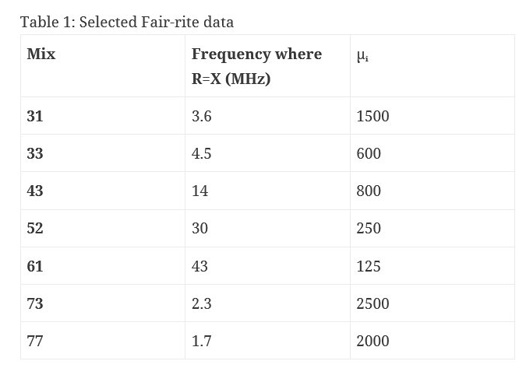
What kind of ferrite cores did I buy?
Measurement of cross-over frequency where R=X can be used to identify unknown ferrite cores

Slide 9
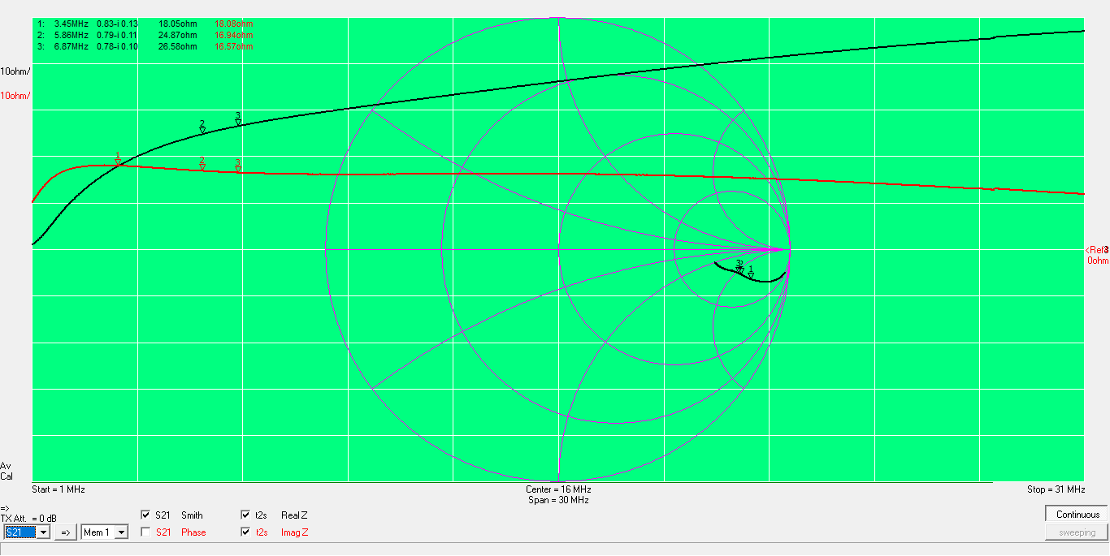
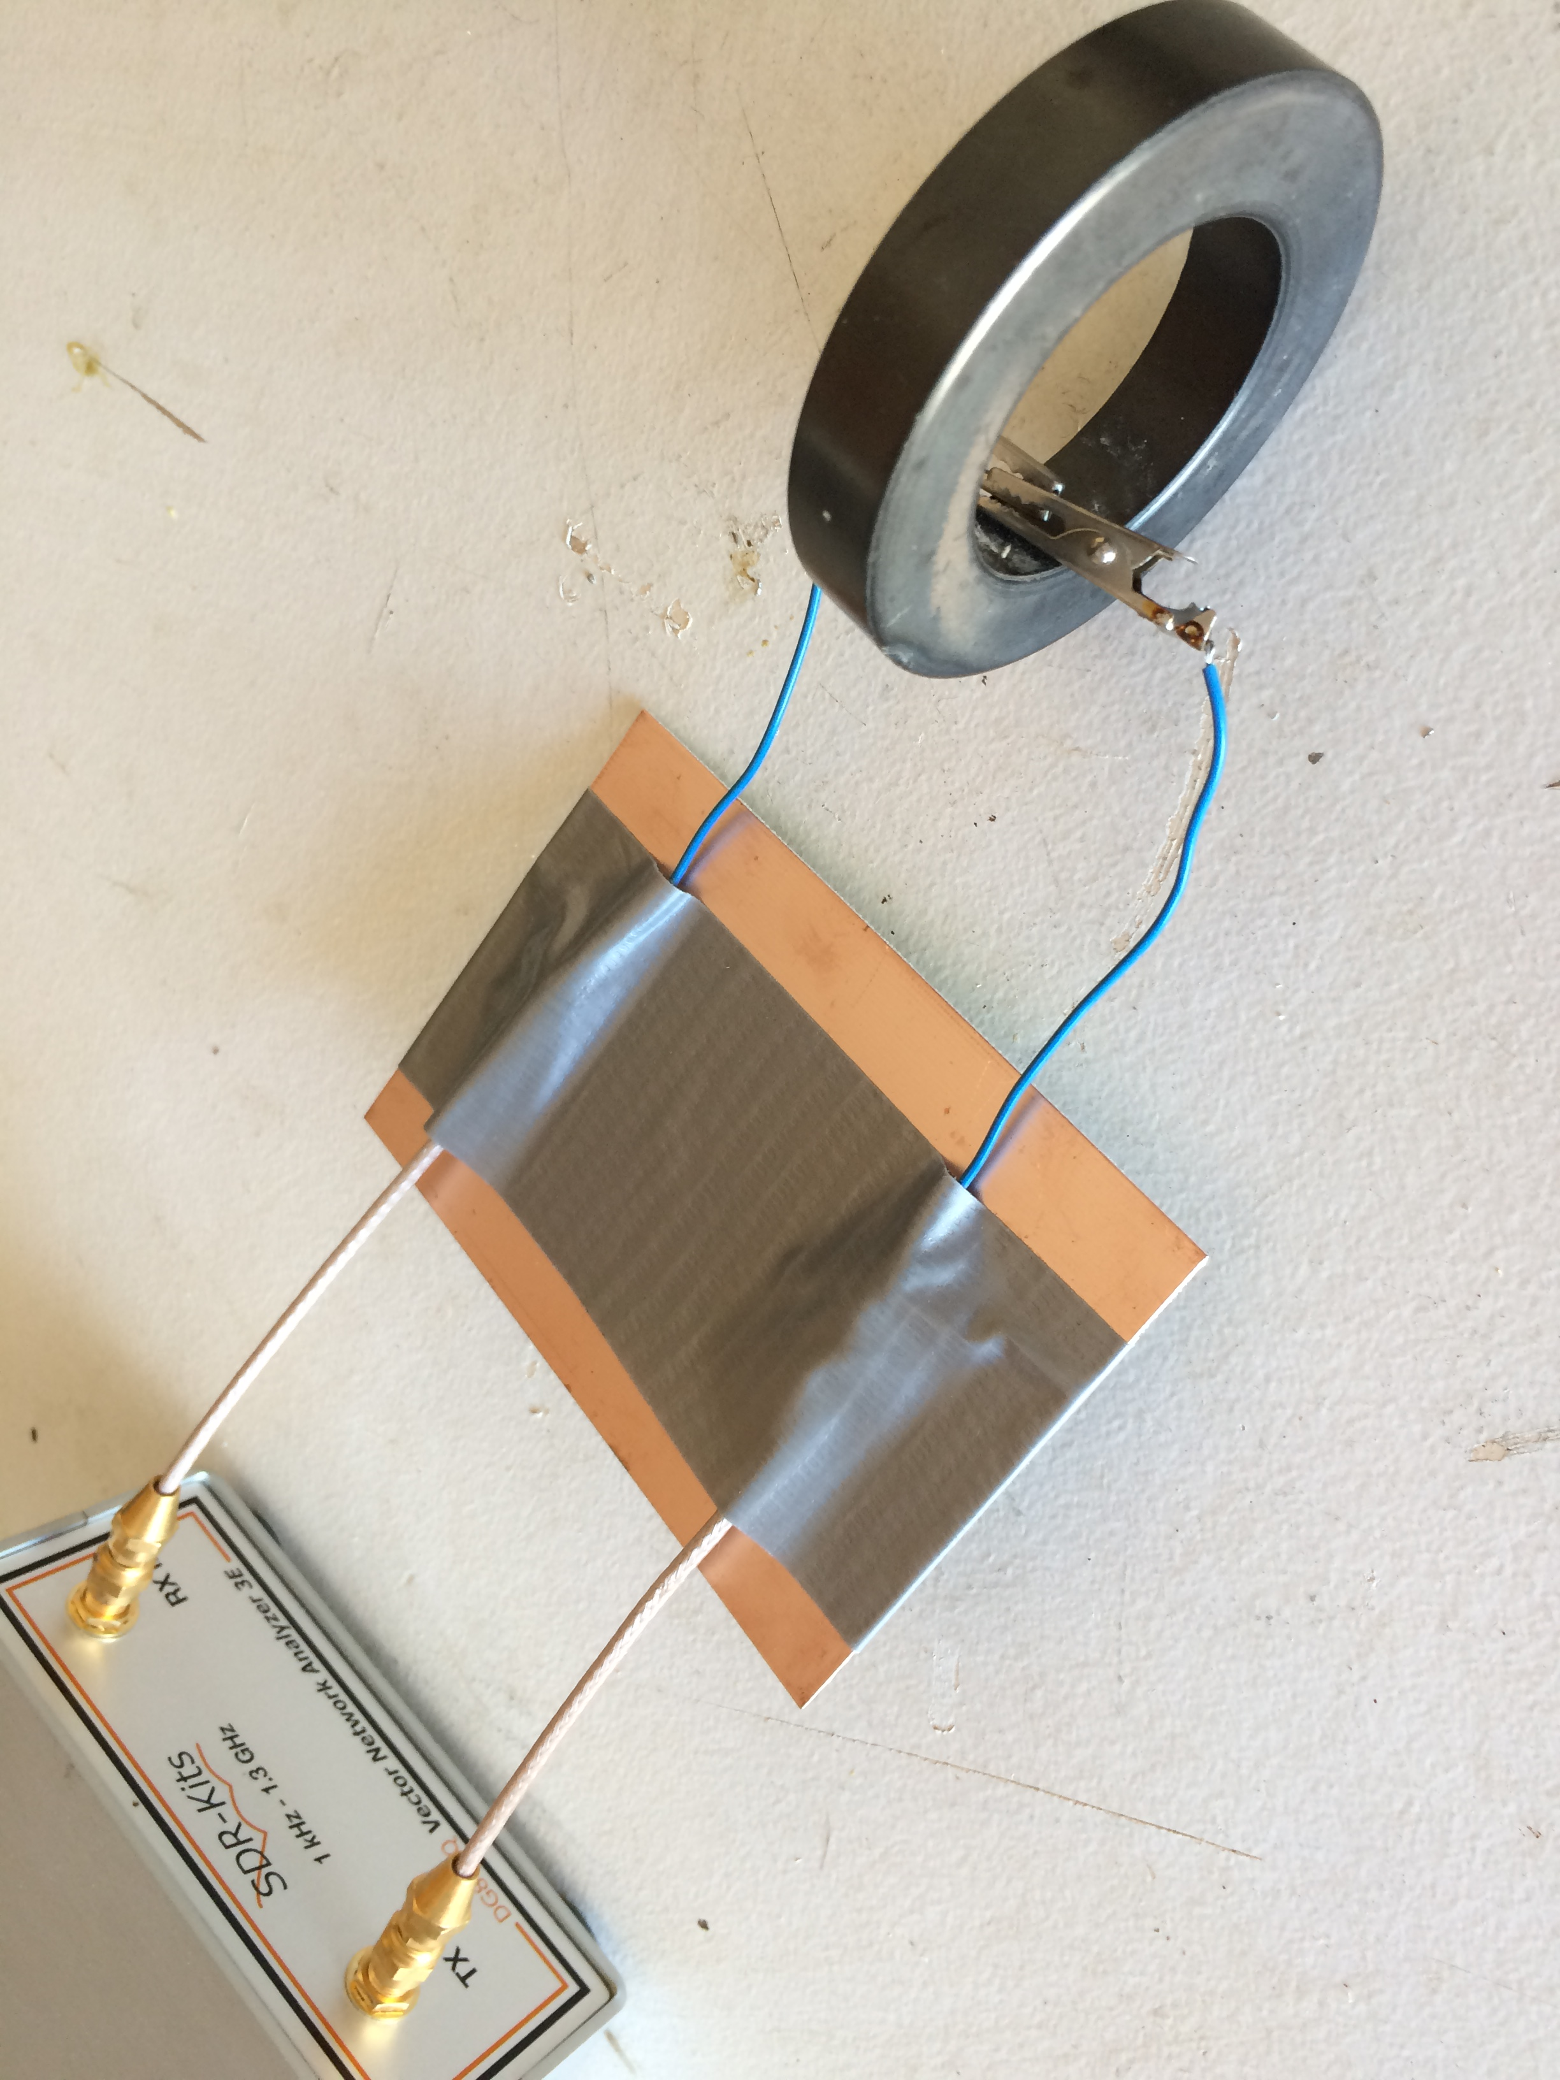
R=X at 3.5 MHz for single turn thru core Core is type 31 mix
R
X
3.5 MHz crossover frequency

Slide 10
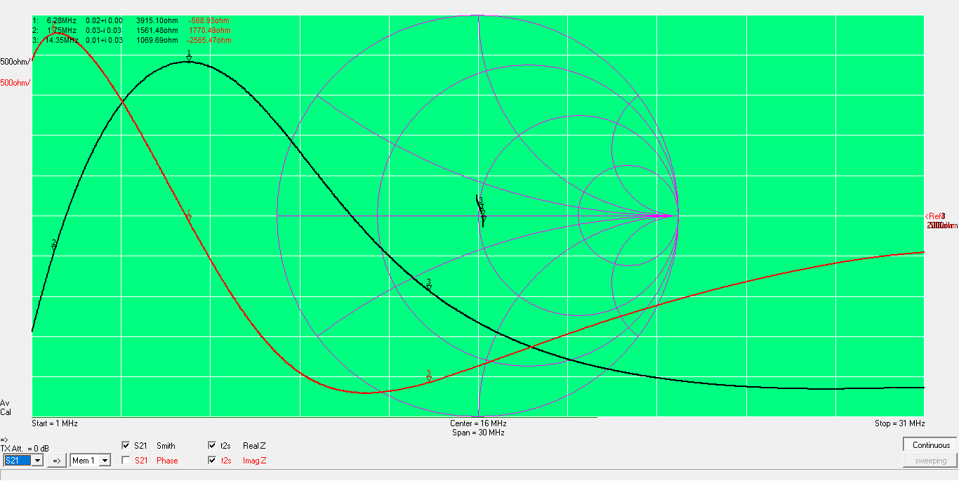
5T RG8 thru 4 cores Resonant at 6.2 MHz but pretty good from 160 to 20 meters (>1000 Ohms resistive)
R
X
S21 measurement converted to parallel impedance
Proximity of metal has little effect
Lossy hand has large effect

Slide 11
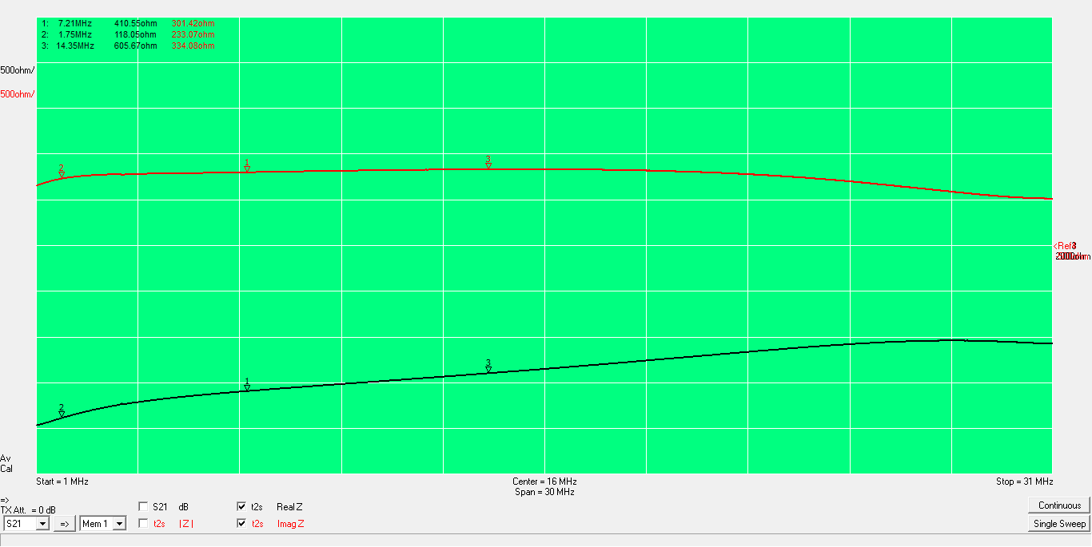
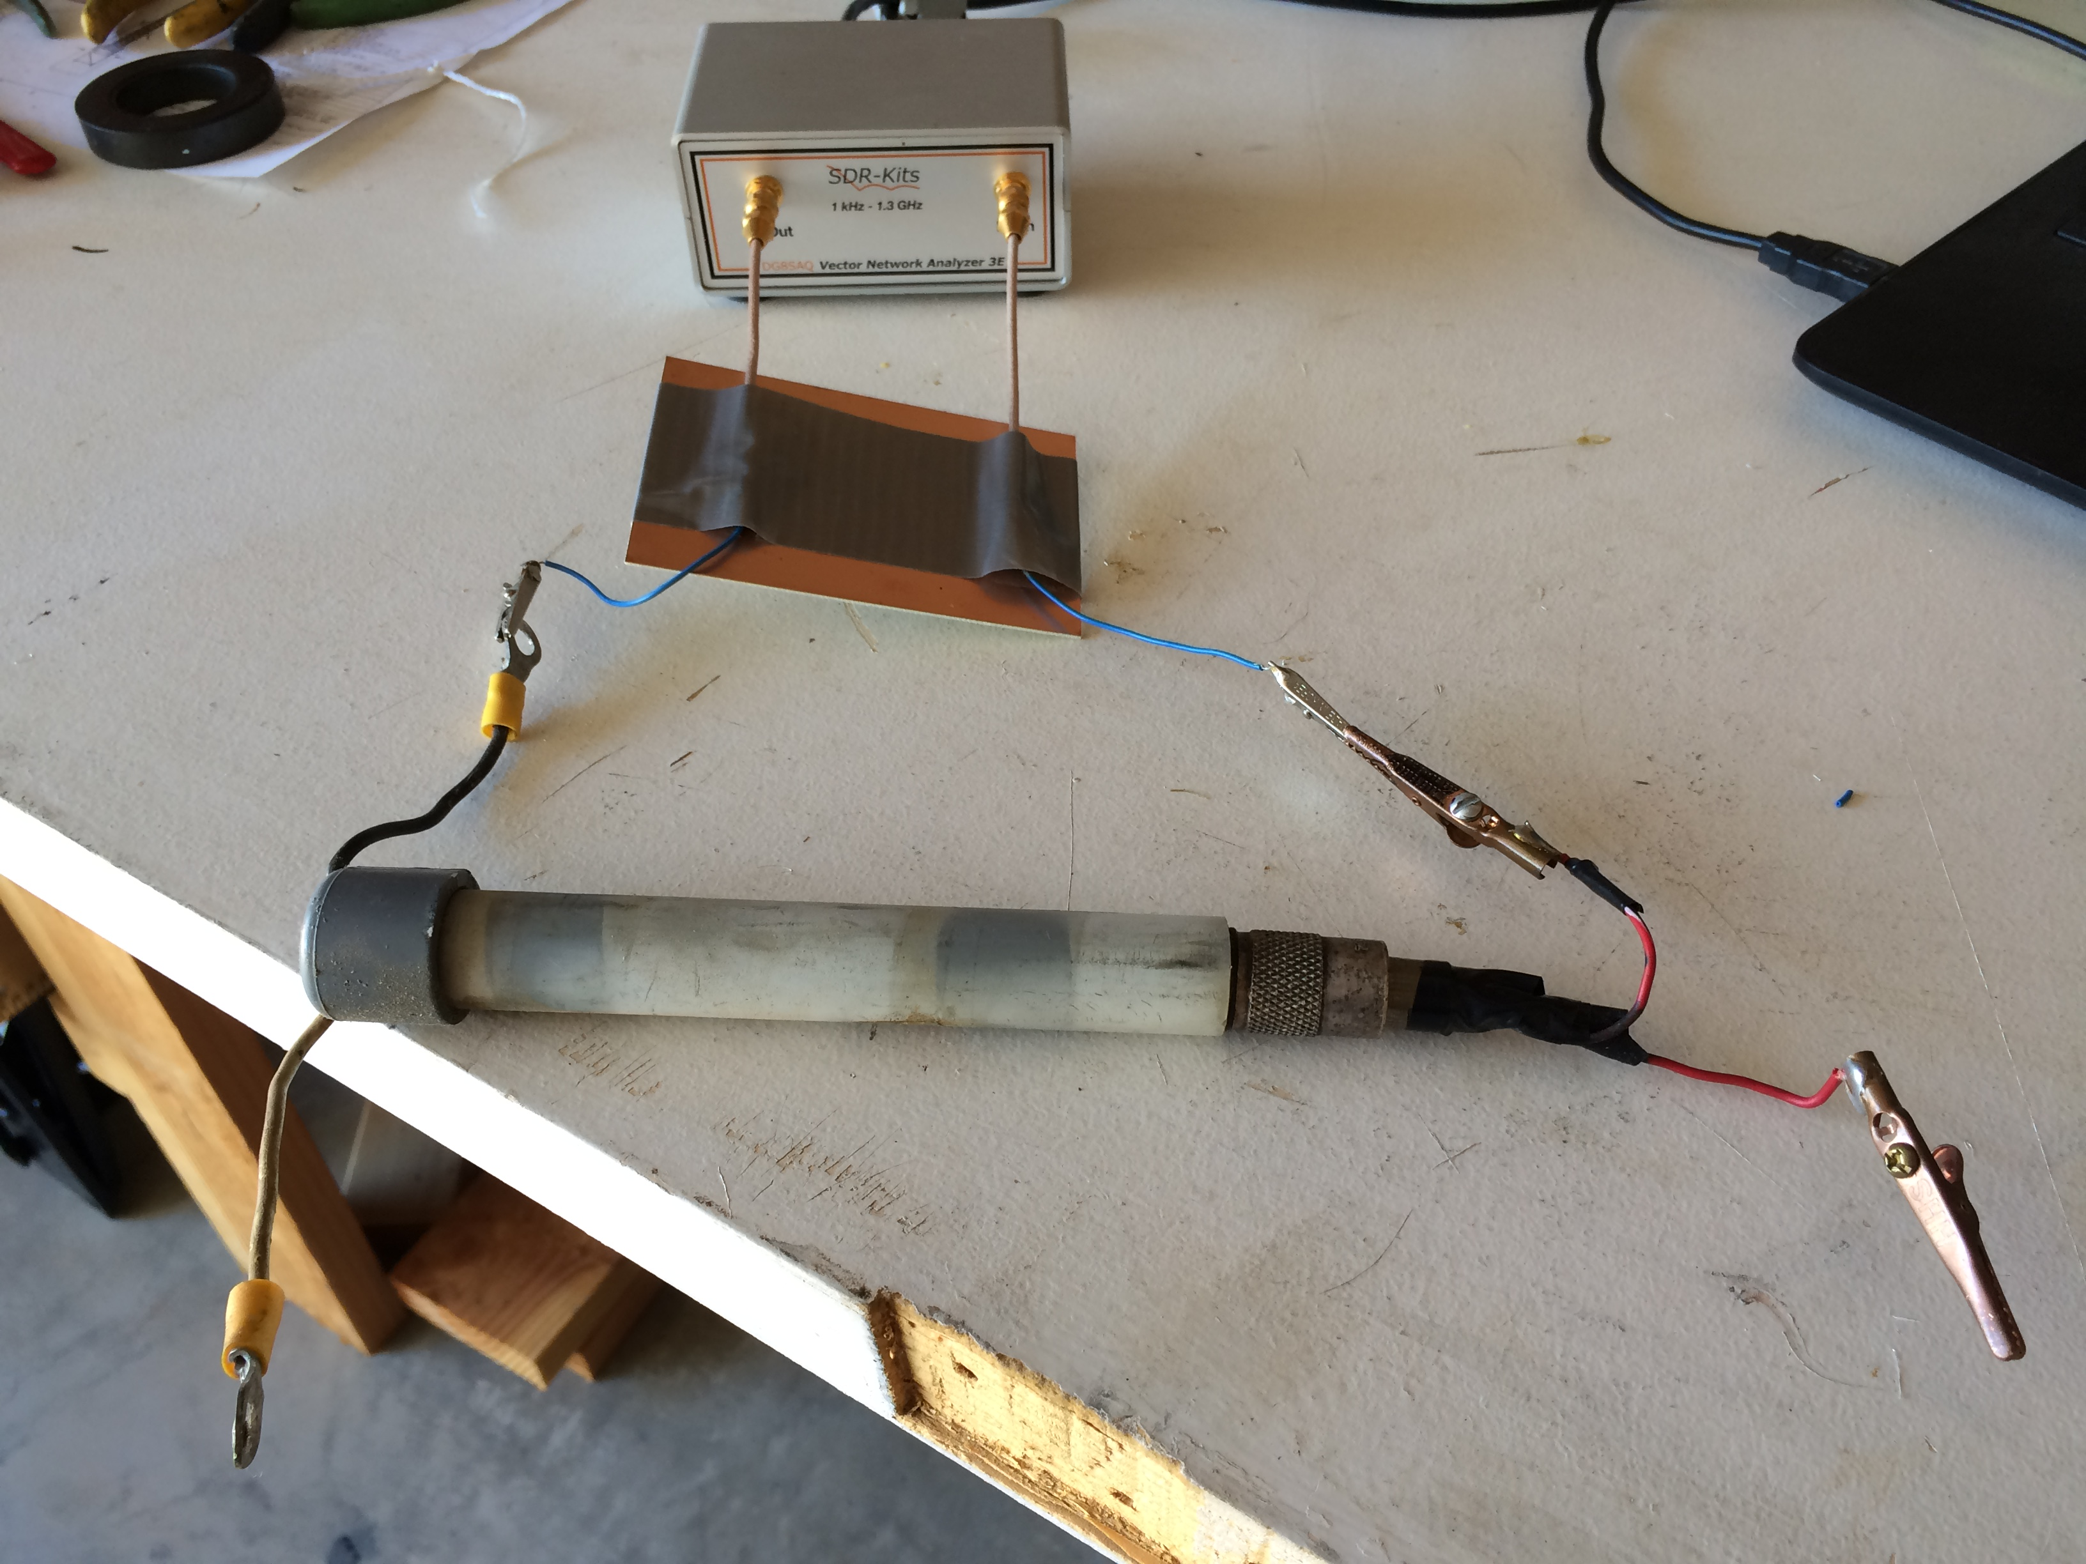
Force12 vertical dipole balun (15 years ago) Very broadband (7- 30 MHz) but NRG (400 to 800 Ohms resistive)
X
R

Slide 12
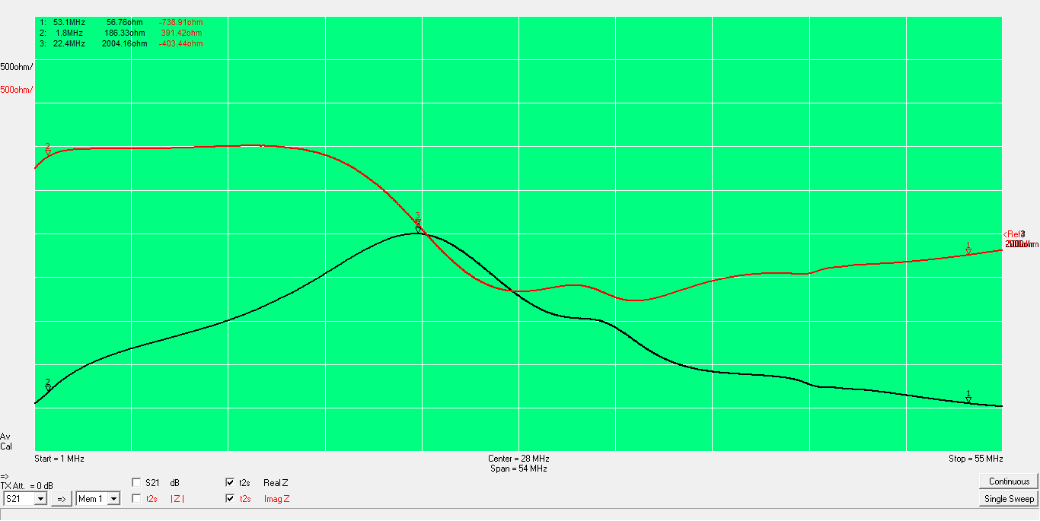
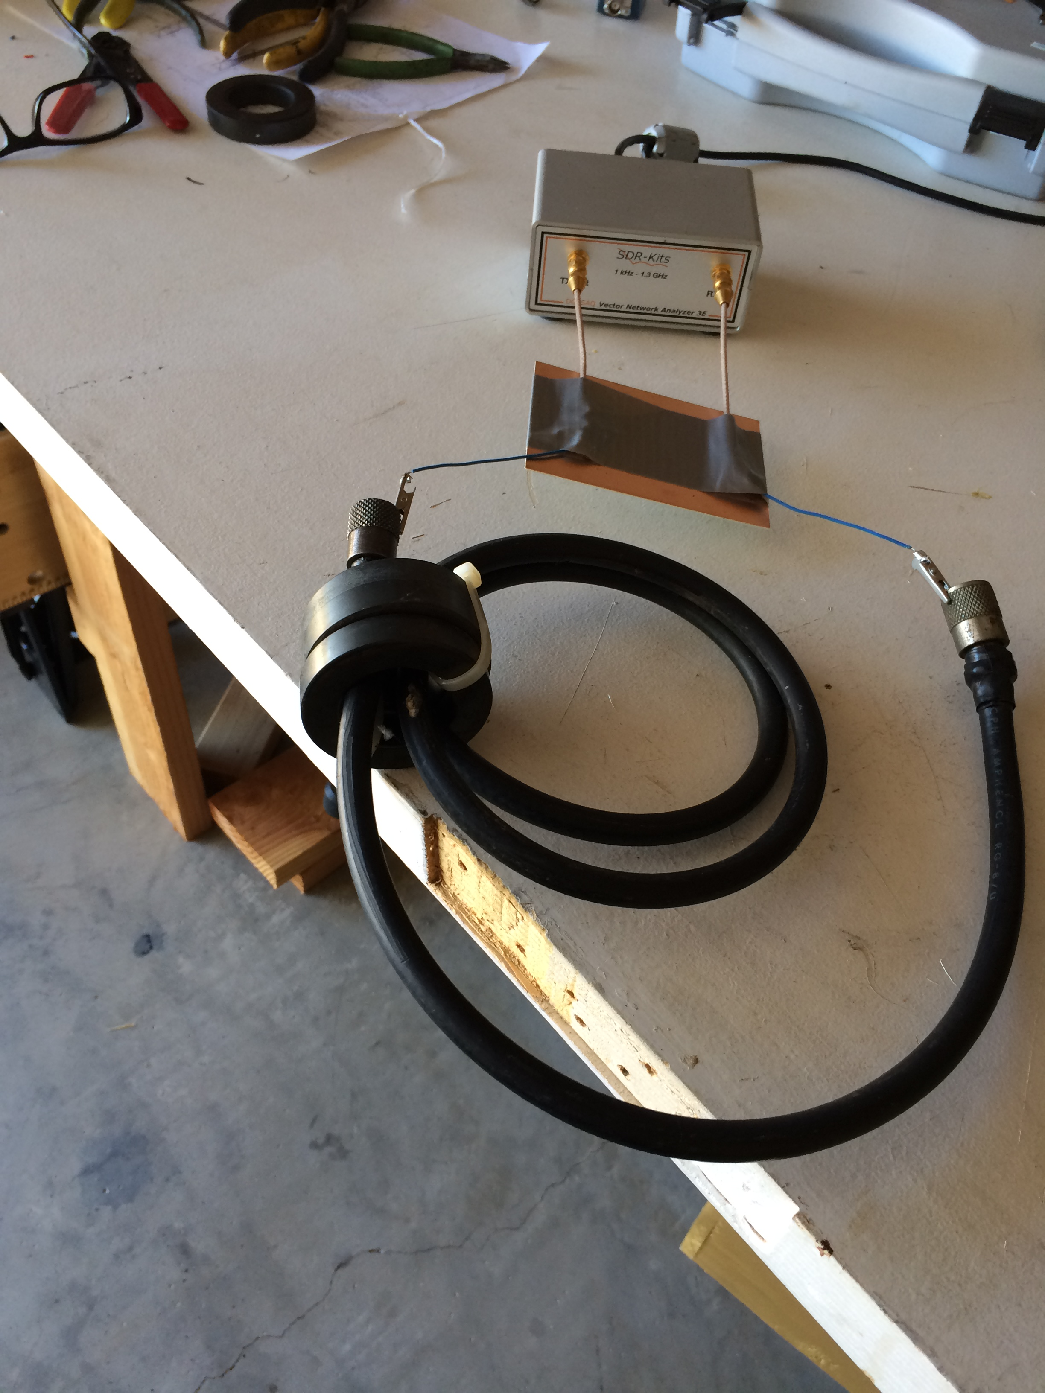
My 6 meter choke 3T/3 cores resonant is at 22 MHz Pretty lousy at 50 MHz (understatement), R=57 Ohms
X
R
Need to use 43 or 61 mix for higher frequencies

Slide 13
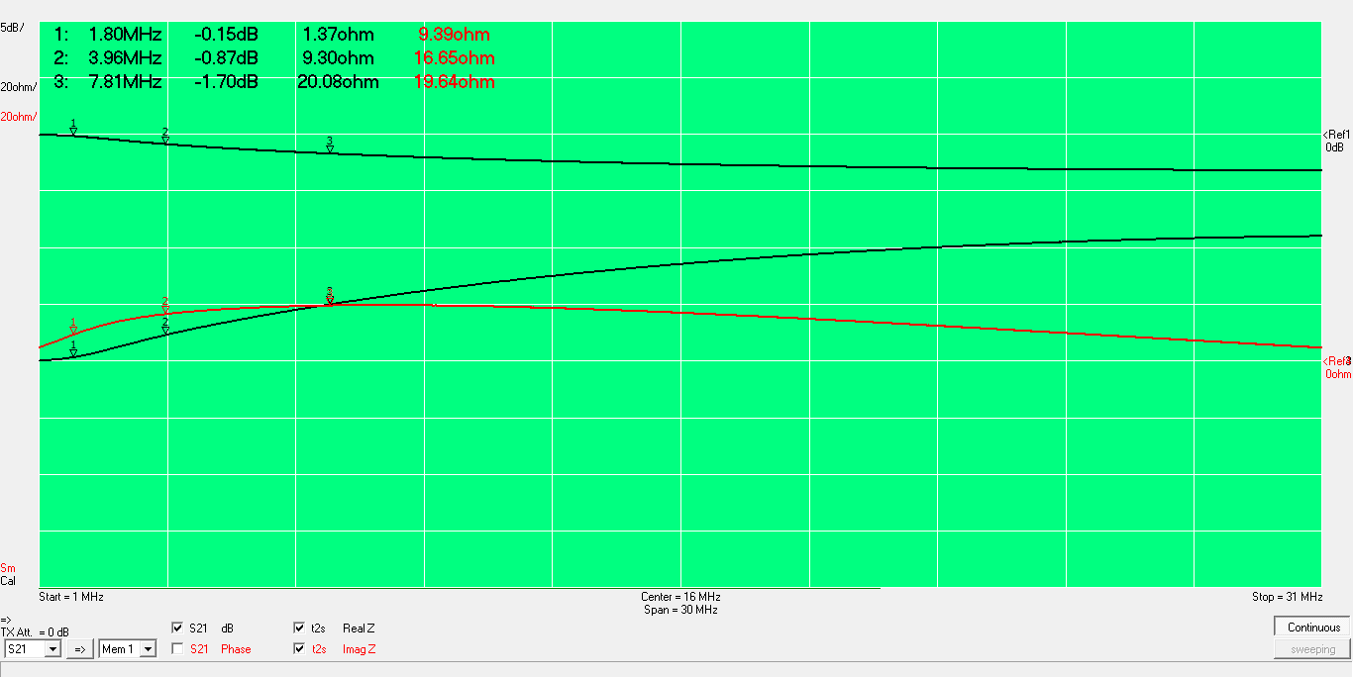
R=X at 7.8 MHz for 43 Core

Slide 14
Appendix
See excellent work by K9YC, K6JCA, G3TXQ and W8JI and others
Note on S21: It is the ratio of the power delivered to port 2 (load) to that delivered to a matched load.
Matched load
Example 50 Ohm in series
Rl=Rs
Vl= Vs/2
50
50
50
Vl= Vs(1/3)
50
50
Vs
Vs
S21= (1/3)/(1/2)=0.67= -3.5 dB

