Slide 1
Coordinates for HFTA
Tower Location
  35.492126
  -120.722055
Side Patio
  35.492215
  -120.722312
Westlake Village
  34.144026
  -118.854103

Slide 2
Beam Headings
G 33 degrees
ZS 81 degrees
LU 137 degrees
ZL 223 degrees
JA 306 degrees

Slide 3
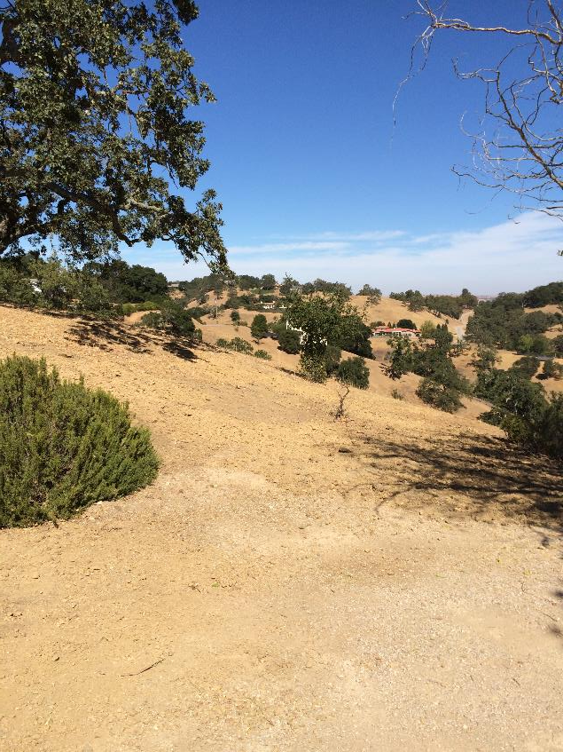
Europe- 3 ele at 65 (blue), 55 (red) and 45 (green) feet

Slide 4
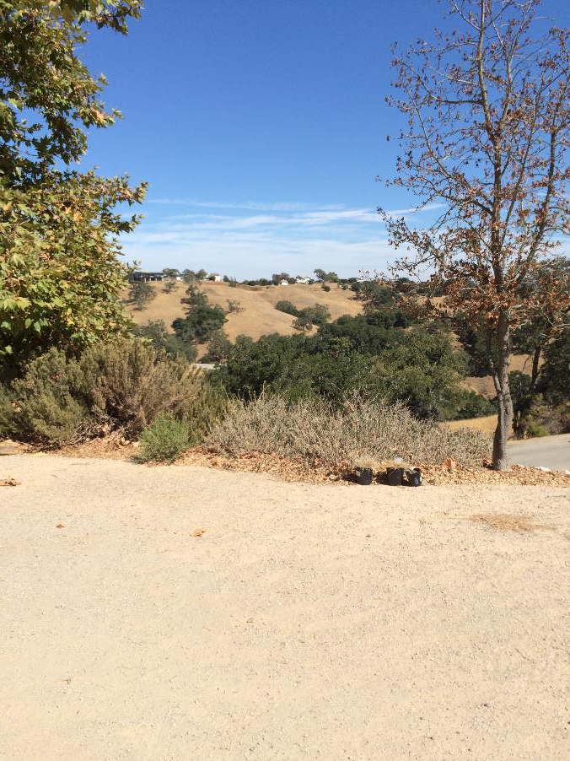
ZS- 3 ele at 65 (blue), 55 (red) and 45 (green) feet

Slide 5
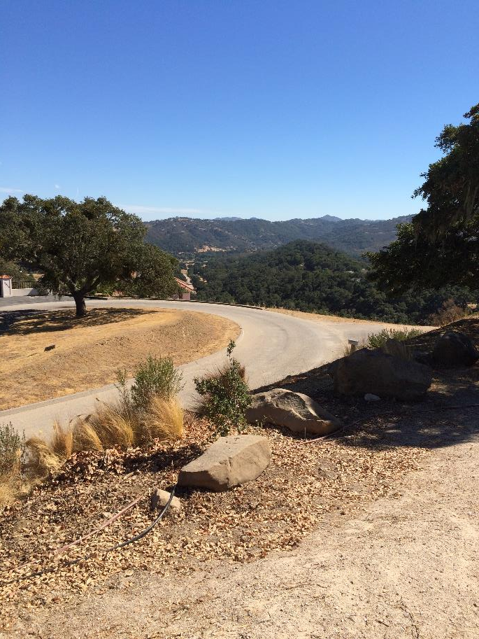
LU- 3 ele at 65 (blue), 55 (red) and 45 (green) feet

Slide 6
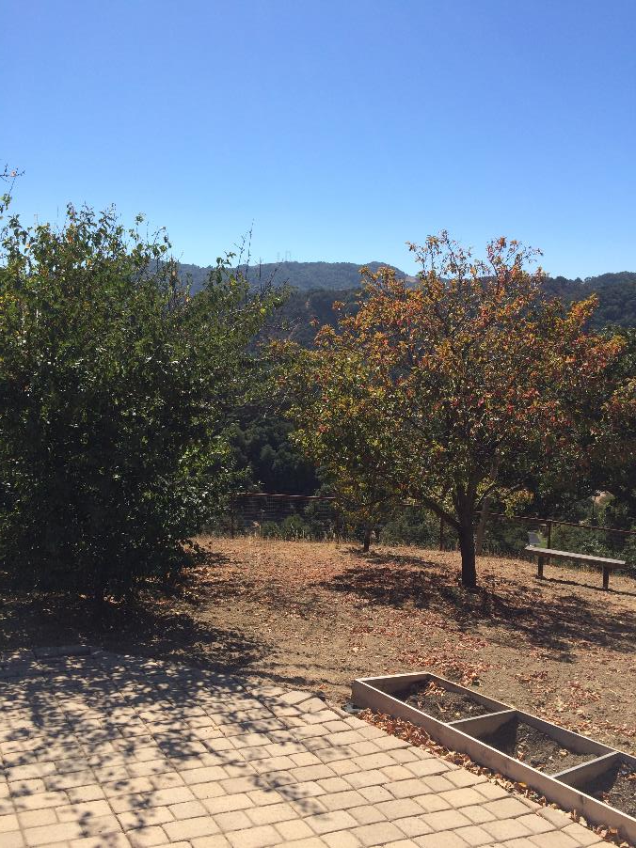
ZL- 3 ele at 65 (blue), 55 (red) and 45 (green) feet

Slide 7
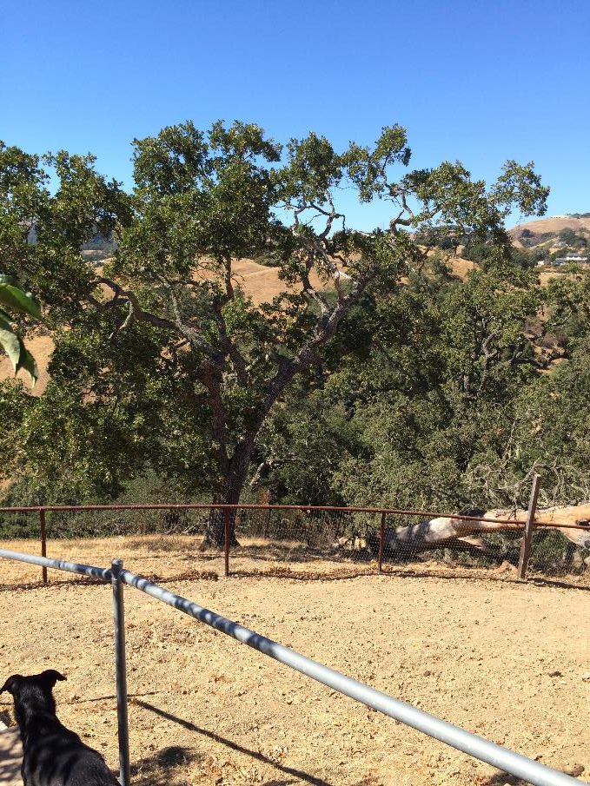
JA- 3 ele at 65 (blue), 55 (red) and 45 (green) feet

Slide 8
Conclusions- HFTA
Very sensitive to terrain close to tower but only 100 ft intervals
Soil makes little difference
HAFTA probably best to compare heights within a single terrain profile

