Slide 1
W6AYC Tower Project
50 foot crank-up
  Max height for most SLO cities and county without special use permit
15 square feet of antenna capability
Emphasis on convenience rather than cost

Slide 2
2018 Timeline- >7 months
Ordered engineering prints from Tashjian
April 19- Permit request to Atascadero
May 8- Permit corrections from city
June 27- Revisions from Tashjian
July 5- Revisions to city
July 23- City permit issued
August 22- Foundation excavation
August 23- Concrete pour
November 17- Tower Install
November 19- Final Inspection
November 24- Antenna installed and operational

Slide 3
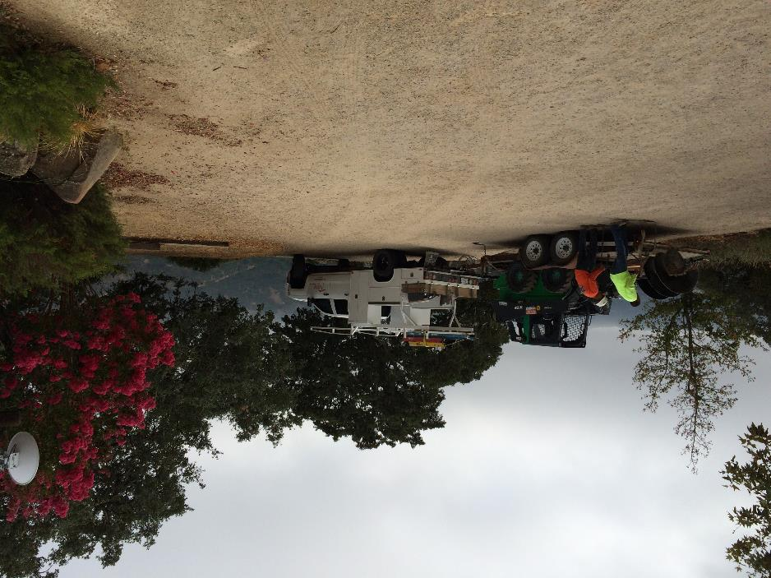
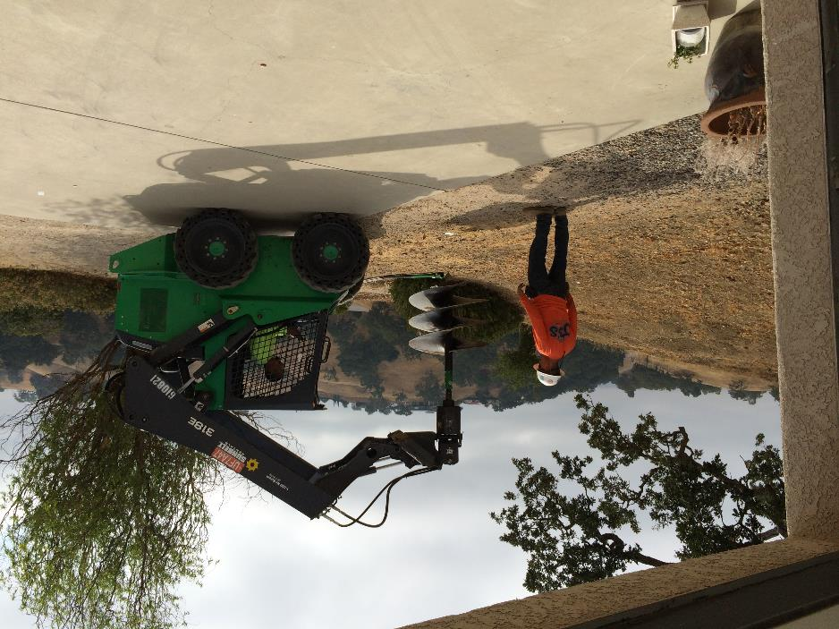
Excavation - August 22

Slide 4
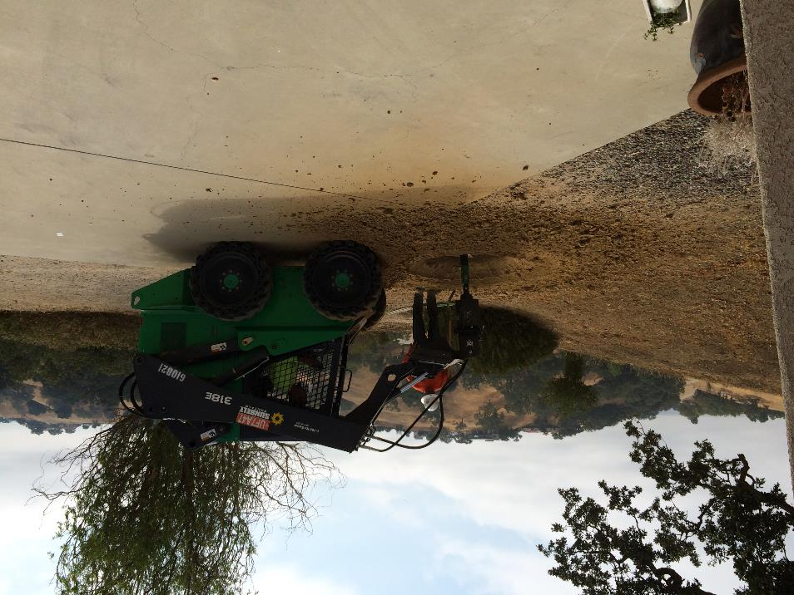
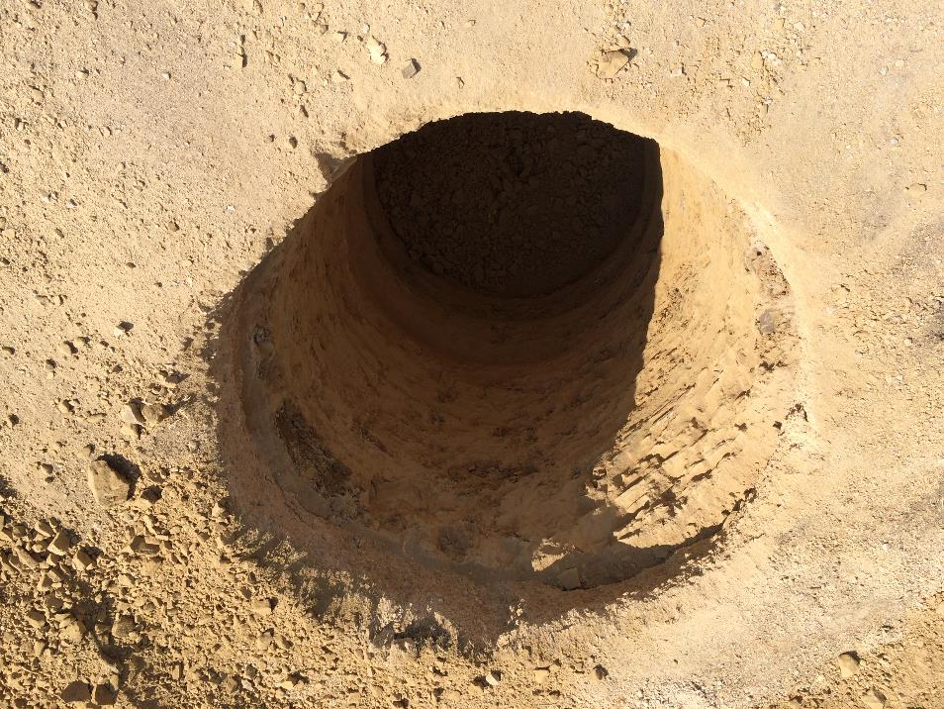
8 foot hole

Slide 5
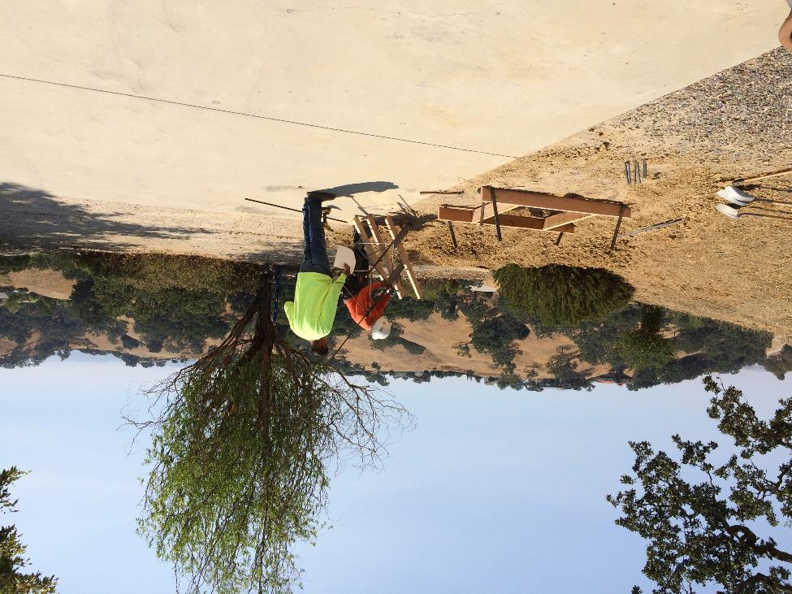
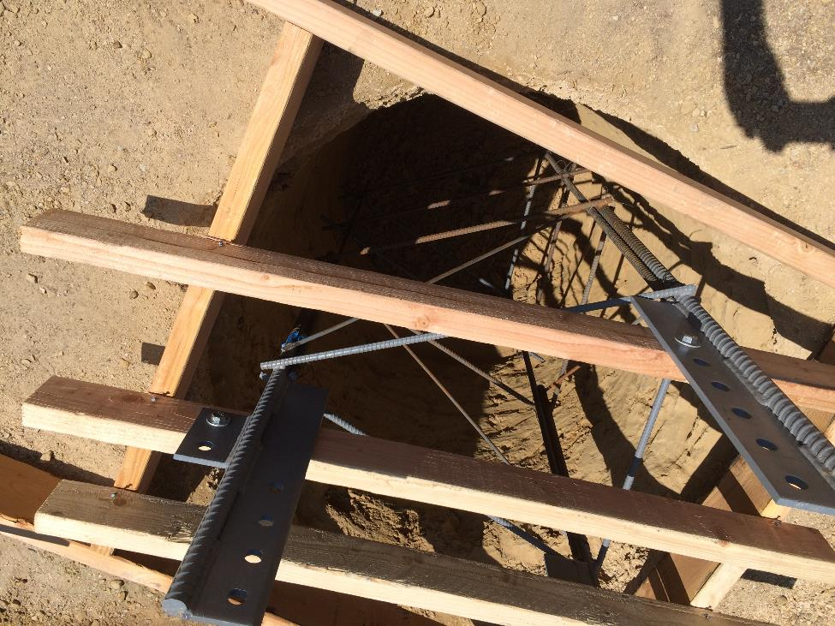
Rebar cage (6 foot)

Slide 6
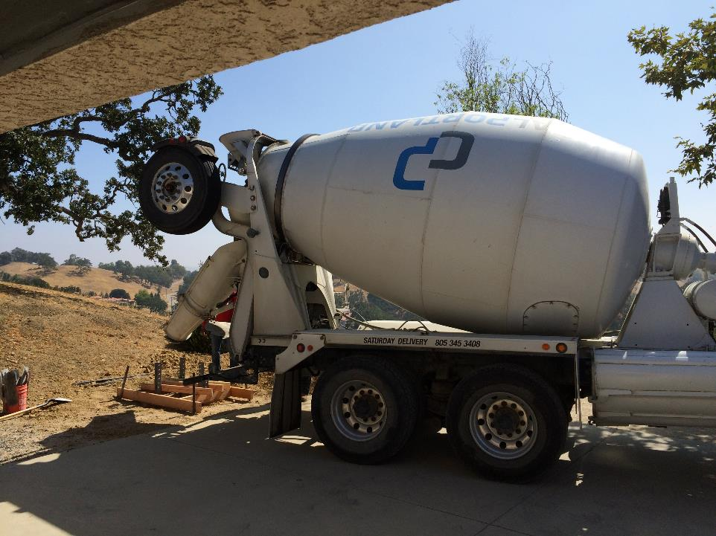
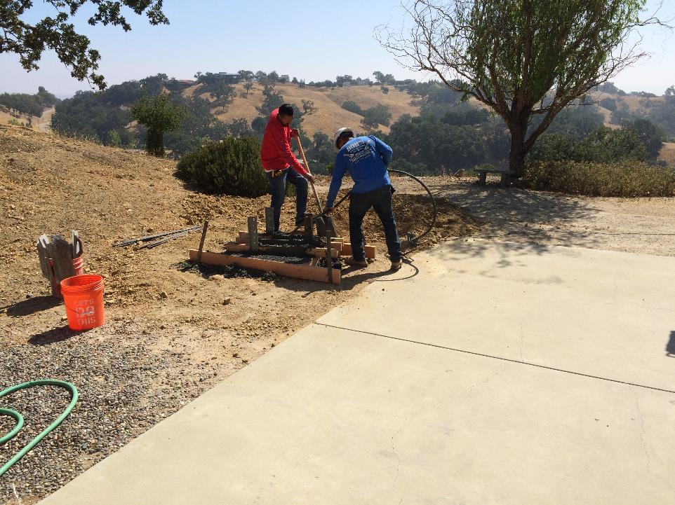
Concrete Pour- August 23

Slide 7
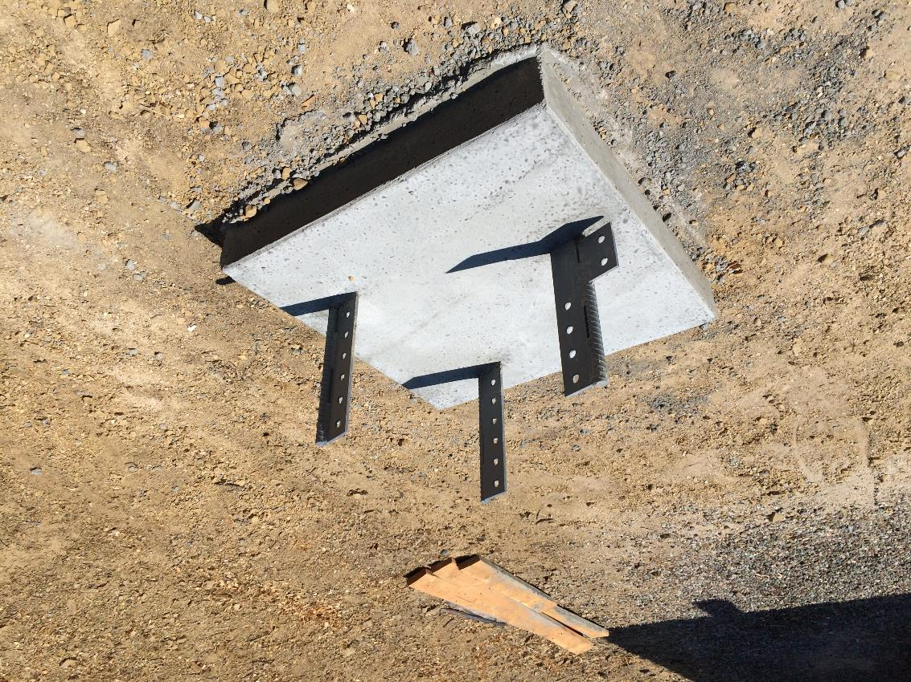
Completed base

Slide 8
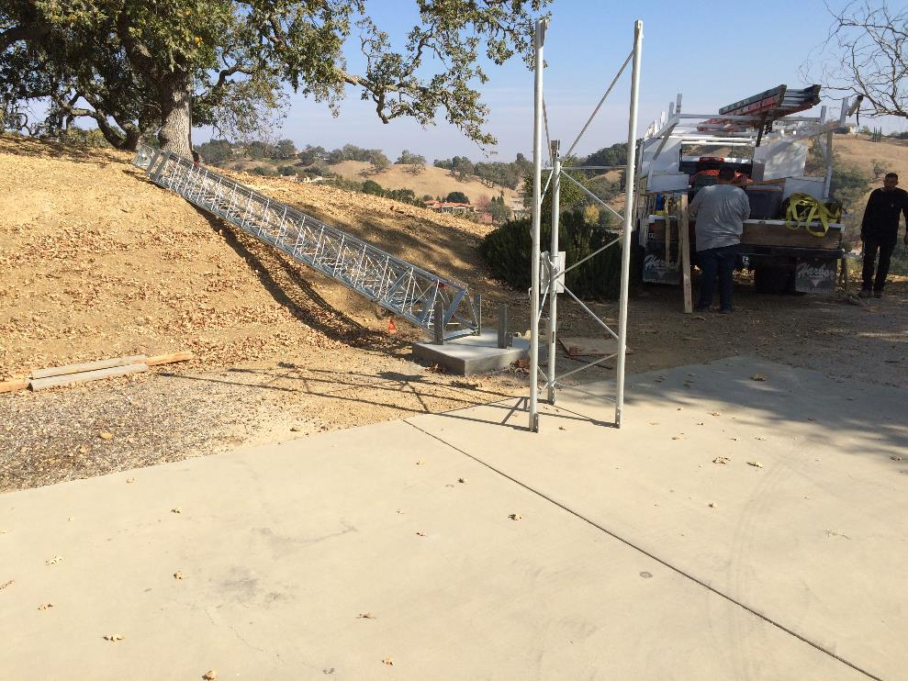
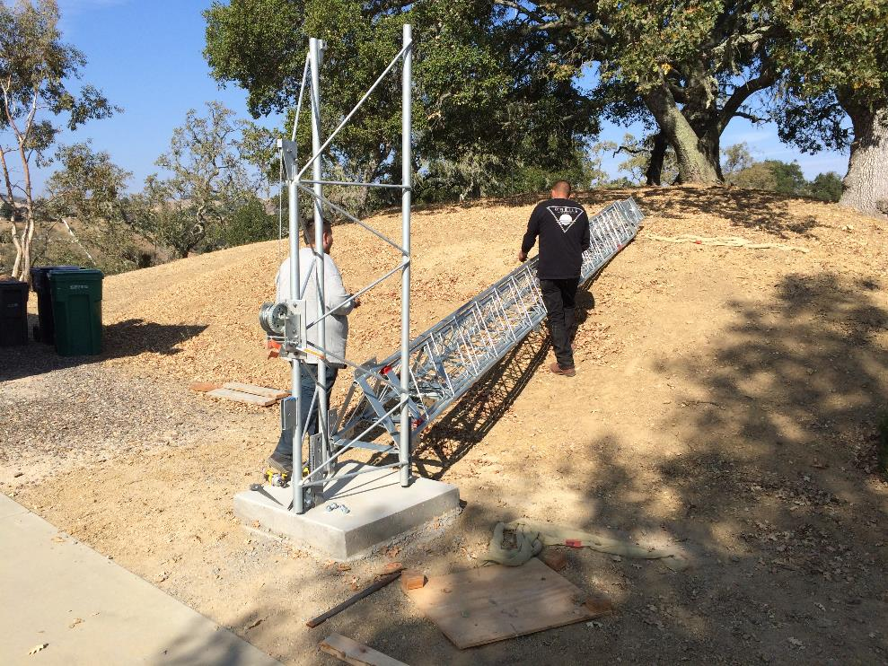
3 months later: November 17- 2 ½ guys humping tower off truck and into position

Slide 9
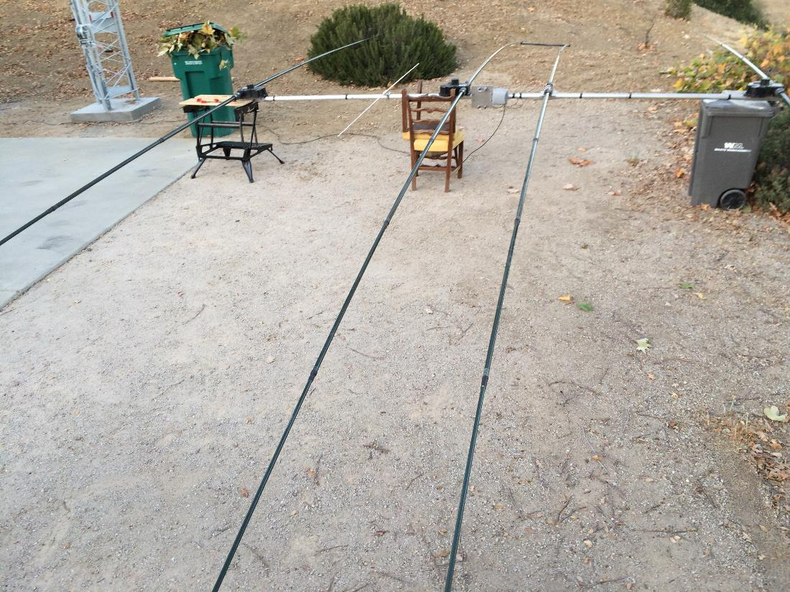
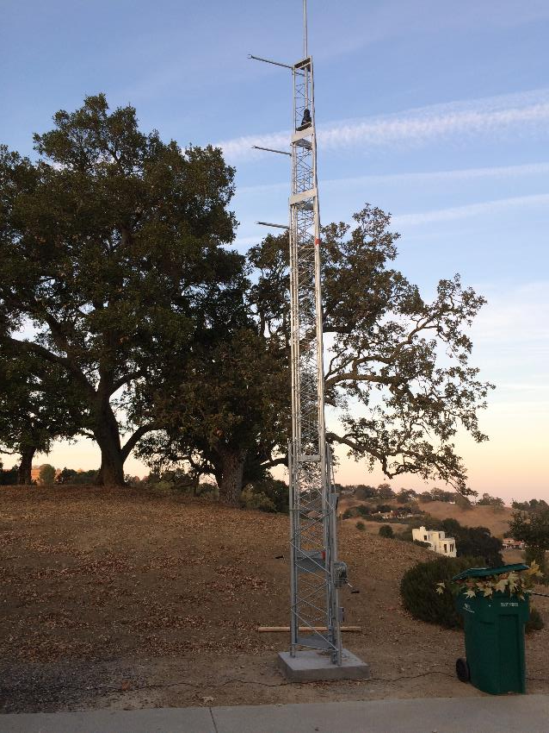
Installed tower and StepIR

Slide 10
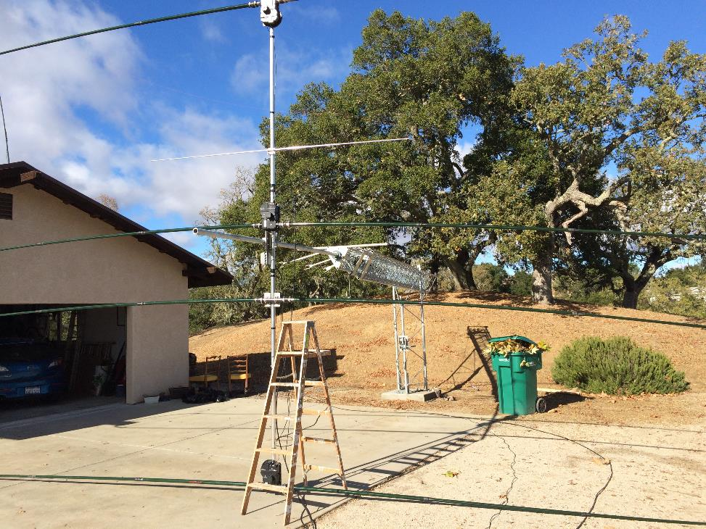
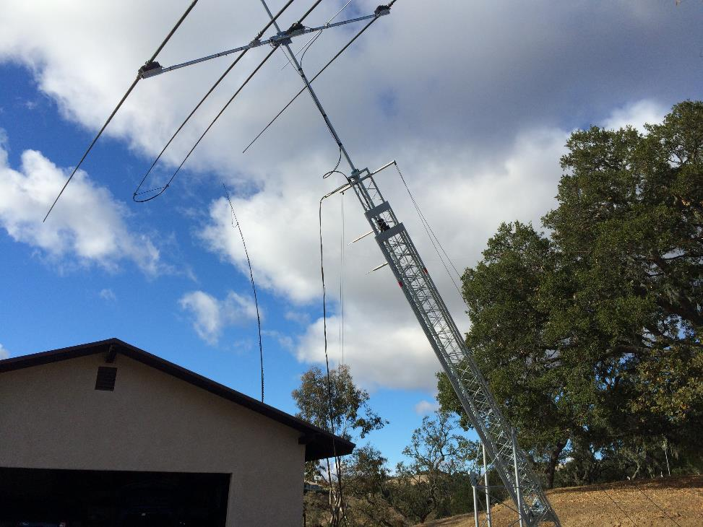
It was all my wife and I could do to attach competed STEPPIR to mast (16 foot boom, 58 lbs)

Slide 11
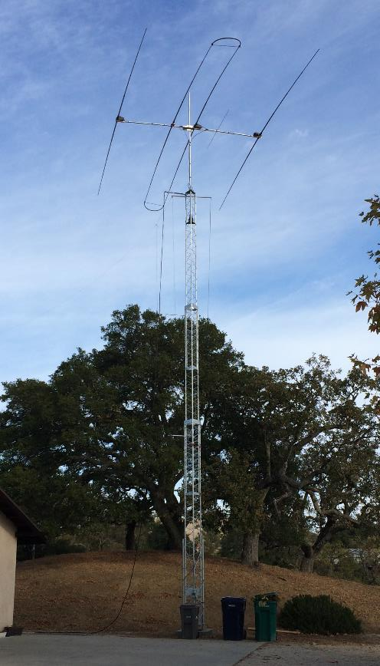
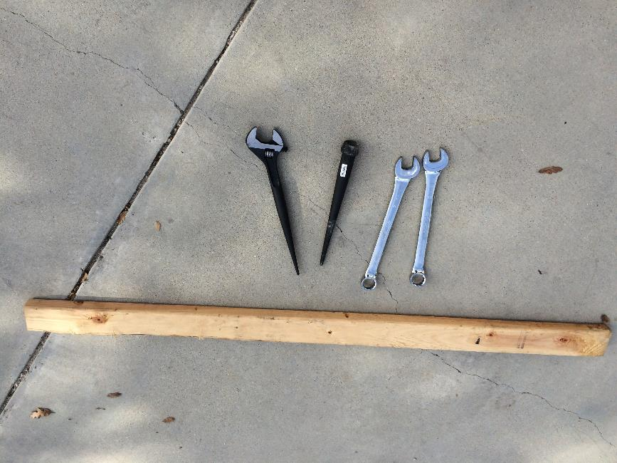
Tower up and new tools

Slide 12
Costs
Replaced a TH-2 2element Tribander ($390) on 30 foot
Spiderbeam mast ($485) and armstrong rotator

Slide 13
Lessons Learned
Ham radio is side work for tower suppliers
  Be patient
Cities use independent contractors to review drawings
  They can be picky
Make sure foundation dig is per city approved documents
Understand rotator ratings
  Yaesu rates rotators for antenna square footage and torque
  Torque is by far the limiting factor for ham antennas
Thrust bearings are not critical
  Rotators take many hundred pounds of vertical load
Crankup-tiltover towers are not precision built
  Crow bars, spud wrenches, hammers, & broad head bull pin tools required to align holes

Slide 14
Appendix
3 element STEPPIR with 40m loop
  8.1 sq ft
  58 lbs
15 foot mast
  55 lbs
Tower rating: 14.5 sq ft at 51 feet height (moment= 740)
  8.1 sq ft at 61 feet height (moment= 494)
Yaesu G1000DXA Rotator: 23 sq ft, “K” factor 230
  8.1 sq ft
  “K” factor= turning radius (meters) x weight (kg) = 6 (26 +10)= 216

