Slide 1
Increasing the bandwidth of a low 80 meter dipole
The “Leeson” match uses ½ wavelength of 50 Ohm coax followed by ¼ wavelength of 75 Ohm line. It is most effective on high dipoles which have input impedance close to 75 Ohms.
This presentation describes results obtained feeding an inverted Vee with the center at 45 feet and a shallow apex angle.
http://ncjweb.com/features/QEX-Leeson-Broadband-Dipole.pdf

Slide 2
First inverted Vee modelling EZNEC shows lowering ends (inverted V) lowers feedpoint impedance
Apex at 50 feet
Ends at 50, 30, 20 ft
20 ft
50 ft

Slide 3
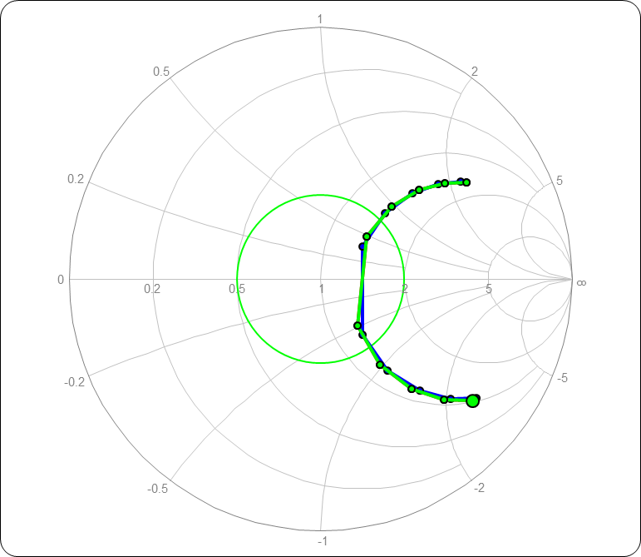
Soil (poor or average) has little effect on impedance

Slide 4
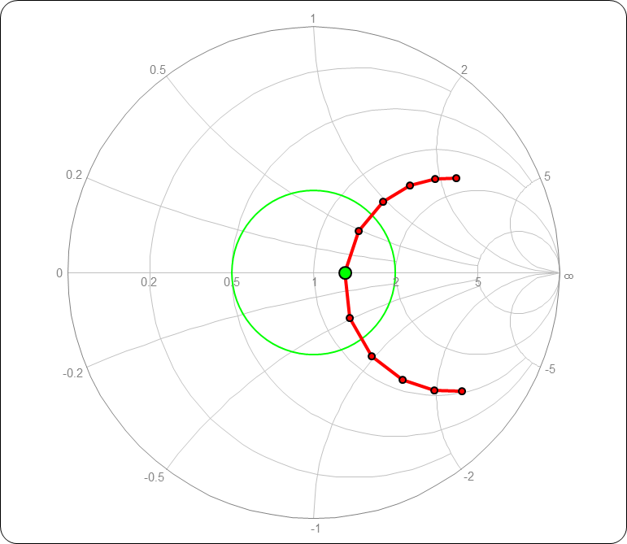
Model result used for matching network analysis 50 foot apex, 30 ft ends, Zin= 64 Ohms at resonance

Slide 5
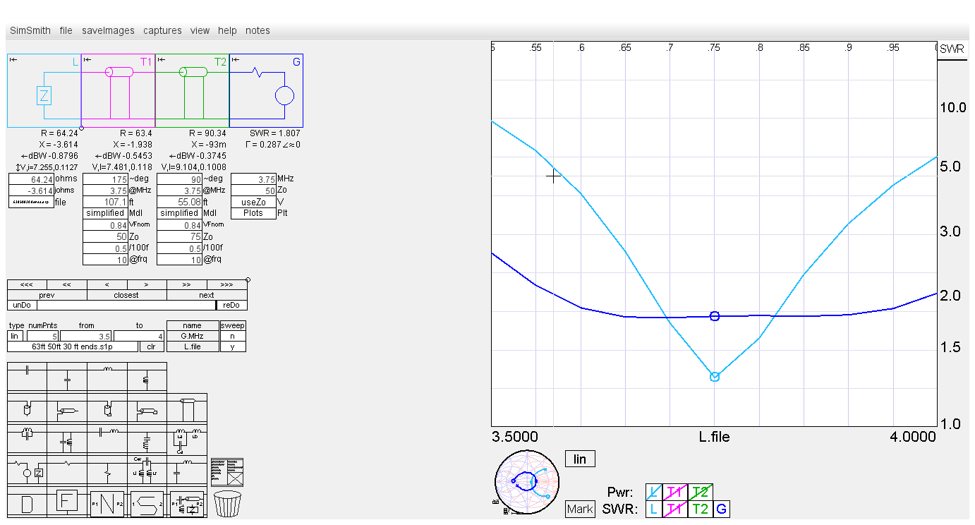
Simsmith modelling of antenna followed by “Leeson” matching sections Minimum VSWR is 1.9, bandwidth is excellent
Dipole
Dipole after “Leeson” matching

Slide 6
Putting up the antenna
Length= 130 feet
Center= 45 feet
Ends= 25, 30 feet
EZNEC predicts resonant frequency- 3.65 mHz, 63 Ohms input resistance
Balun is 15T RG400 around #31 toroid

Slide 7
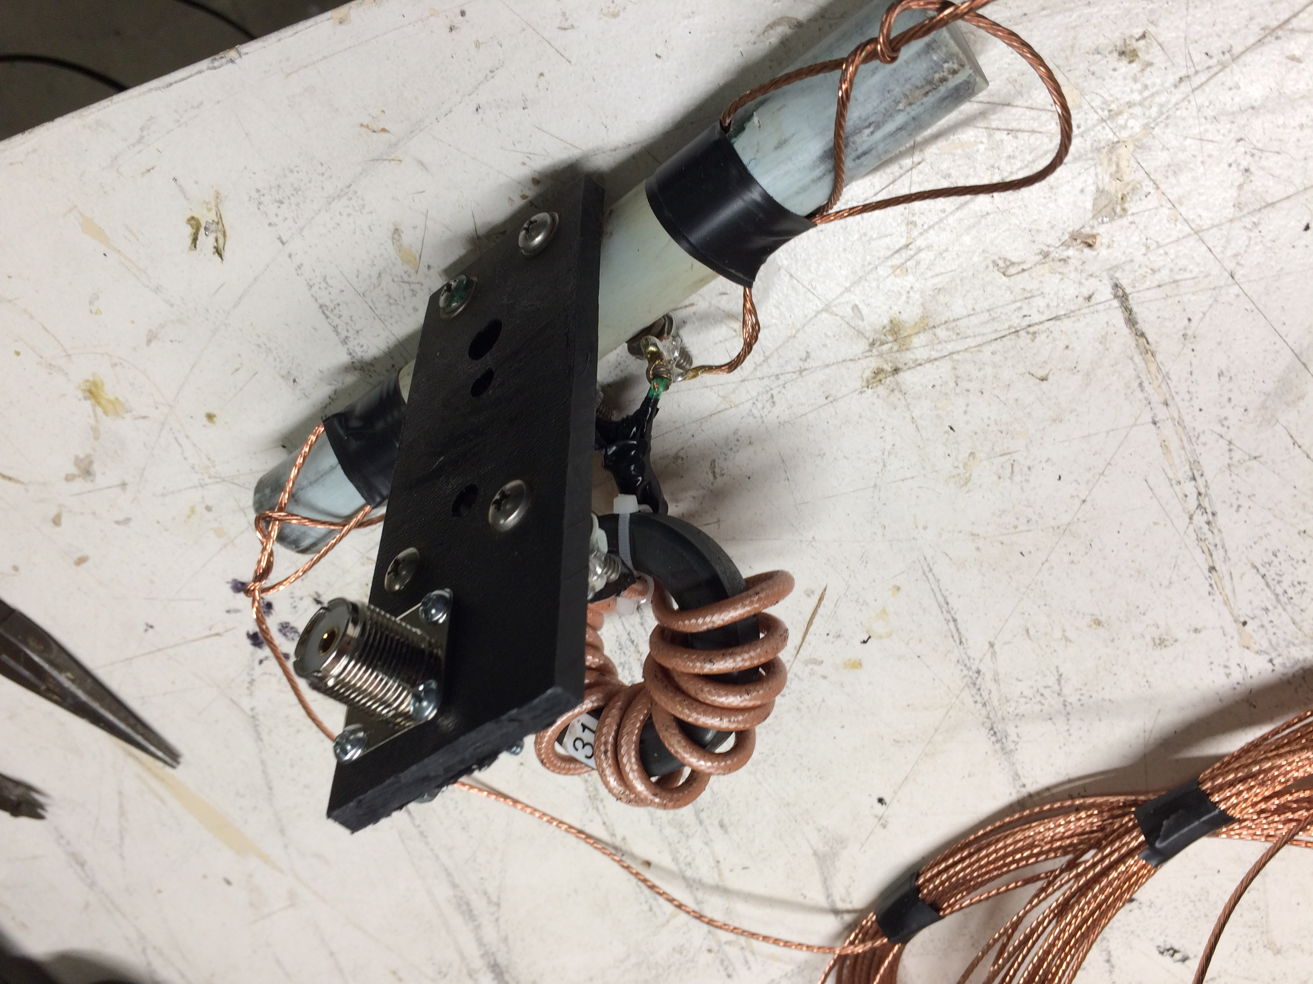
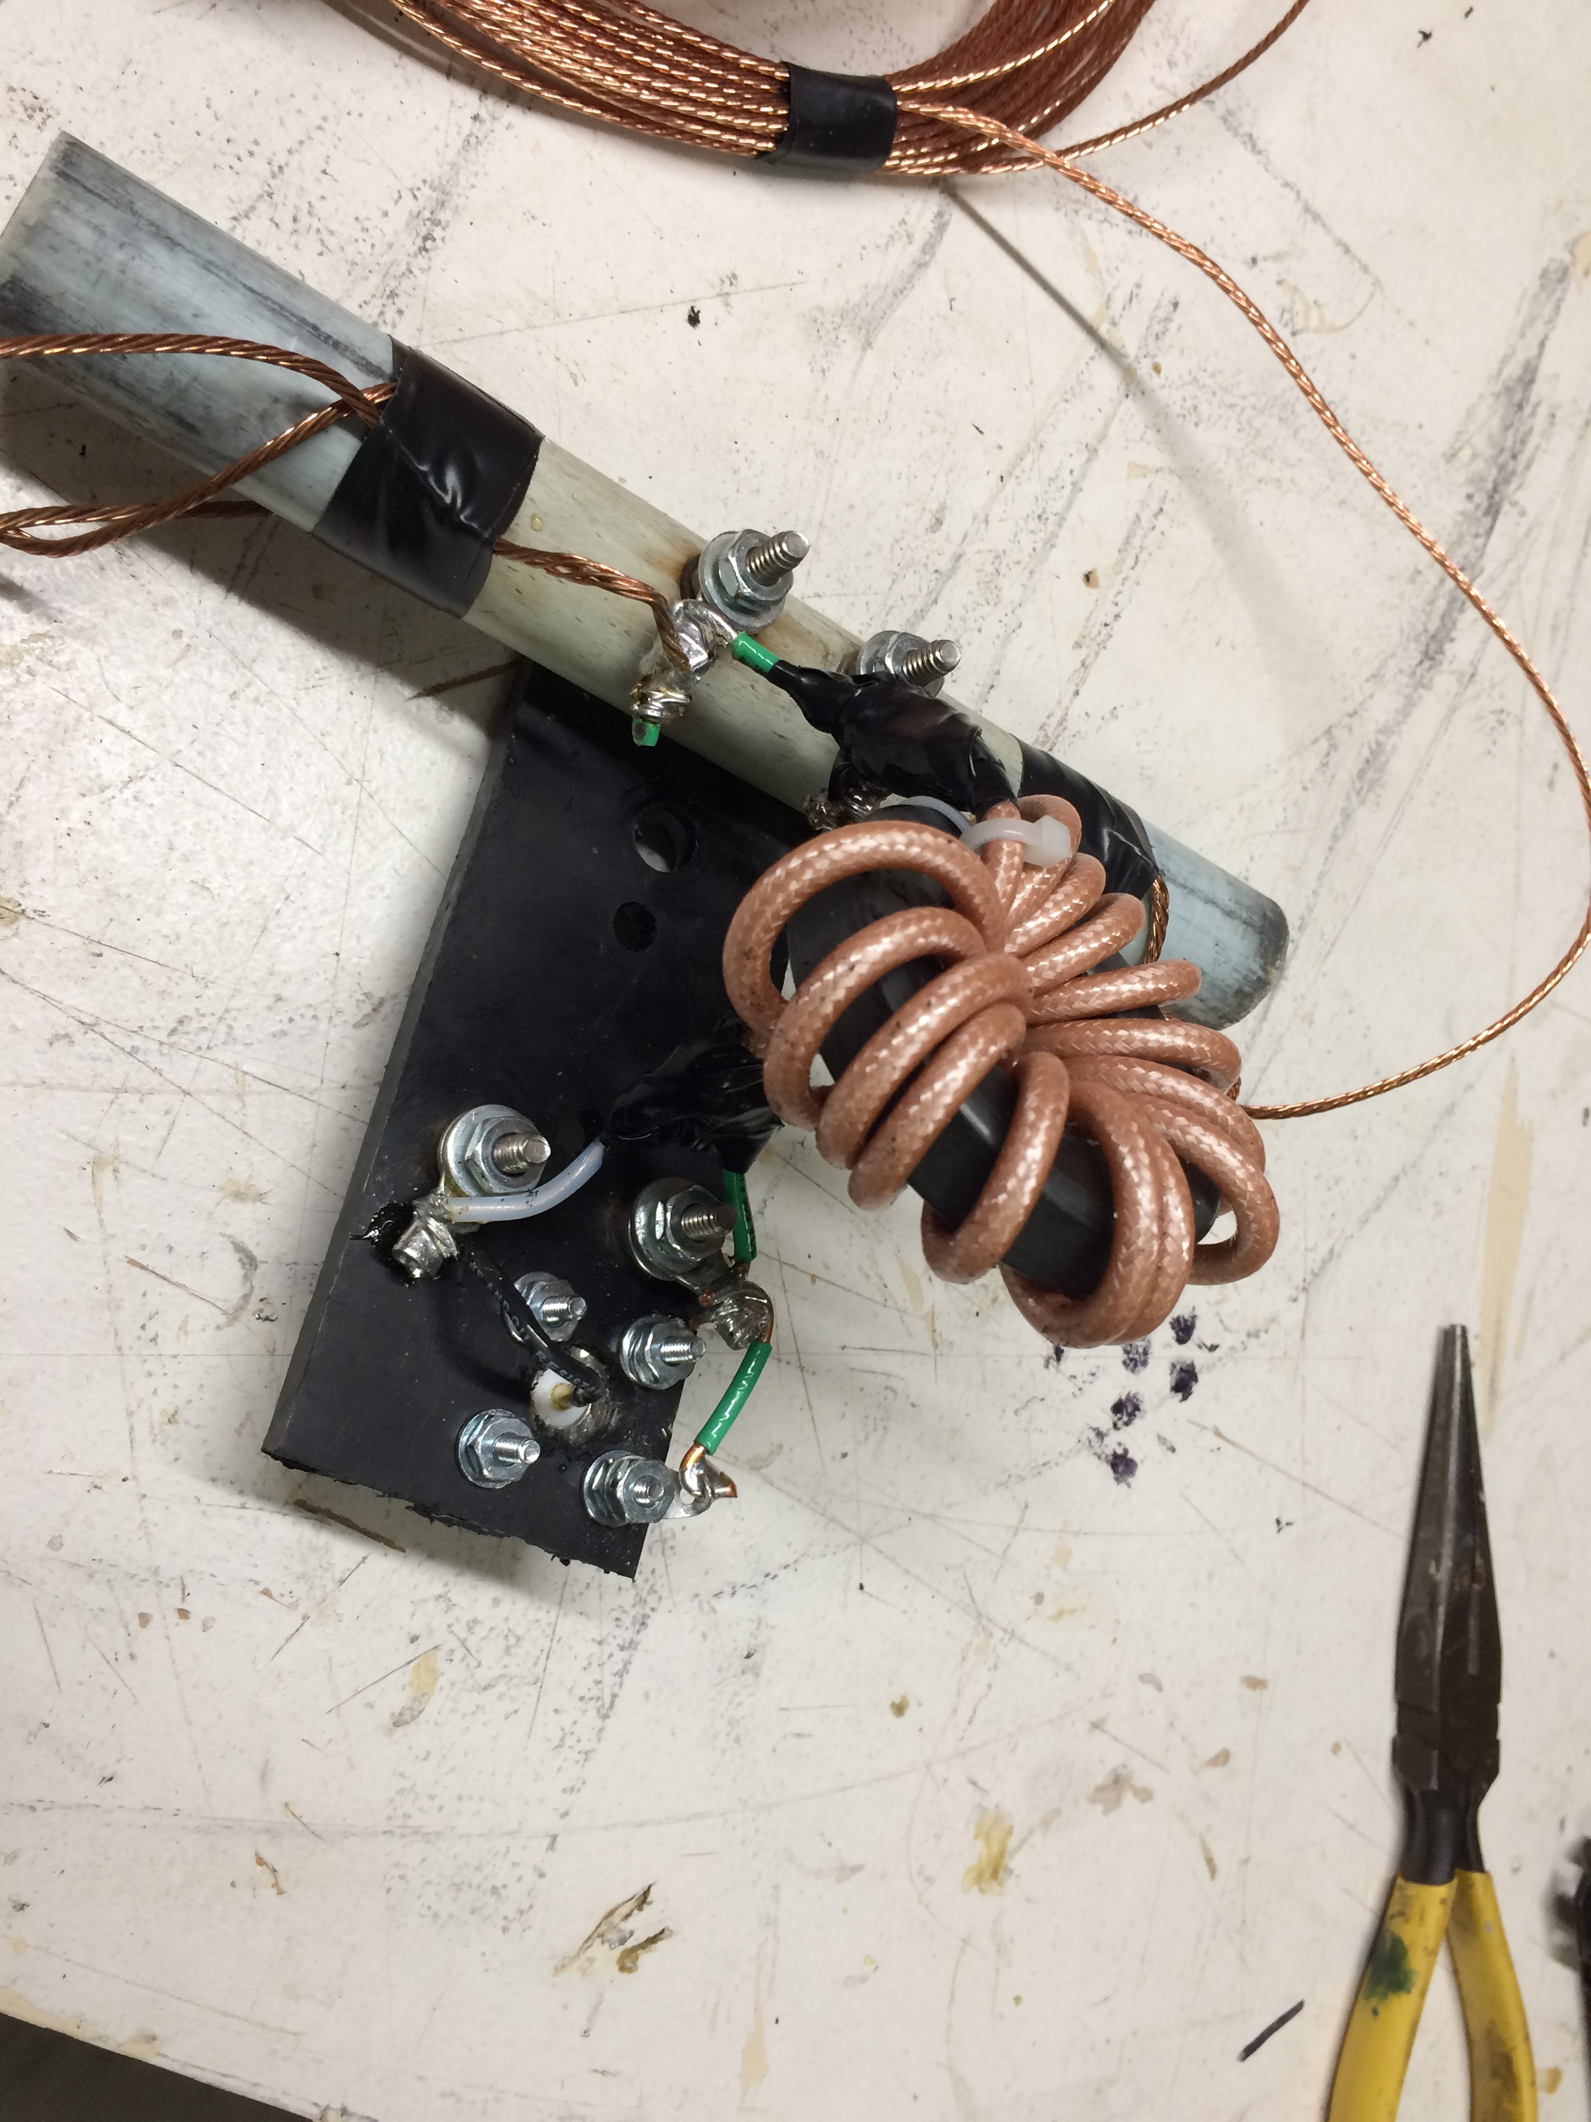
Center insulator and balun

Slide 8
Pneumatic dog ball launcher fabricated for placing antenna lines over trees

Slide 9
Dipole hung from tower

Slide 10
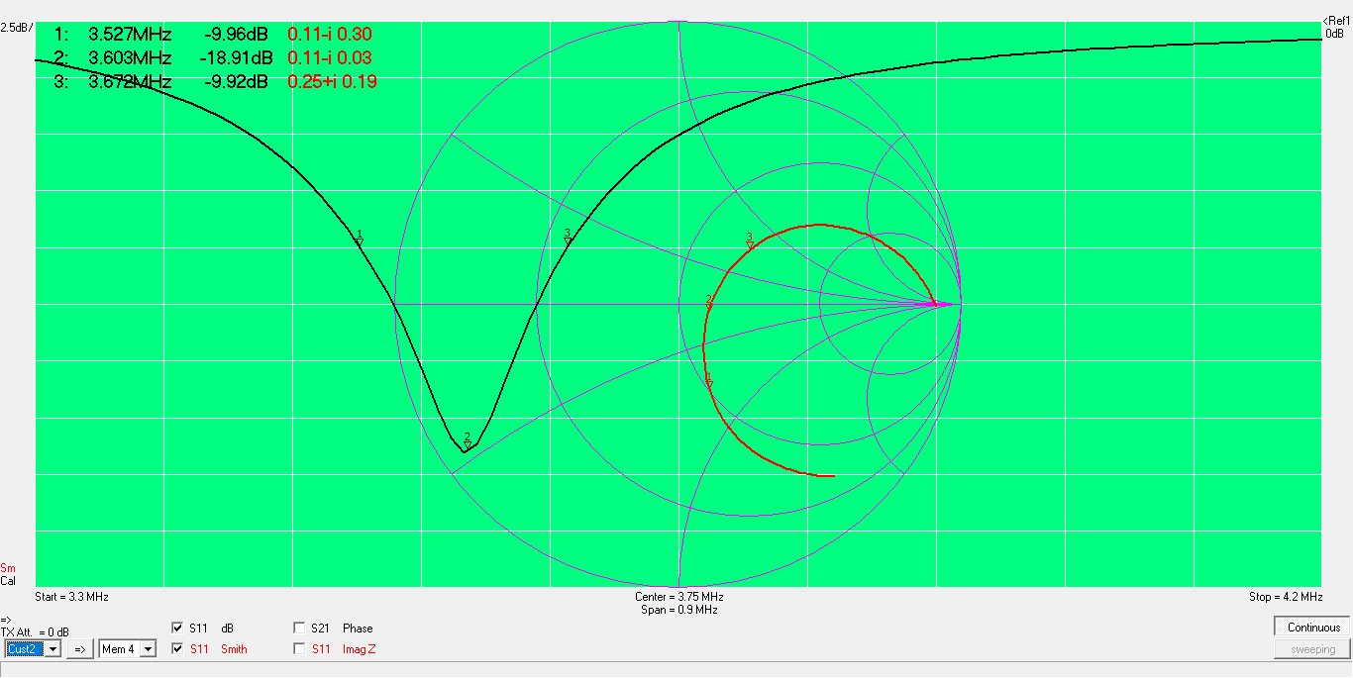
Measured feedpoint impedance after balun Resonant frequency 50 kHz lower than model

Slide 11
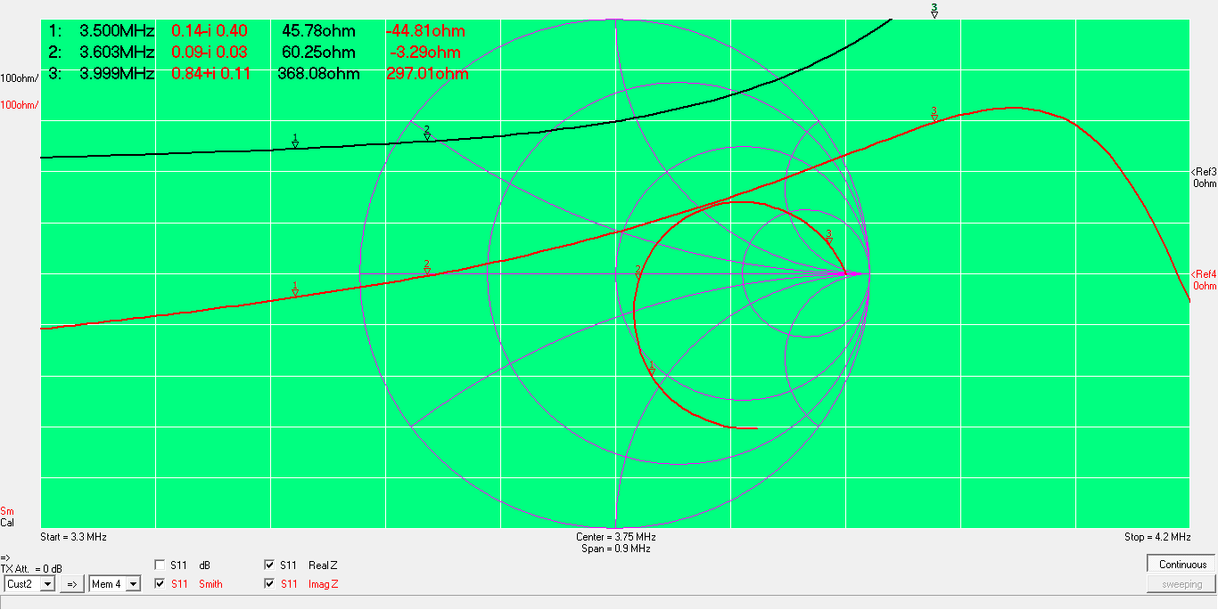
Resistance is 60 Ohm at resonance

Slide 12
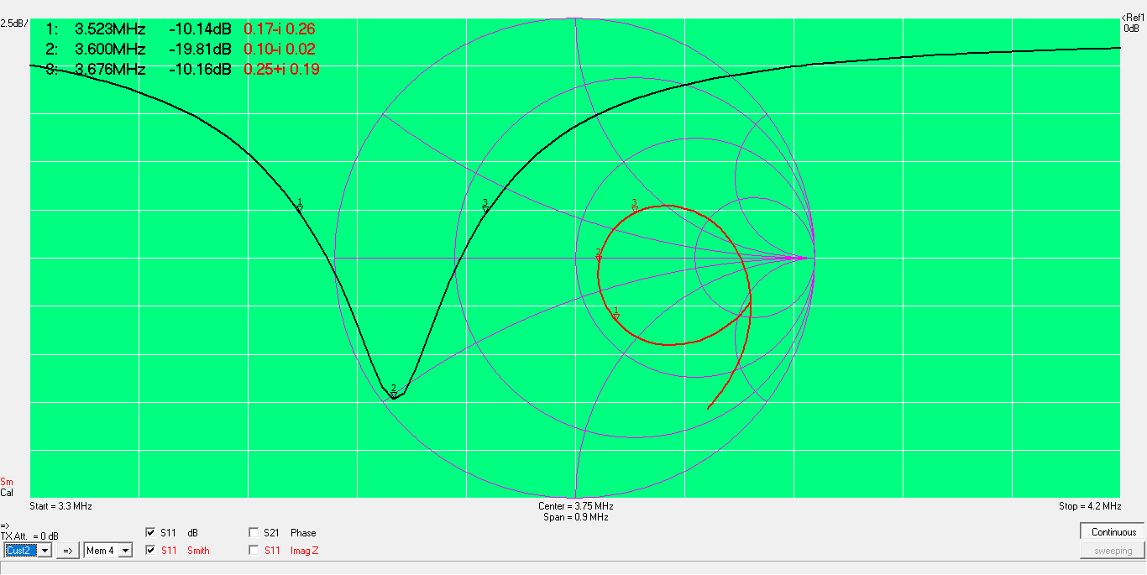
After 110 feet of coax Bandwidth for VSWR=2 is 150 kHz

Slide 13
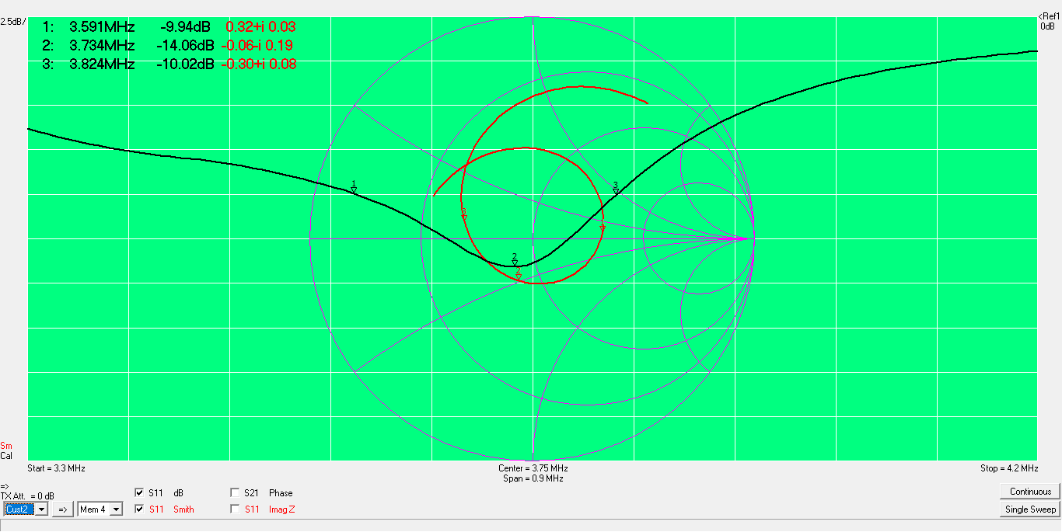
Adding 90 degree of RG-11 75 Ohm line Bandwidth for VSWR=2 is 235 kHz

Slide 14
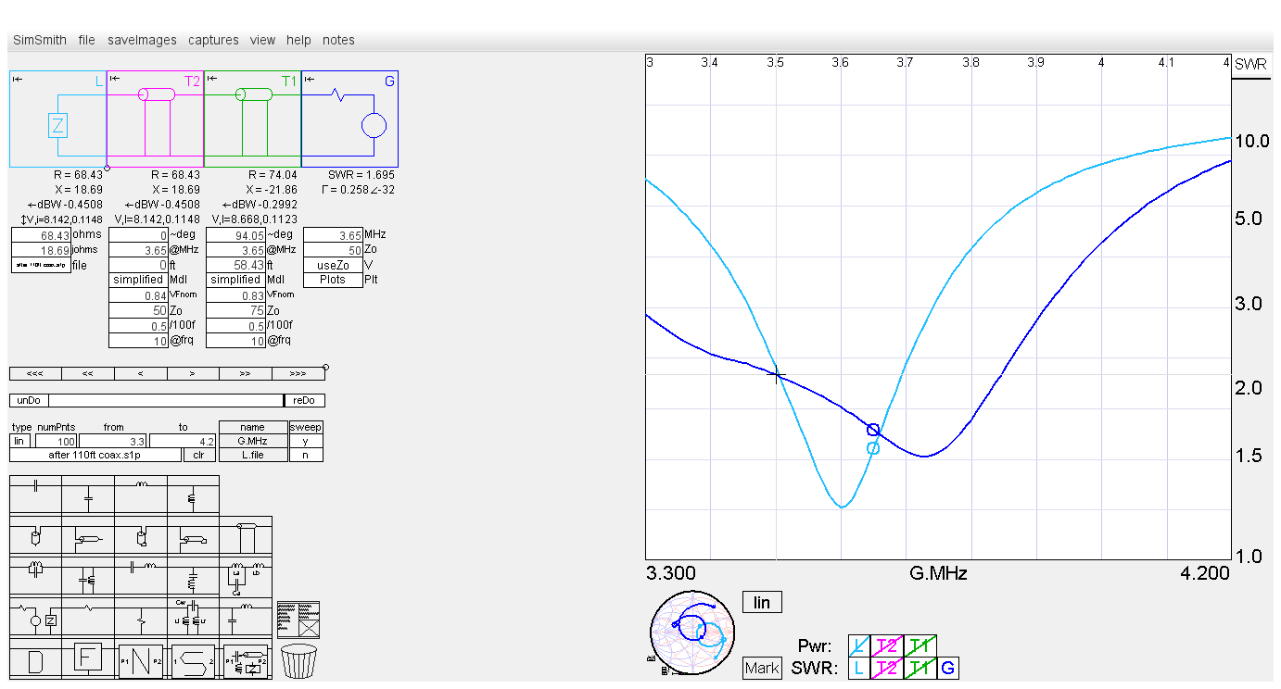
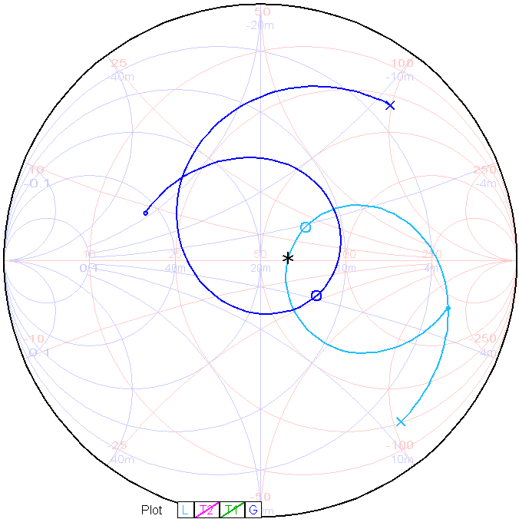
Simsmith simulation tracks measurement
Dipole
Dipole after
“Leeson” matching

Slide 15
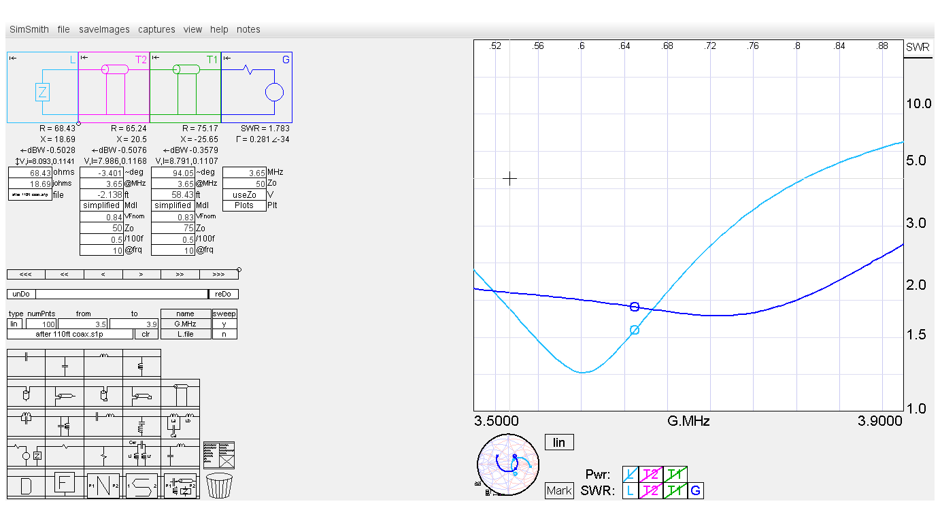
Simulation shows shortening 50 Ohm line by 2 feet is optimum 2 dB bandwidth is doubled from 150 to 300 kHz
Dipole
Dipole after
“Leeson” matching

Slide 16
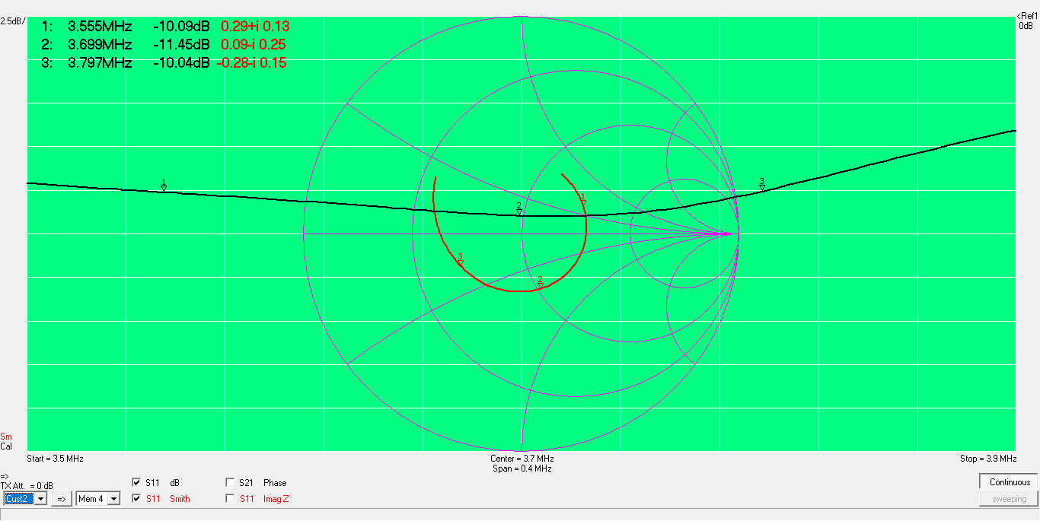
50 Ohm line shortened

Slide 17
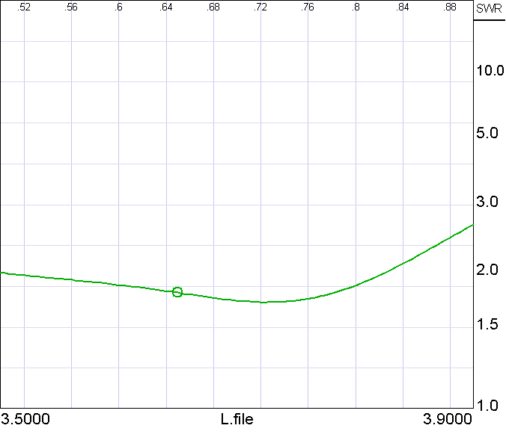
Network analyzer data plotted in Simsmith to show VSWR

Slide 18
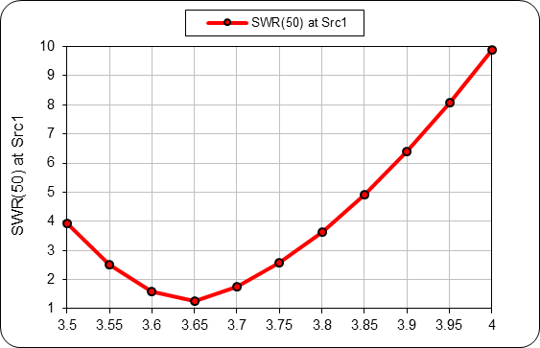
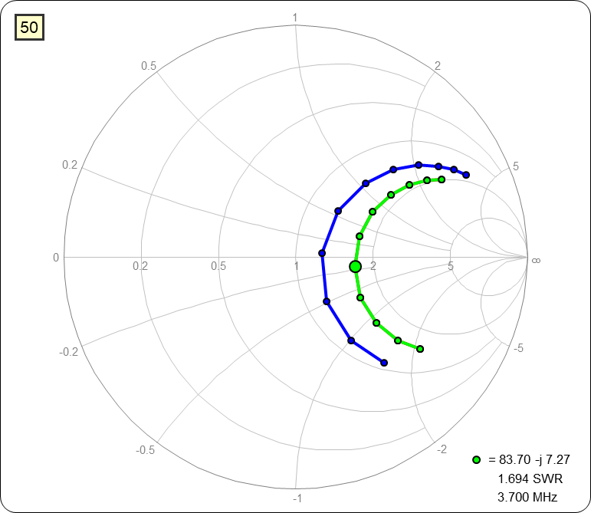
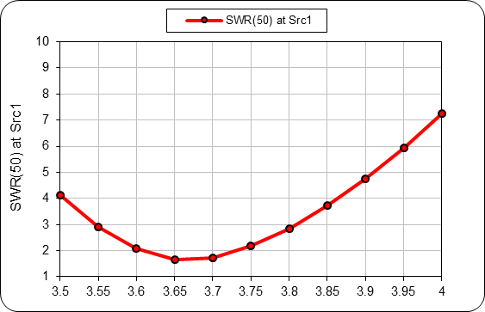
Why is better performance shown in literature? Published articles are for “high” dipoles.
50 foot apex
50 foot apex
75 foot apex
75 foot apex
Raising antenna apex from 50 to 75 feet increases feedpoint impedance and lowers Q (tighter arc on Smith chart).
In other words, the high dipole starts with better bandwidth.

Slide 19
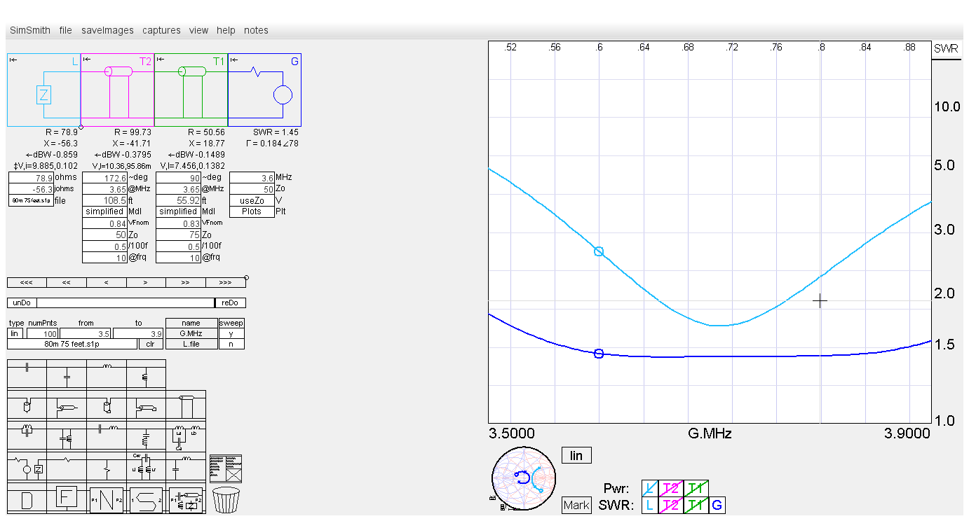
Excellent matching with 75 foot apex dipole
Dipole
Dipole after “Leeson” matching

Slide 20
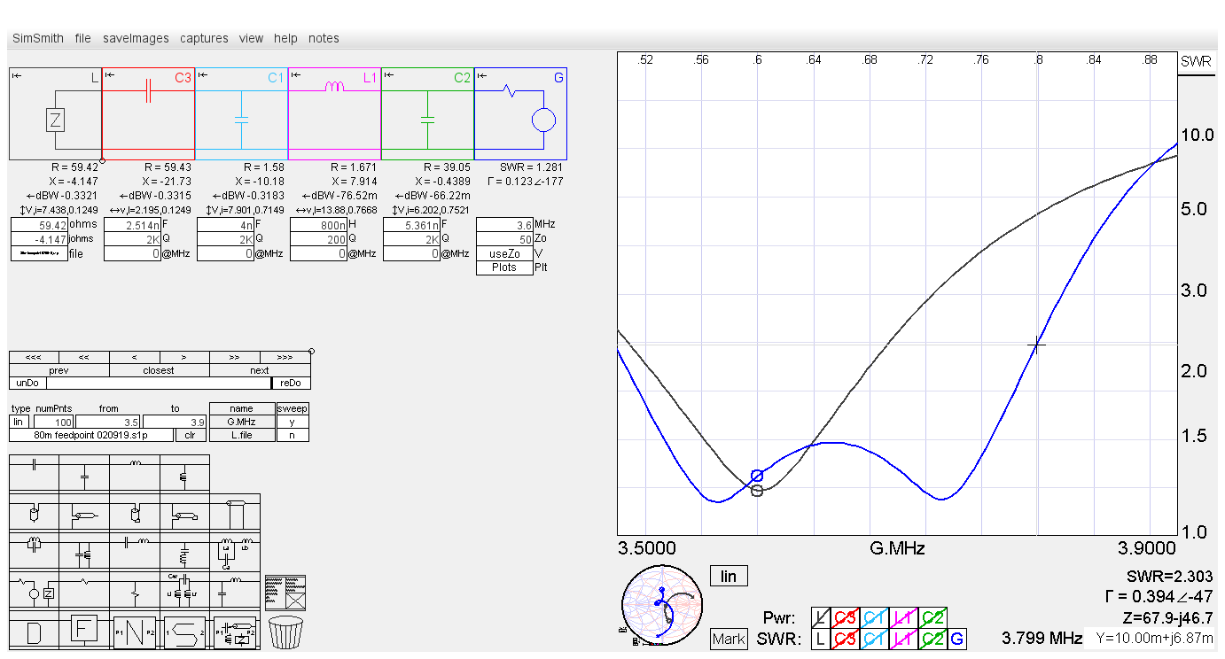
A second order matching circuit can also be used to “double tune” an antenna for increased bandwidth at lower VSWR. However component values may not really be practical
Dipole
Double
Tuned with LC

Slide 21
Conclusions
Bandwidth of low dipoles can be substantially increased using “Leeson” matching
For VSWR=2 bandwidth is increased from 150 to nearly 300 kHz in our application
Performance is limited by two factors
Lower feedpoint impedance at low heights (62 Ohms for our dipole)
Higher Q at low heights causes extended arc on Smith chart
For this reason inserting a step up transformer from 62 to 75 Ohms would have limited benefit
A second order lumped element matching circuit can achieve broader band-width at lower VSWR but component values may not be practical.

