Slide 1
Use HAFTA to compare options for mounting 40 and 20 meter beams on same mast
Option 1:
  40m at 52 feet
  20m at 60 feet
Option 2
  20m at 52 feet
  40m at 60 feet
Compare for 5 directions
  Eu, ZS, LU, ZL, JA

Slide 2
Inputs for HFTA
Tower Location
  35.492126
  -120.722055
Beam Headings
  G 33 degrees
  ZS 81 degrees
  LU 137 degrees
  ZL 223 degrees
  JA 306 degrees
HAFTA FOM= Average (gain at angle X statistical percentage band is open at that angle) in dB

Slide 3
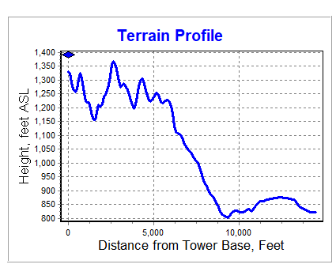
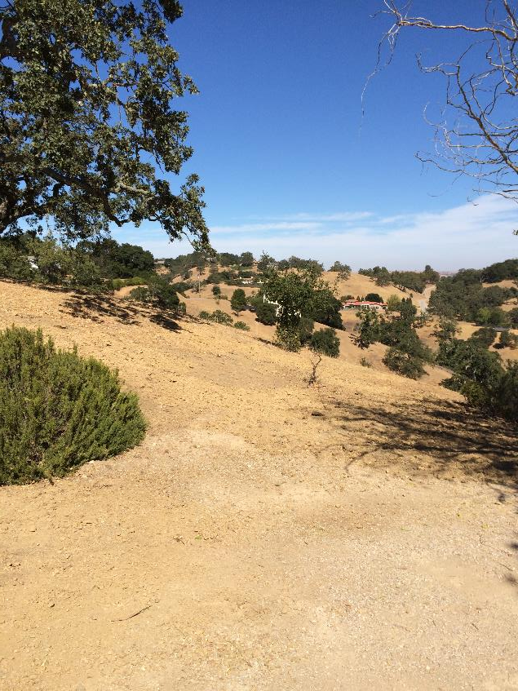
Europe

Slide 4
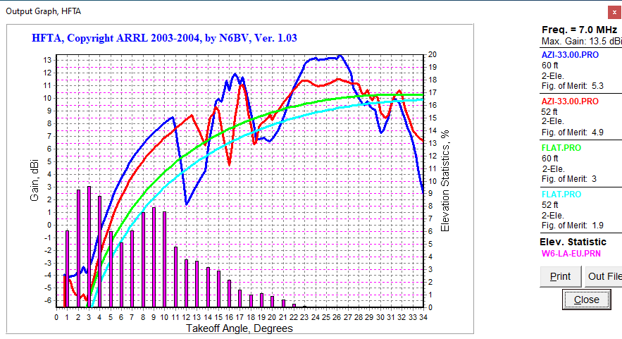
7 MHz to Europe (2 elements)
60 ft is 1.5 dB better than 52 feet
Terrain is 3.5 dB better than flat ground

Slide 5
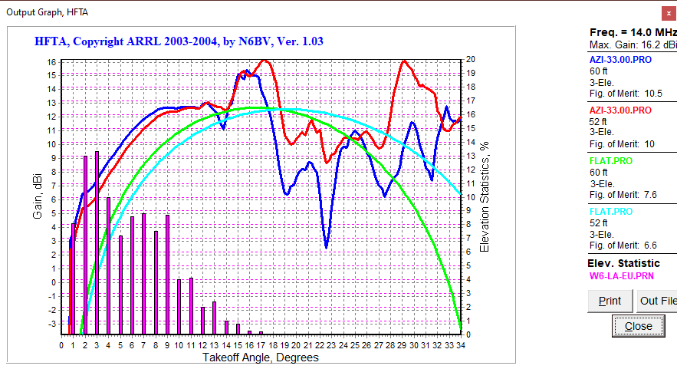
14 MHz to Europe (3 elements)
60 ft is 1 dB better than 52 feet
Terrain is 2.5 dB better than flat ground

Slide 6
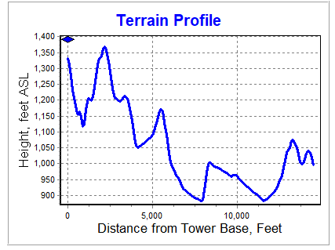

ZS

Slide 7
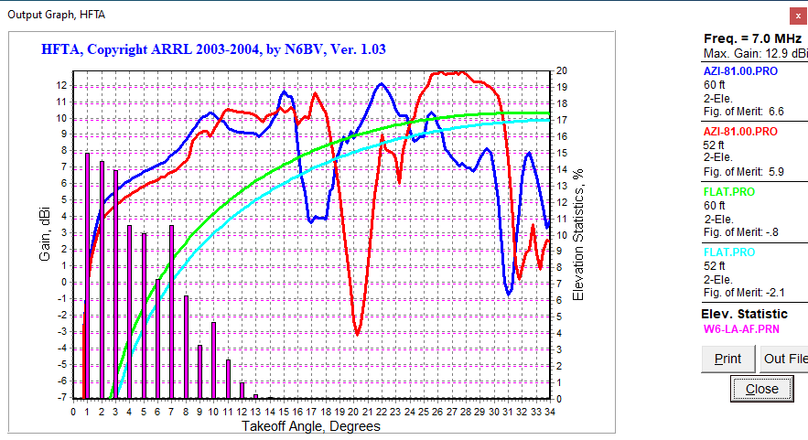
7 MHz to ZS (2 elements)
60 ft is 0 dB better than 52 feet
Terrain is 4 dB better than flat ground
Low FOM for flat terrain is due to extremely
low arrival angles from ZS.

Slide 8
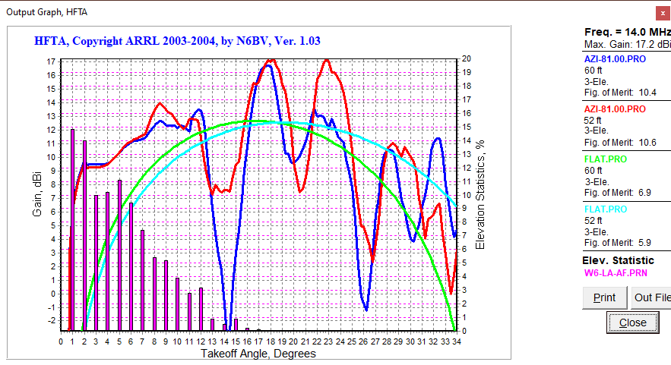
14 MHz to ZS (3 elements)
60 ft is 0 dB better than 52 feet
Terrain is 3 dB better than flat ground

Slide 9
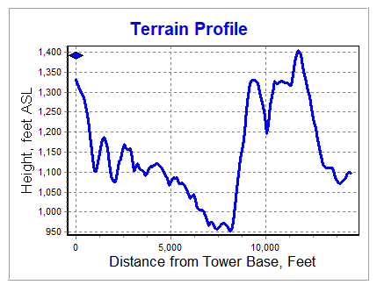
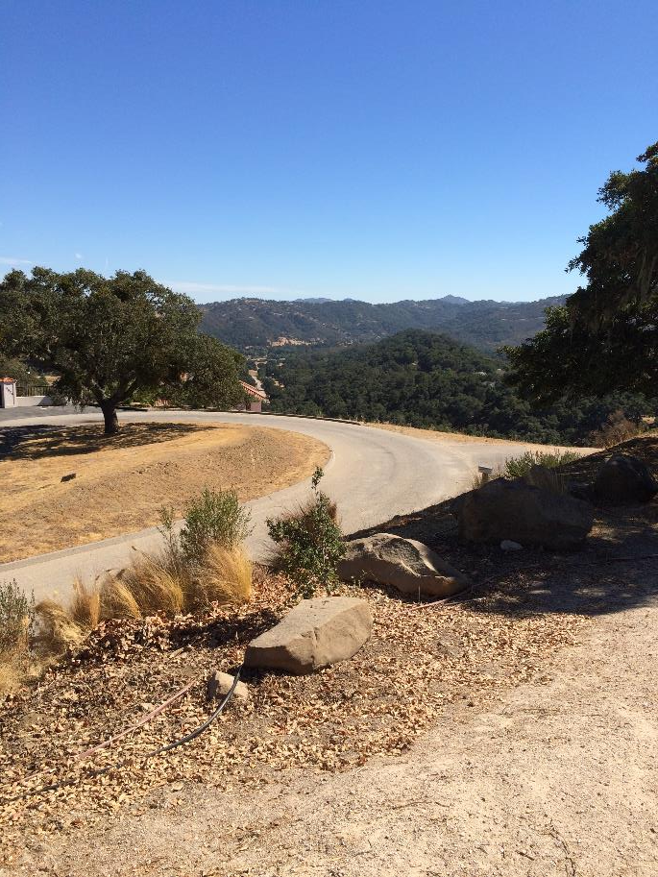
LU

Slide 10
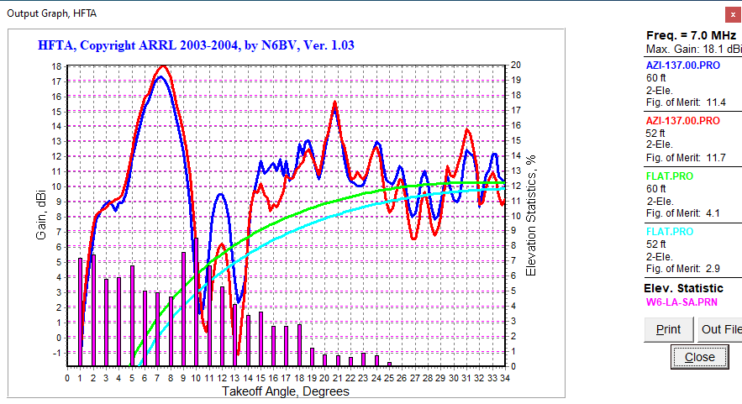
7 MHz to LU (2 elements)
60 ft is 0 dB better than 52 feet
Terrain is 8 dB better than flat ground

Slide 11
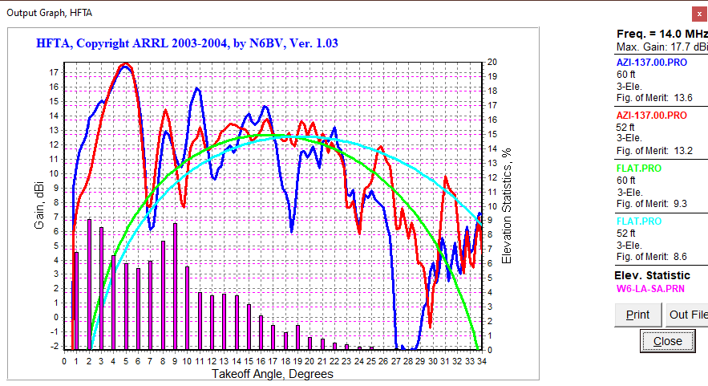
14 MHz to LU (3 elements)
60 ft is 0.5 dB better than 52 feet
Terrain is 5 dB better than flat ground

Slide 12
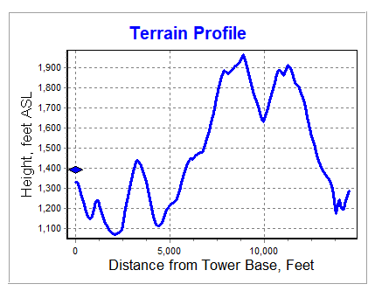

ZL
4.2 degrees

Slide 13
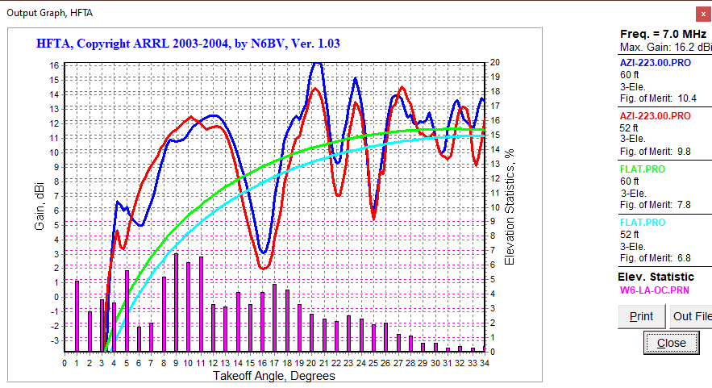
7 MHz to ZL (2 elements)
60 ft is 0.5 dB better than 52 feet
Terrain is 4 dB better than flat ground

Slide 14
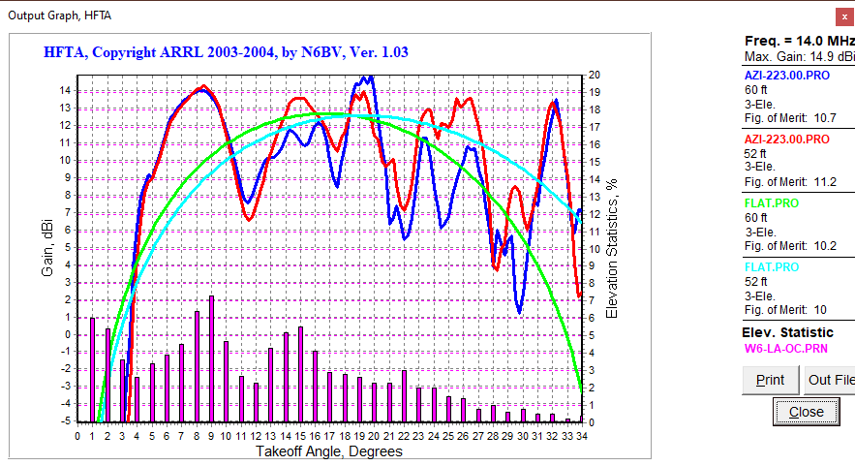
14 MHz to ZL (3 elements)
60 ft is 0 dB better than 52 feet
Terrain is 2.5 dB better than flat ground

Slide 15
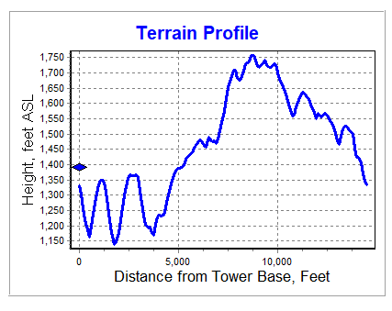
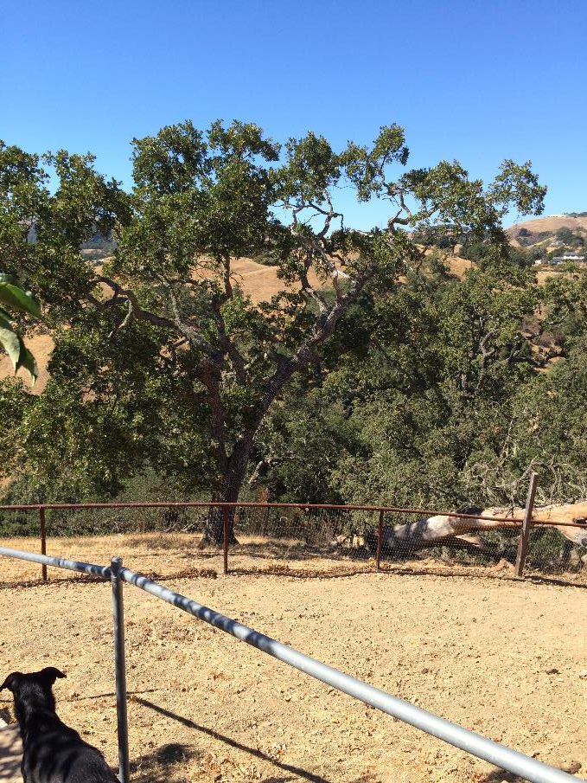
JA
2.6 degrees

Slide 16
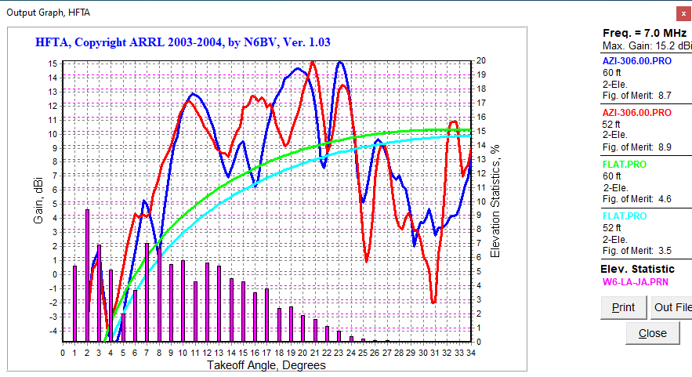
7 MHz to JA (2 elements)
60 ft is 0 dB better than 52 feet
Terrain is 4 dB better than flat ground

Slide 17
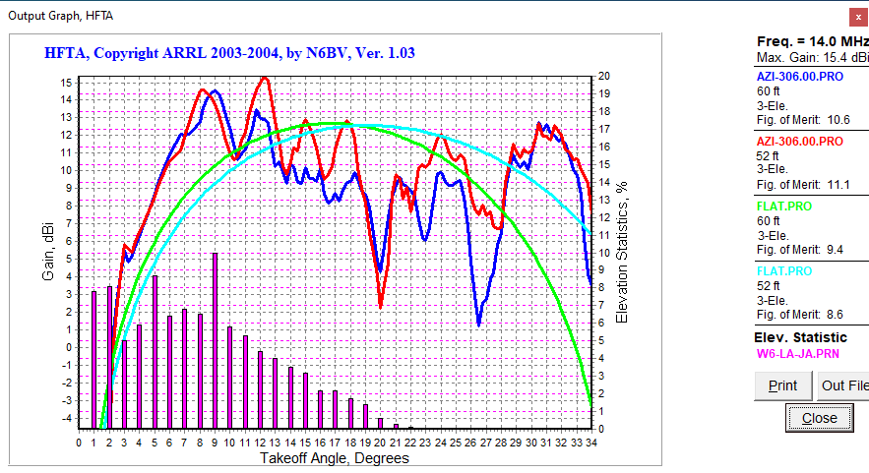
14 MHz to JA (3 elements)
60 ft is 0 dB better than 52 feet
Terrain is 2 dB better than flat ground

Slide 18
Surprisingly little difference between 60 and 52 feet for either 7 or 14 MHz
Lower FOM for EU and ZS is due to extremely low
arrival angle on these paths

Slide 19
Hilltop location has significant gain over flat land
Greater effect on 7 than 14 MHz is due to longer
wavelength minimizes effect of flat earth around
tower before slope.

Slide 20
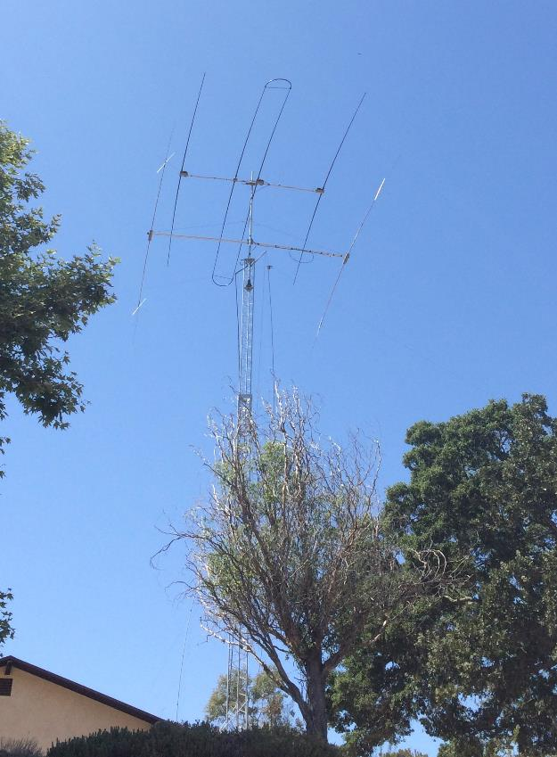
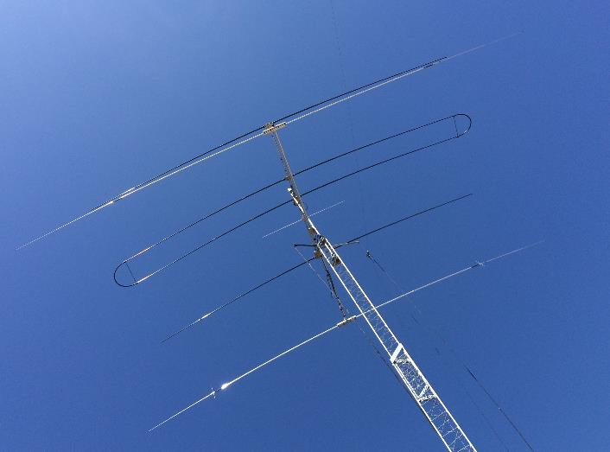
SteppIR at 60 feet, XM240 at 52 feet

Slide 21
Conclusions
Little difference on 14 or 7 MHz between 52 and 60 feet
Hilltop location provides significant advantage over flat terrain
  Exception is in direction of distant hill causing 4 degree horizon for 14 MHz and angles less than 4 degrees
  Enhancement is greater at lower frequencies where longer wavelength minimizes effect of flat earth around tower before slope
HAFTA generated FOM is not the whole story
  Need to look at details of lobes
  Need better understanding of arrival angles over various paths

