Slide 1
2 element receive array for 160m at W6AYC
Motivation
  K9AY array (7 dB RDF) always superior to TX antenna (5 dB RDF) but better performance desired
Constraints
  Limited flat yard space available
  4 direction instantaneous switching desired
Options considered:
  Shared Apex array (8 dB RDF)
  2 phased verticals (9 dB RDF)
  Waller Flag (12 dB RDF)

Slide 2
Tradeoffs
Shared apex array
  Pro- Small footprint, ground independent
  Con- Minimal improvement over K9AY, doesn’t fit that well in available space
Two verticals spaced 1/8 wavelength
  Pro- at least 2 dB better than K9AY, instantaneous direction switching, four-direction array fits in my yard, high output level (no preamp required, common mode not a big problem)
  Con- only 2 dB RDF improvement, have to run feedlines to each vertical and design a phasing box
Waller flag
  Pro- excellent directivity
  Con- physical rotation required, low output level requires special attention to preamps and common mode noise
2 element vertical array chosen for development.
Waller flag might be an extremely interesting educational experience in the future.

Slide 3
Array of 2 element verticals
Design
  Array
  Vertical elements
  Phasing versus antenna pattern
  Crossfire phasing
Construction
Results
Future work
Design was based on material from ON4UN’s Low Band Dxing, W8JI’s website and the YCCC 9 circle array manual (W1FV).

Slide 4
Delay is added in Antenna 2 feedline so that signals from left arrive at the combiner 180 degrees out of phase
Antenna 1
Antenna 2
Antenna separation
Desired signal direction
Delay
-Delay is in feedline of antenna in the direction of receiving
-Close spaced arrays have lower output and are more critical for
phasing
- Example: Antenna separation of 45 degrees and phase delay
of 135 degrees gives 180 degrees difference at the combiner
for signals from the left, causing cancellation (at 0 degree elevation)
- We usually move the nulls up in elevation by increasing delay
Combiner
Receiver

Slide 5

Layout of array at W6AYC
NW vertical
NE vertical
67 feet
60 feet
Corner vertical
Array of 3 verticals, two used at a time (NW/SE and NE/SW)

Slide 6
Vertical elements
Passive elements with umbrella loading wires ala W8JI chosen for simplicity and robustness
  24 foot verticals with three 20 foot umbrella loading wires
  Larger elements minimize sensitivity to surrounding objects
  Large electrical size maximizes bandwidth
  Umbrella wires guy the verticals
  Earlier work showed short verticals to be very sensitive to surroundings. This is sometimes attributed to capacitance to surrounding objects. A better explanation is that the small capture area is overwhelmed by reradiation from local objects. Short verticals with high impedance amplifiers are great for clear pastures.

Slide 7
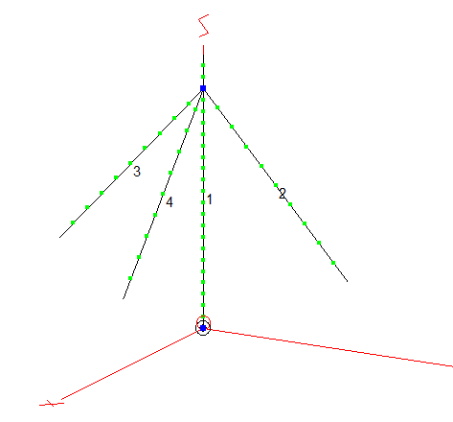
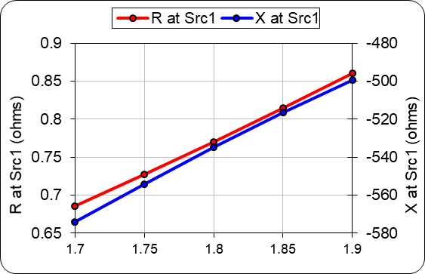
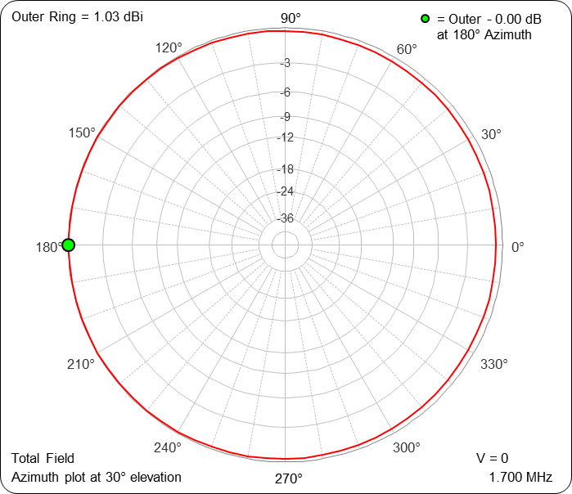
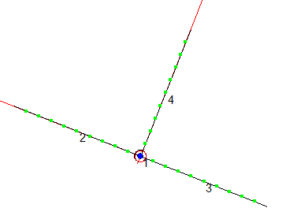
Simulation of vertical 24 foot element with three 20 foot umbrella wires
Input impedance is 0.8 –j 530 at 1.8 MHz.
Imaginary part drops to -160 Ohms at 80m.
Asymmetry of umbrella wires has little effect

Slide 8
Vertical elements will be matched to 75 Ohm RG-6
Series inductor used to cancel –j530 Ohms plus a series resistor to match to 75 Ohms
Resistive matching and 75 Ohm cable maximizes bandwidth
  Output signal levels are high so resistive matching is tolerable
  Mismatch causes amplitude and phase errors. ON4UN’s analysis indicates maximum voltage and phase errors of about 5% for VSWR=1.1 (26 dB return loss) and 10% for VSWR= 1.2 (21 dB return loss).
  Voltage errors degrade null depth. Phase errors move the nulls around.

Slide 9
A DPDT direction relay places the delay in either feedline
Antenna 1
Antenna 2
Antenna separation (67 or 60 feet)
Feedline length 69 feet
Feedline length 69 feet
Delay
Combiner
Receiver

Slide 10
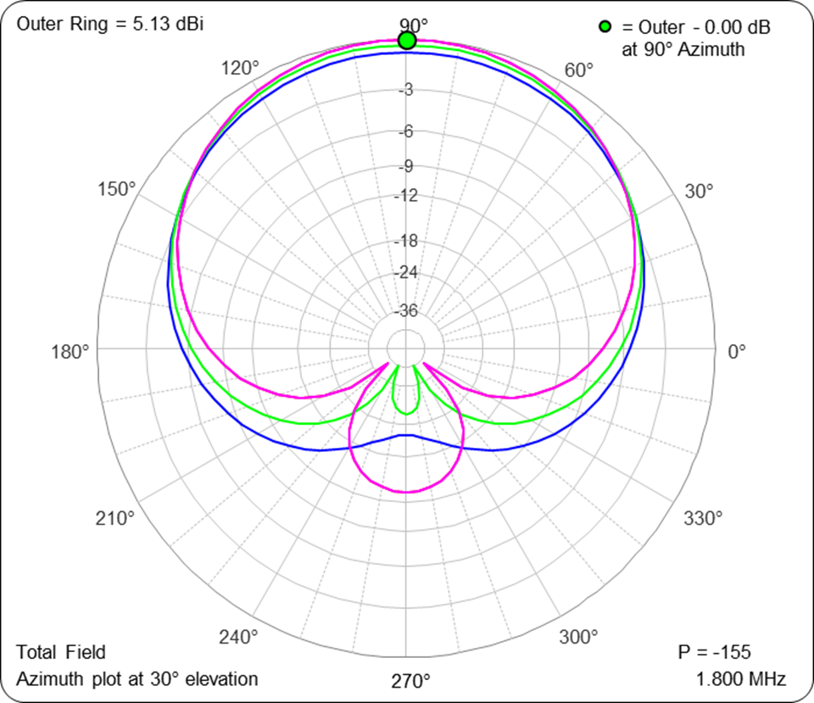
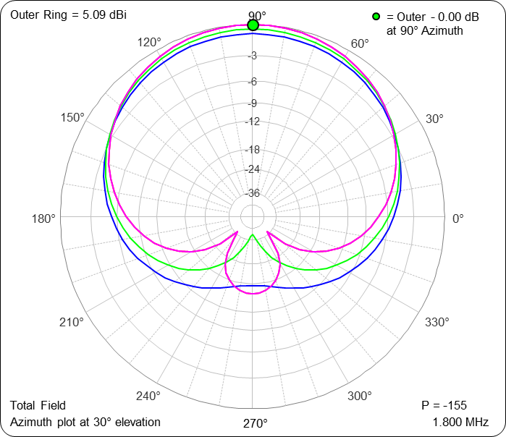
Optimum delay is 145 degrees- good for 67 and 60 foot spacing
160m, 67 foot spacing
160m, 60 foot spacing
155 degrees
155 degrees
145 degrees
145 degrees
135 degrees
135 degrees

Slide 11
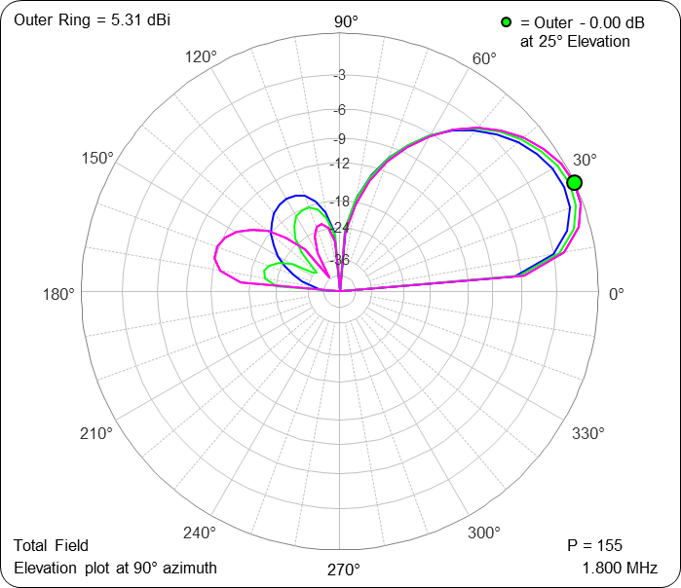
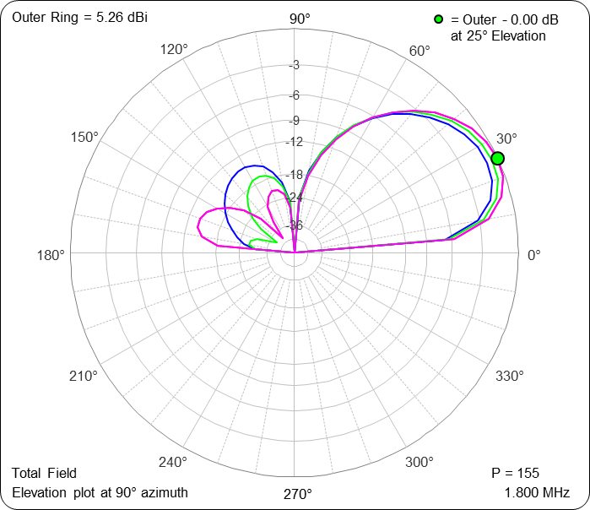
Little change in nulls between 60 and 67 feet spacing
160m, 67 foot spacing
160m, 60 foot spacing
135 degrees
135 degrees
145 degrees
145 degrees
155 degrees
155 degrees

Slide 12
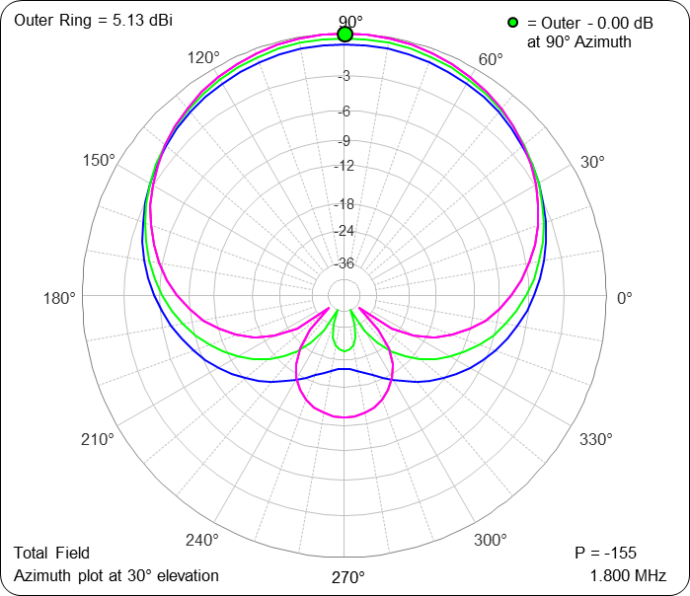
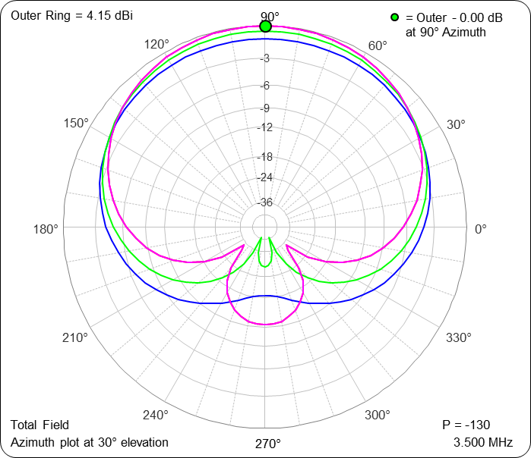
Pattern is still good on 80m
160m, Directivity= 9.4 dB
80m, Directivity= 8.7 dB
155 degrees
130 degrees
145 degrees
110 degrees
135 degrees
90 degrees

Slide 13
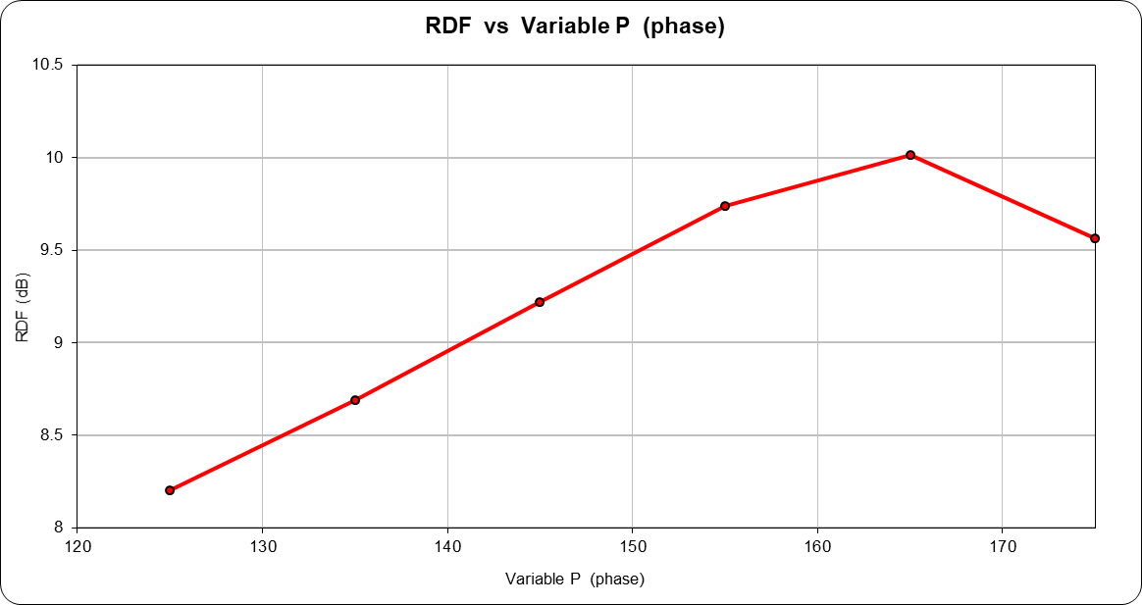
RDF gets better with increasing phase
Front beam narrows but rear lobes increase

Slide 14
Antenna control
An array relay will select either the NW/SE or NE/SW array
A second relay controls the direction of the selected array
Delay is implemented by “crossfire phasing”
  Popularized by W8JI
  Large bandwidth allows a single array to work on 2 and sorta 3 bands
  Uses minimal length of coaxial delay line

Slide 15
Cross-fire phasing compensates for spacing between antennas allowing multiband operation
180 degree
transformer
Input
Output
Delay line
Output= 180 degrees – delay
For example: 160m antenna spaced 45 degrees with crossfire phasing and a 35 degree delay line is usable
on 80m and somewhat on 40m.
Freq Ant separation Delay line Cross-fire delay Total delay
1.8 45 35 145 190
3.6 90 70 110 200
7.2 180 140 40 220
All numbers are degrees.

Slide 16
Construction- Vertical elements
24 foot verticals constructed of telescoping aluminum
NW and center attached to fence posts with hose clamps
NE vertical mounted on aluminum stake
Three 20 foot umbrella wires for guying
Ground system consists of fence plus three 50 foot radials
Feedlines are choked by W1FV common mode choke from YCCC kit

Slide 17
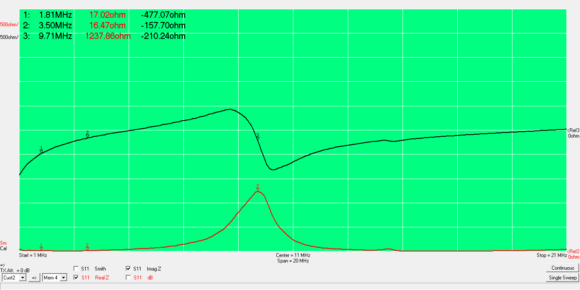
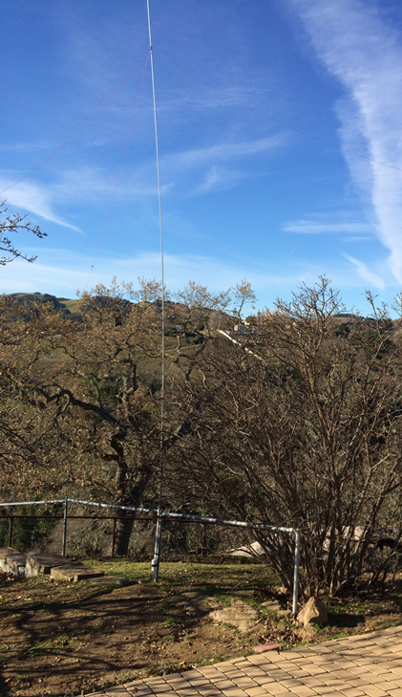
NW vert measured input impedance, -j477 Ohms

Slide 18
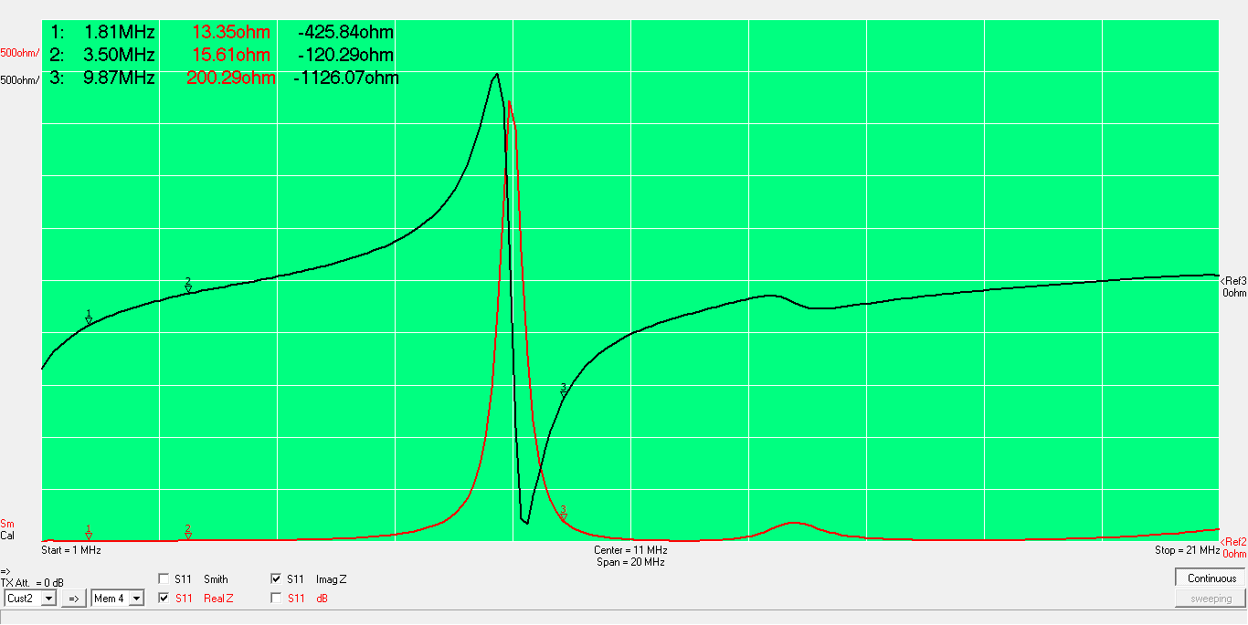
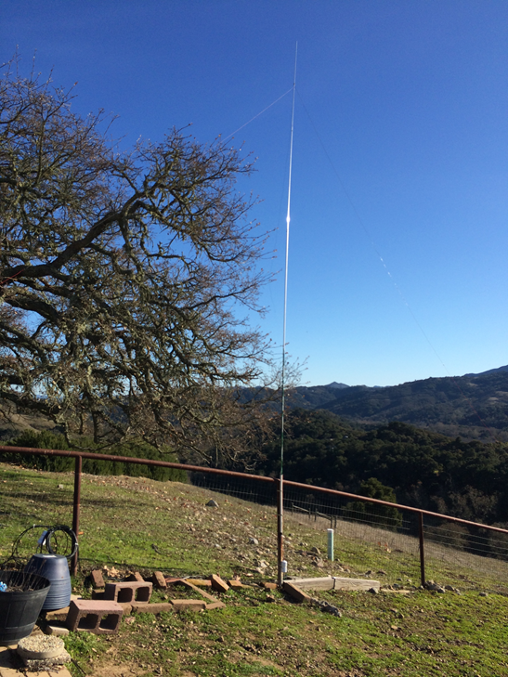
Center vert measured input impedance, -j426 Ohms

Slide 19
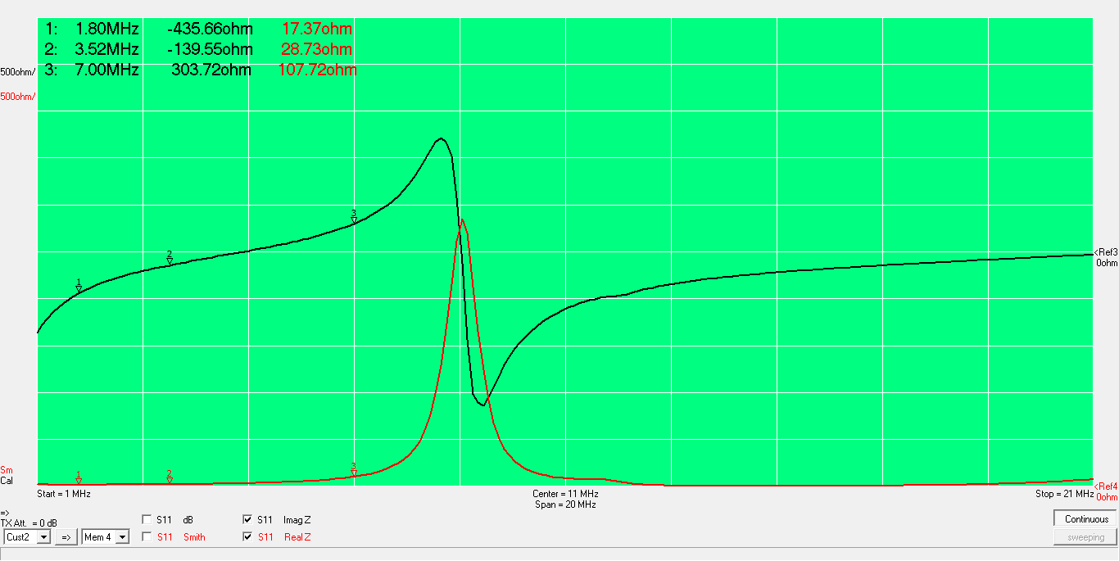
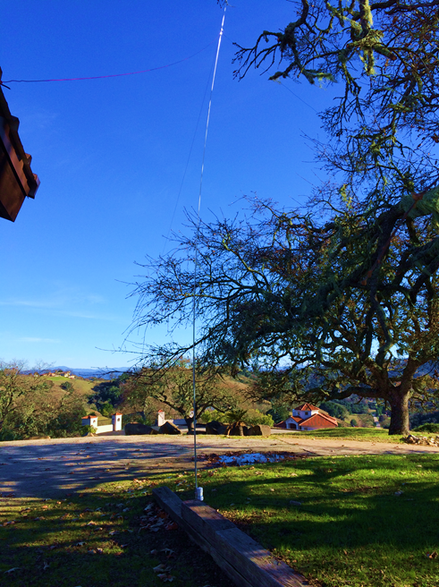
NE vert measured input impedance, -j436 Ohms

Slide 20
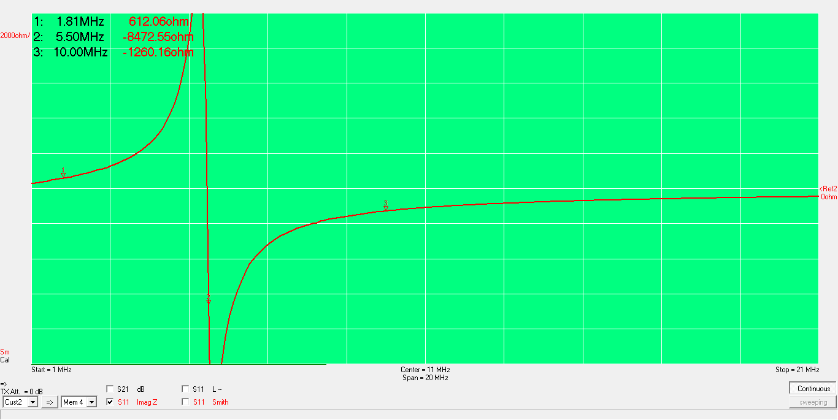
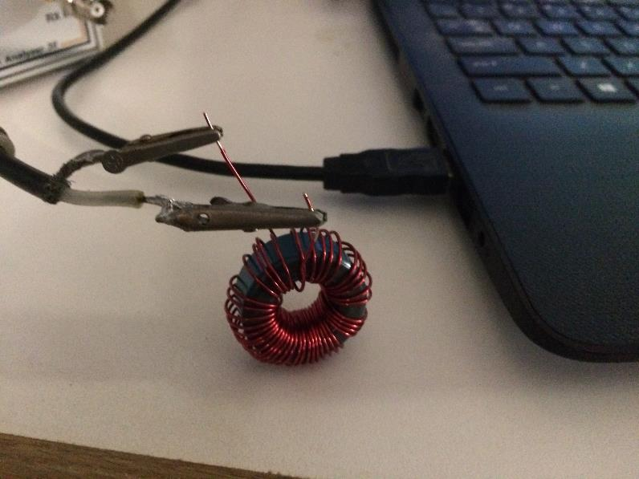
Inductor using powdered iron cores
41T, T106-1, Q=50
Molded inductors could be used but may be susceptible to ESD damage.

Slide 21
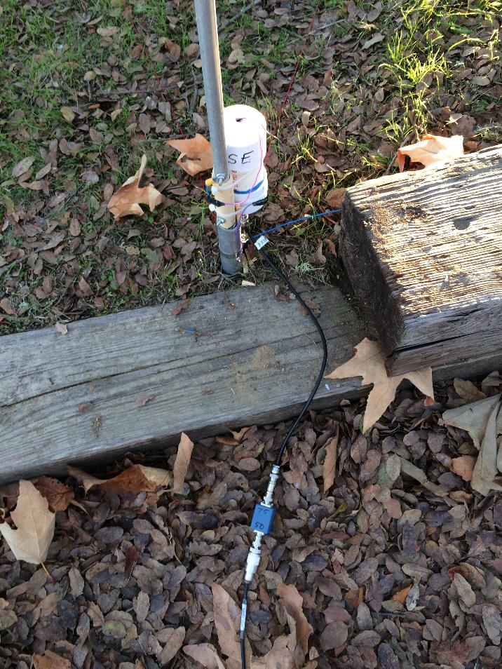
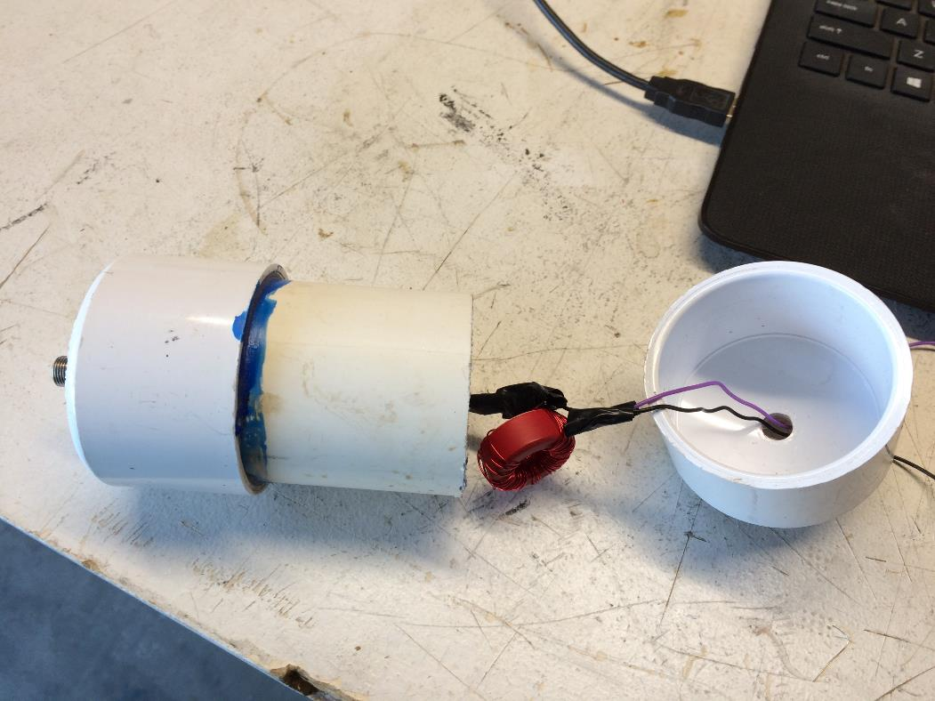
Matching network

Slide 22
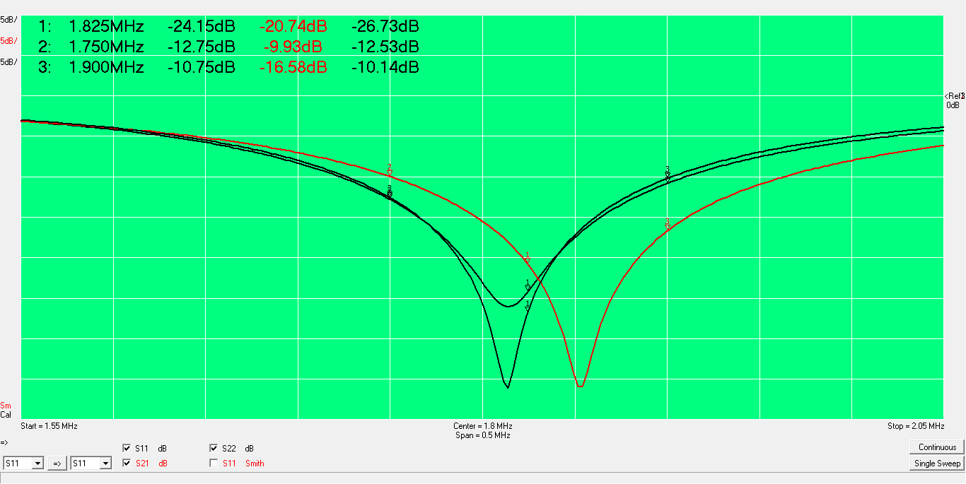
Return loss of verticals is better than 10 dB (VSWR=2) over 150 kHz
Rtn
Loss (dB)
0 dB
5 dB
10 dB
15 dB
20 dB
Corner
25 dB
Frequency could be lowered by
bunching inductor turns
30 dB
35 dB
NE
NW

Slide 23
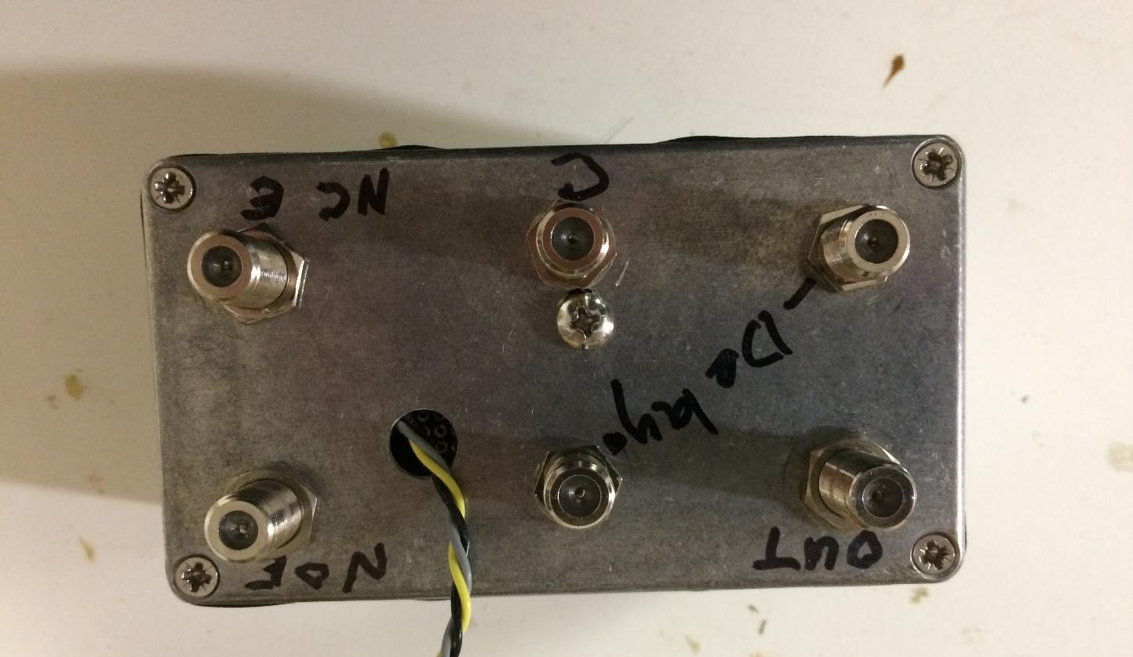
Phase controller box
NE Vertical
RX Output
Wires
Yellow- ant select
Gray- phase select
Black- ground
Corner Vertical
NW Vertical

Slide 24
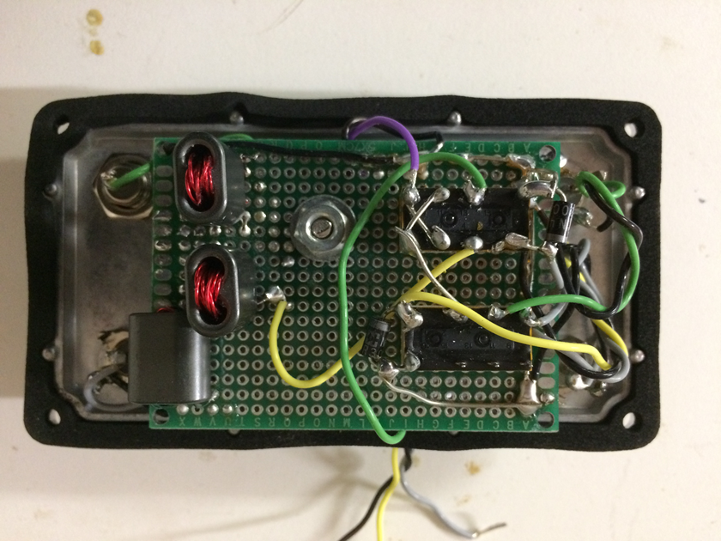
Controller is built on perf board
Phase inverter
Dead bug relays
Power splitter
2:1 Xfmr

Slide 25
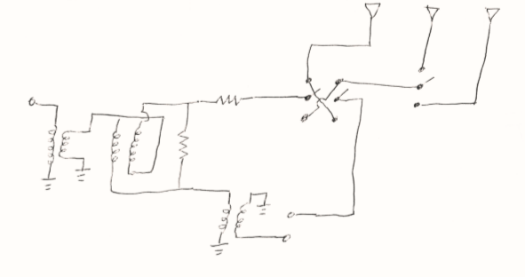
Phase box schematic
Corner
NW
NE
(circuit impedance)
NC
NC
(75 Ohm)
3 Ohm, 0.3 dB attn
Output to RX
(35 Ohm)
(75 Ohm)
Array Relay
Phase Relay
150 Ohm
(75 Ohm)
Relays are Panasonic
DS2Y-SM-DC12V
Impedance Xfmr
7T/5T
Power Splitter
7T/7T
Delay line connection
Phase Inverter
6T/6T
All xfmrs use binocular cores
Fair-Rite 2873000202, Type 73 material

Slide 26
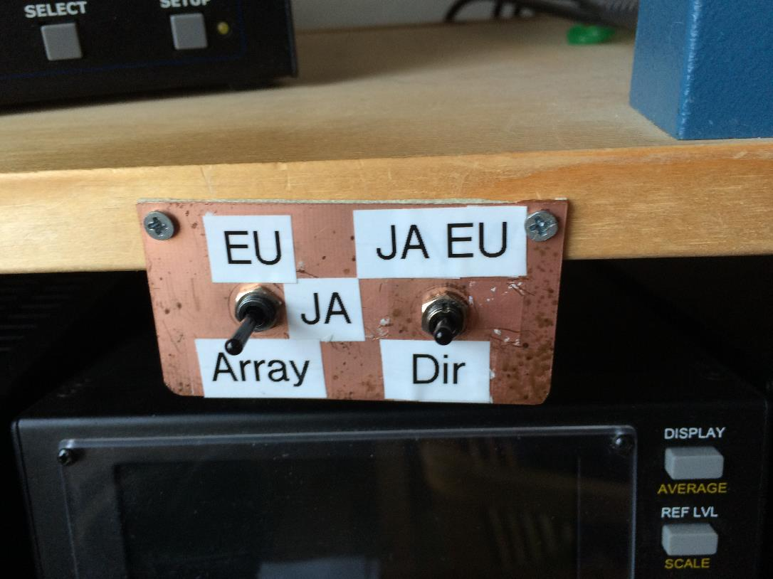
Hi-tech direction controller using two SPDT switches

Slide 27
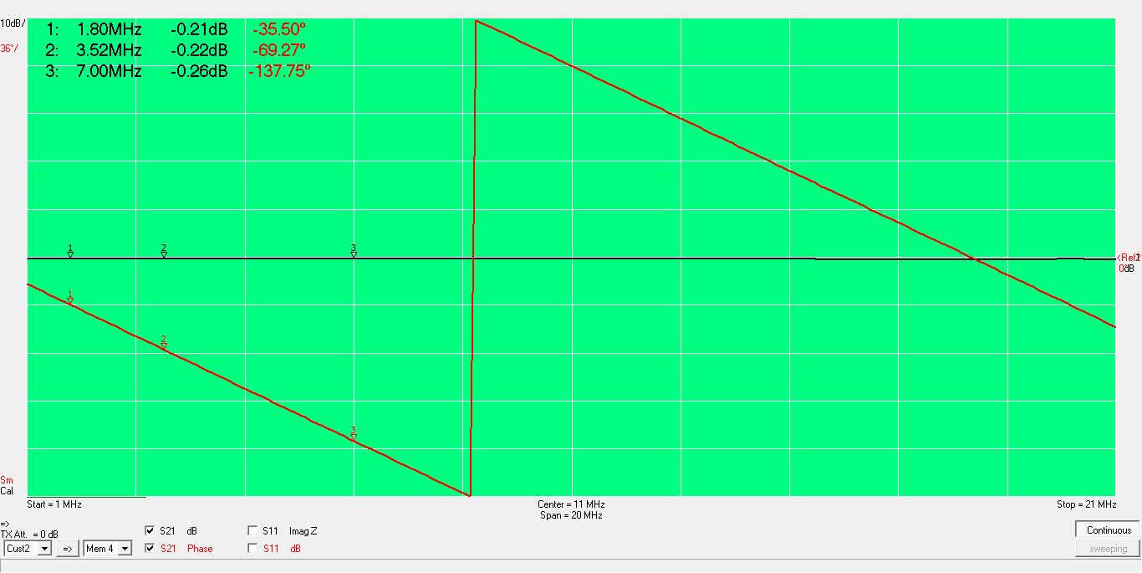
44 foot RG-6 delay line= 35.5 degrees

Slide 28
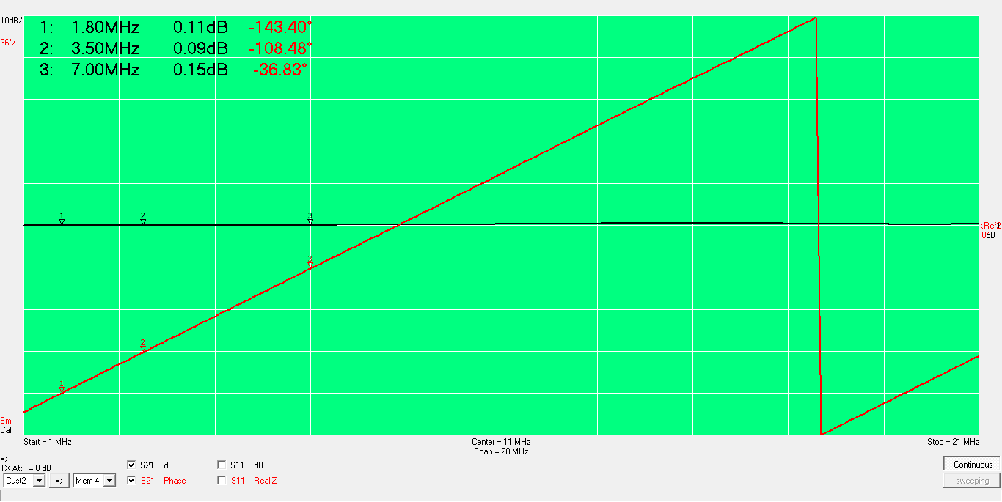
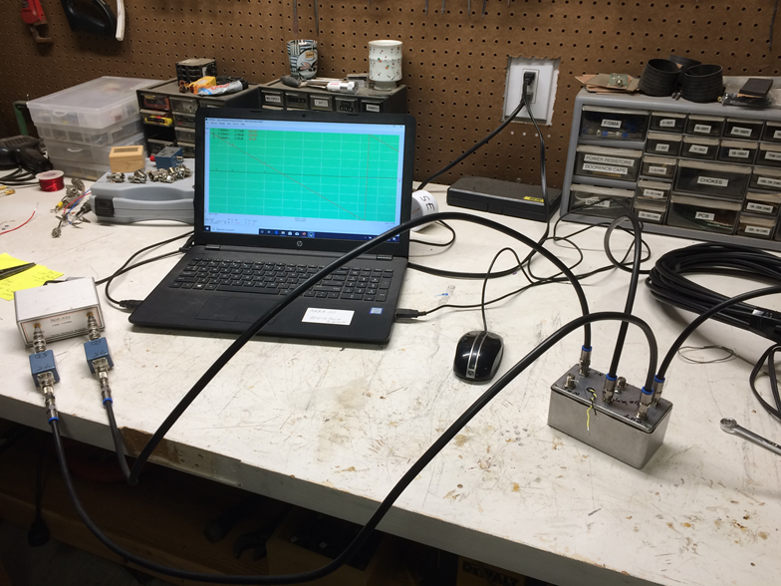
Phase box gives 143 degrees delay
0.1 dB greater loss in delay side

Slide 29
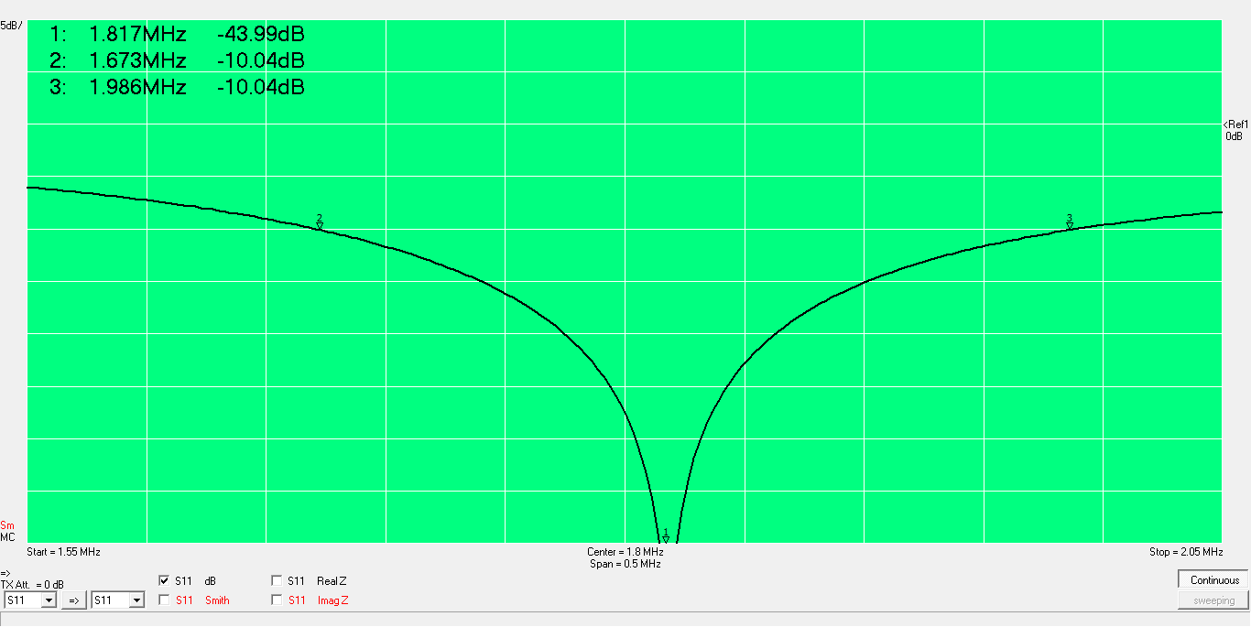
EU Return Loss- In shack measurement is good for verifying both dipoles are being combined

Slide 30
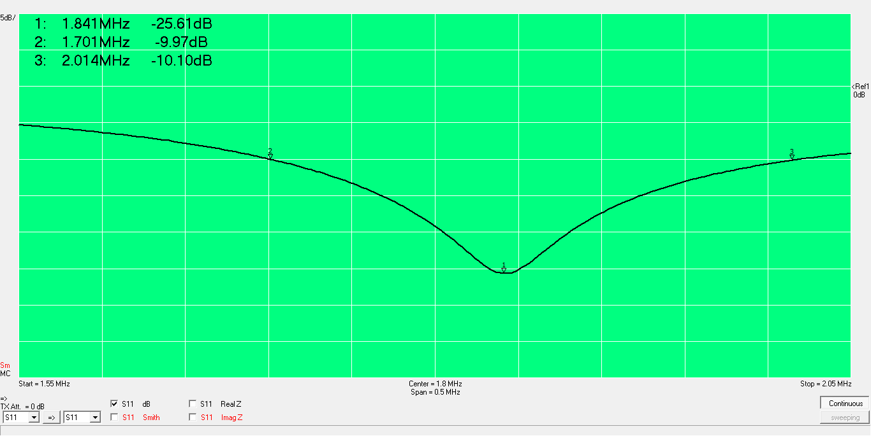
SE Rtn Loss

Slide 31
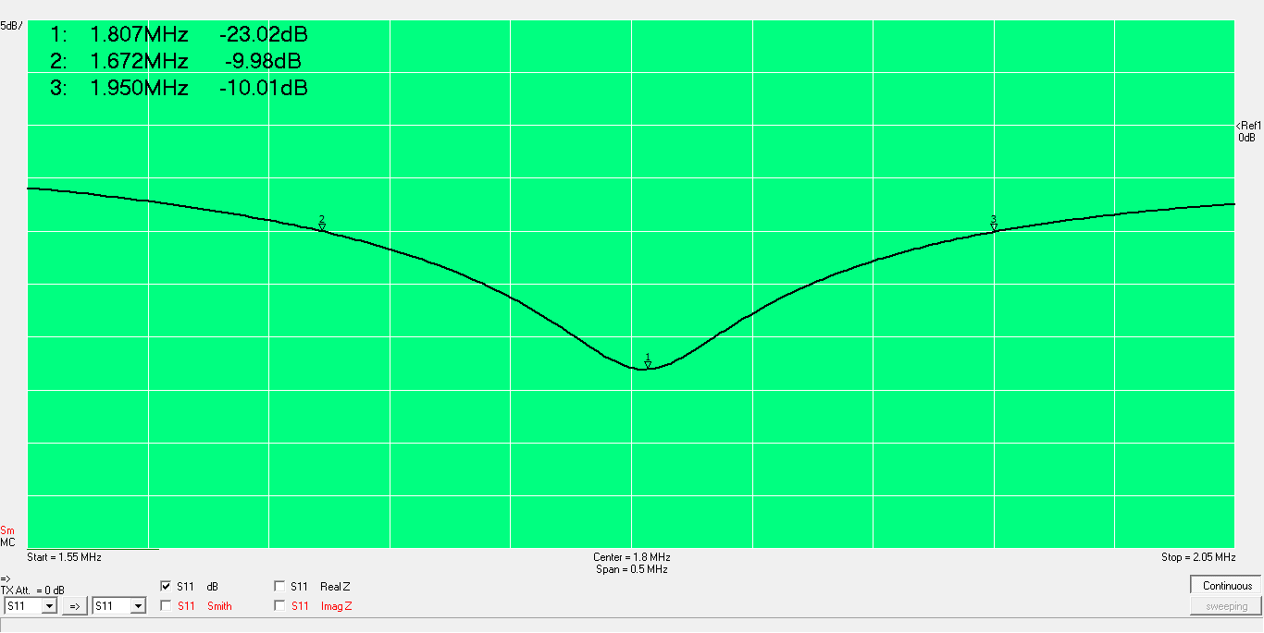
JA Rtn Loss

Slide 32
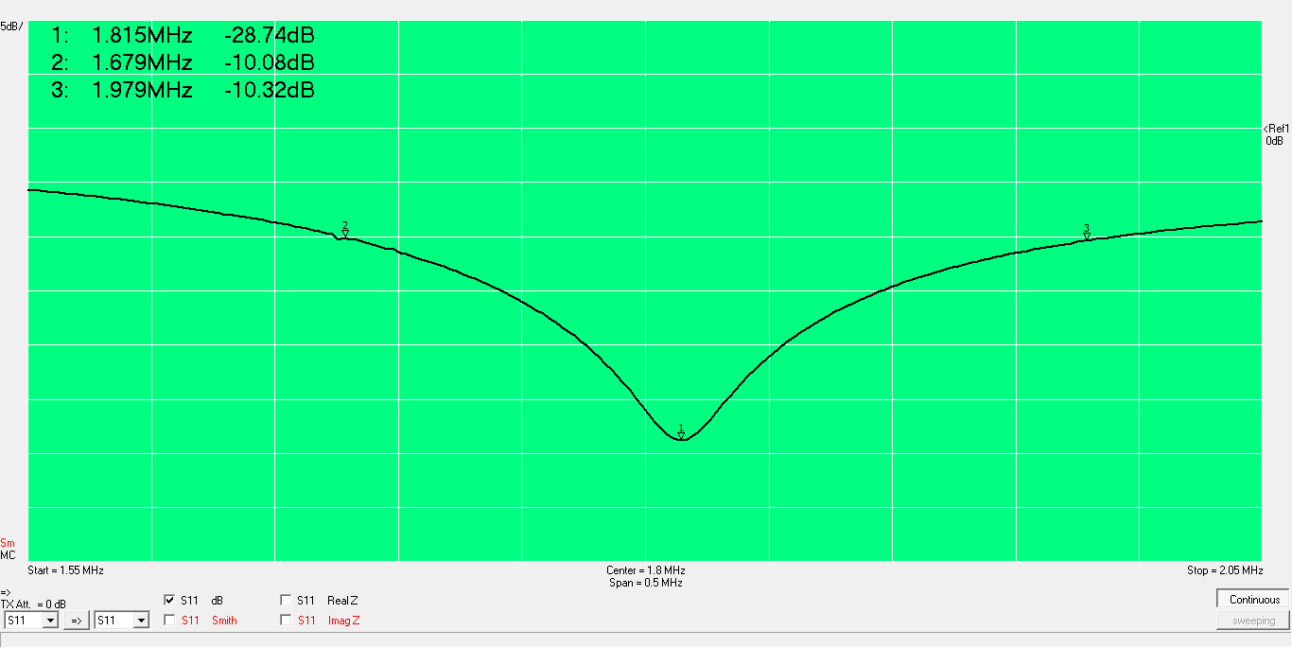
SE Rtn Loss

Slide 33
Results and thoughts
Front-to-back varies from impressive (15 to 20 dB) to nominal (5 dB) with fading
  Much better than the typical 6 to 12 dB with K9AY
Evaluation is subjective and difficult
Front-to-back isn’t really an issue for us on the west coast
  RDF is most important but hardest to demonstrate
  Good front-to-back is reassuring
My experience with RX antennas indicates the 2 to 4 dB expected SNR improvement over the TX antenna is difficult to demonstrate most of the time
  When noise pops up directivity can be a phenomenal help

Slide 34
Future work
Push button controller for direction control
Expand coverage to 80m
  Dual band matching network may limit bandwidth
  Diplexer driving parallel matching networks may be better option

Slide 35
Appendix

Slide 36
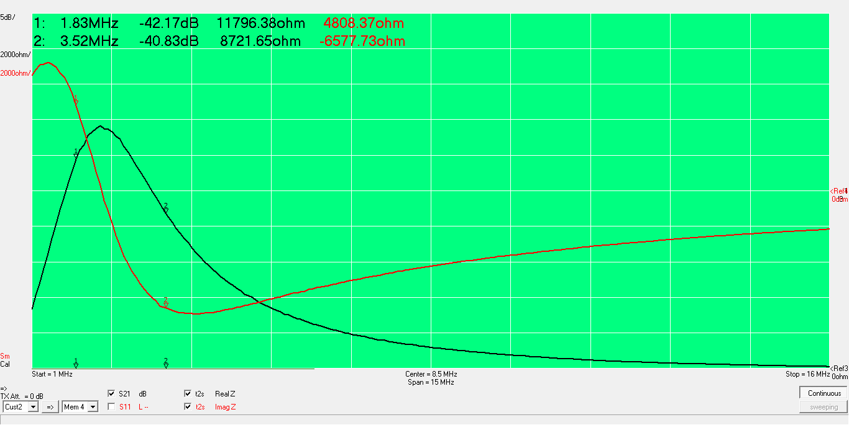
YCCC Choke (W1FV) is excellent for 160 and 80m

Slide 37
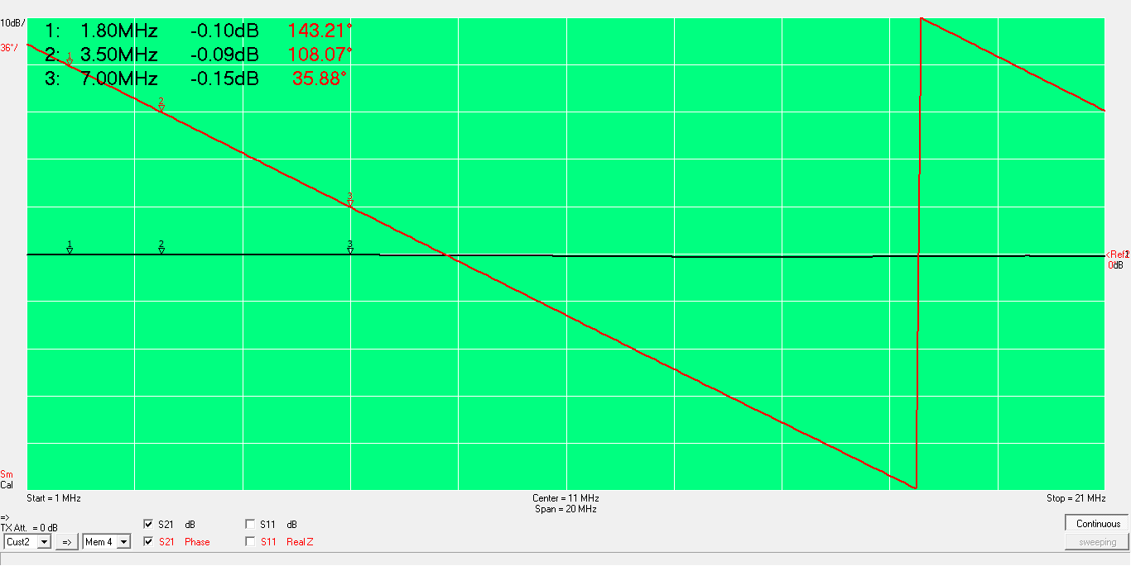
Calibration on corner antenna, NC end leads by 143 degrees
Points SE in NC phase

Slide 38
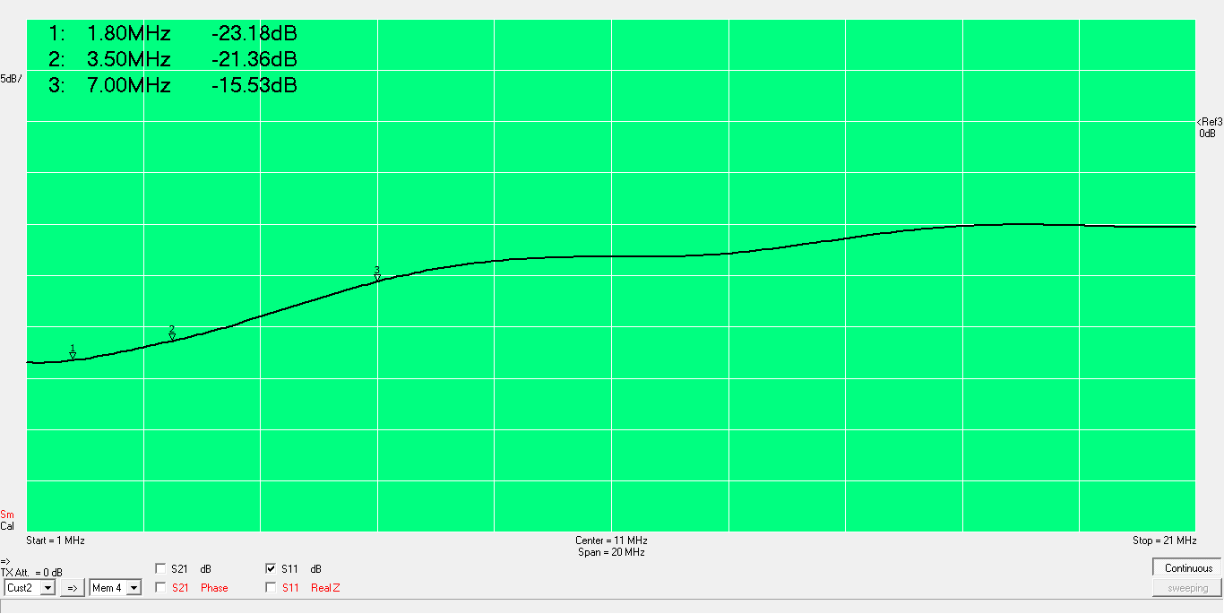
Output of phase control box return loss

Slide 39
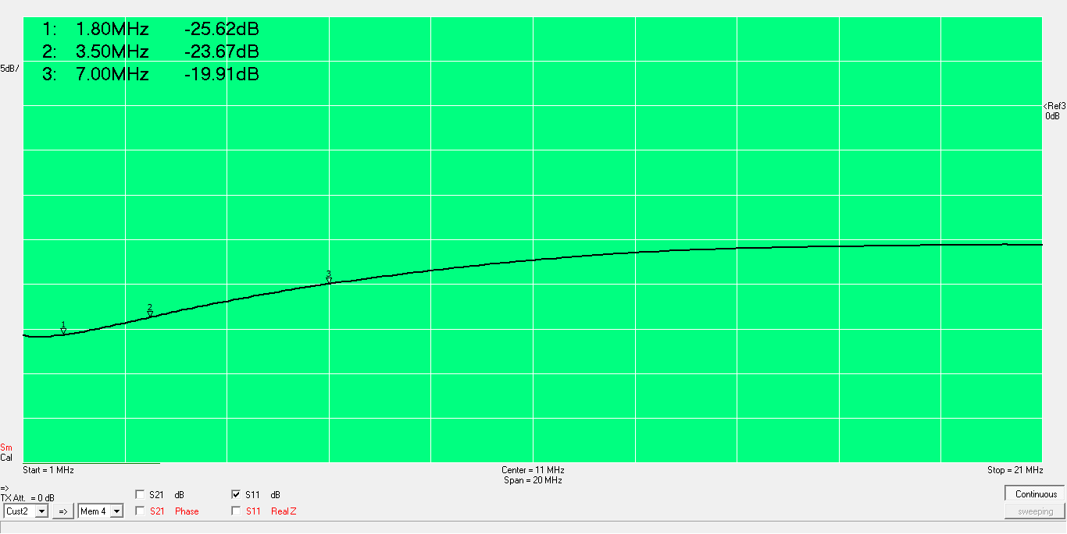
Leg antenna of phase control box return loss

Slide 40
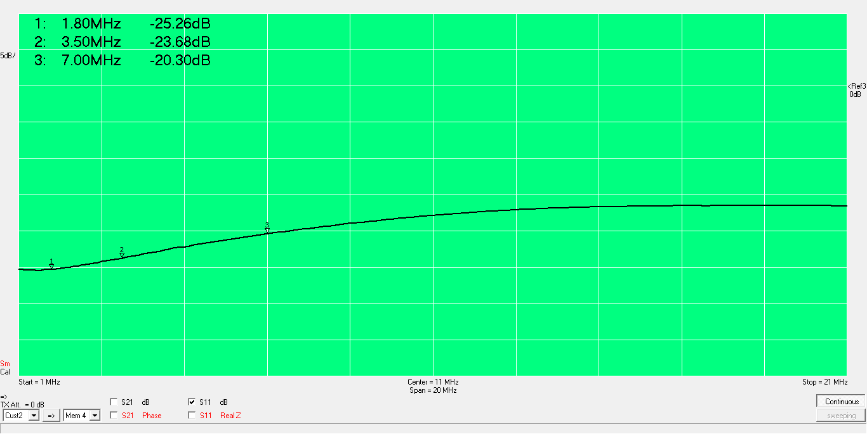
Corner antenna of phase control box return loss

Slide 41
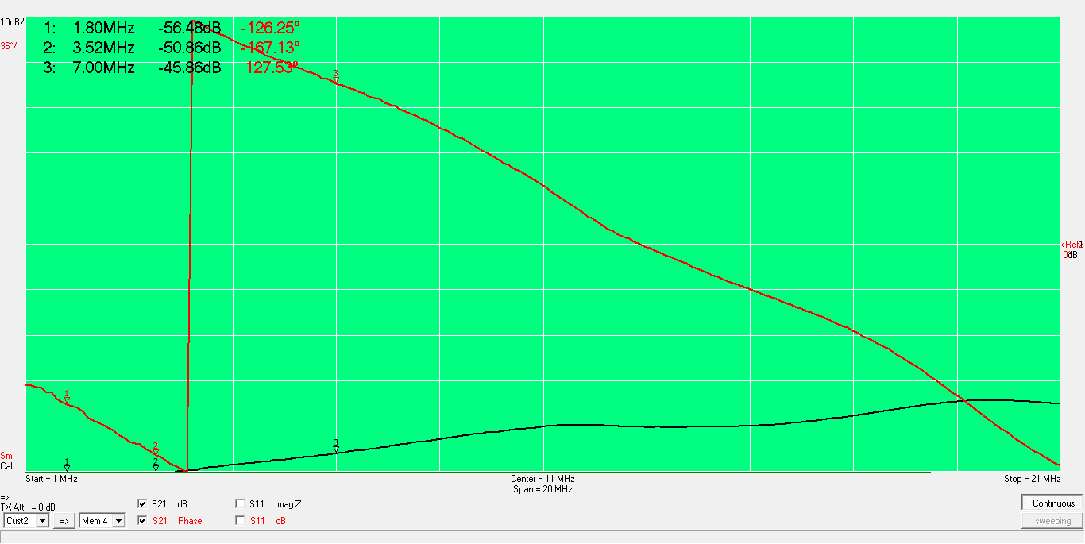
50 dB isolation to unswitched antenna

