Slide 1
Roof Solar Install- 5KW System
SolarEdge HD Wave Inverter SE6000HD-US
Sixteen 310 W panels
Sixteen SolarEdge P320 Optimizers
75 foot run from solar panels to inverter mounted beside ground level service panel

Slide 2
RFI Research
Little info available on specific systems components
FCC Part 15 Class B compliance on outputs of SolarEdge inverter and optimizer
Part B limits conducted emissions below 30 MHz and radiated emissions above
Per local building code, lines from solar panels to inverter must be run thru EMT
Shielded, no Loops: Should be no radiation from long connection
Like the inverter, optimizers use high current DC to DC converters and are a potential source of RFI

Slide 3
RFI Mitigation Plan
Install multi-turn ferrite chokes on input and output of optimizers
Contractor agrees to install for nominal cost
I provide suppressors
Contractor installs connectors on suppressors and does hookup on roof
Evaluate interference- Add additional suppressors at inverter if needed
Relatively easy at ground level

Slide 4
Suppressor Chokes
Material
Two (red, black) 200 foot spools of 10 AWG “Solar” Wire- $150
Thirty-five 2.4 inch Type 31 ferrite cores (Mouser)- $260
Design Procedure
Measure impedance of cores with various number of turns using VNA
Results indicated suppressors should be effective on 40 thru 10m, 80 and 160m not an issue since solar array not energized at night

Slide 5
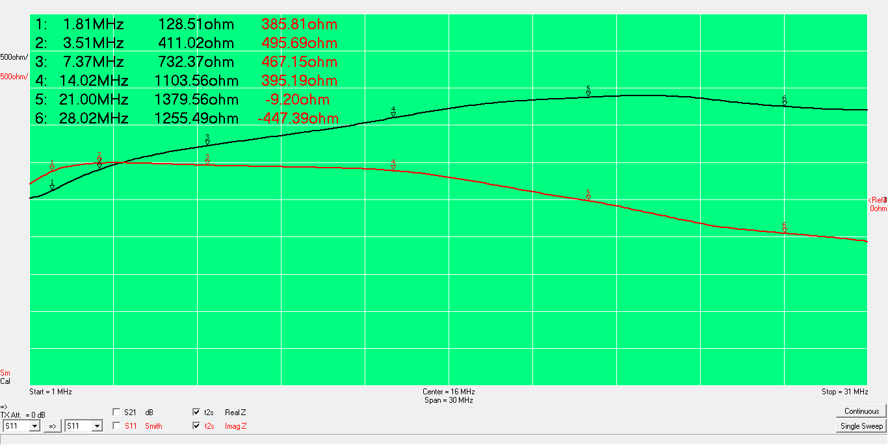
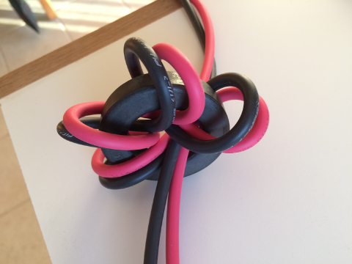
5T thru Type 31 Sample #1

Slide 6
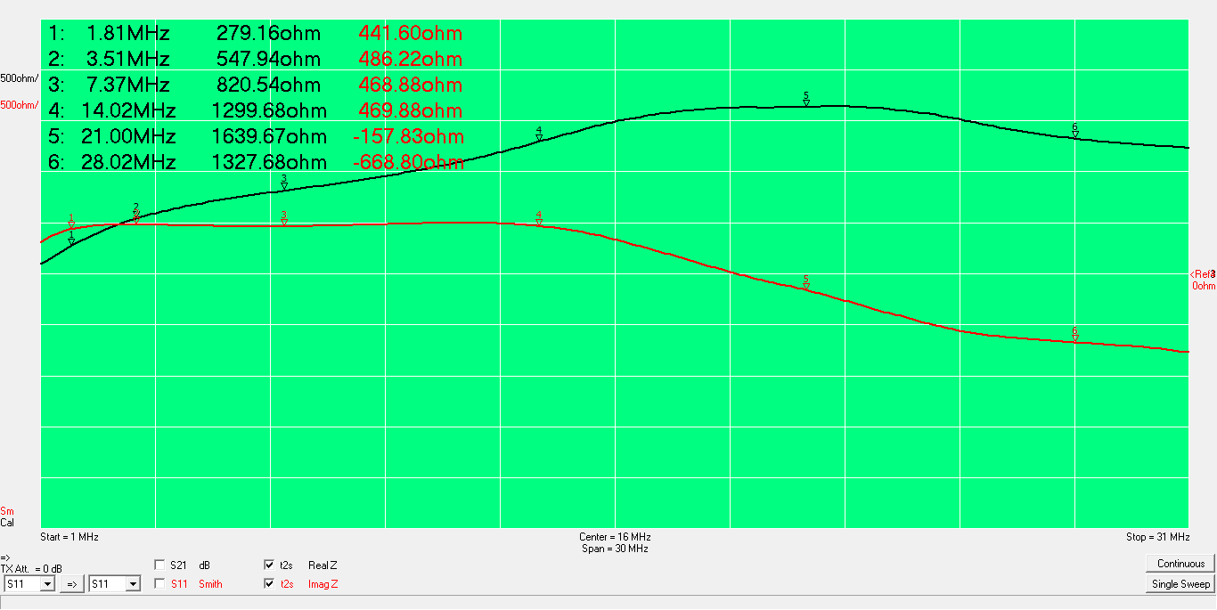
5T thru Type 31 Sample #2

Slide 7
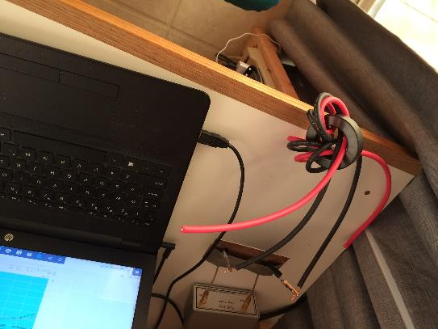
6T thru Type 31 Sample #1

Slide 8
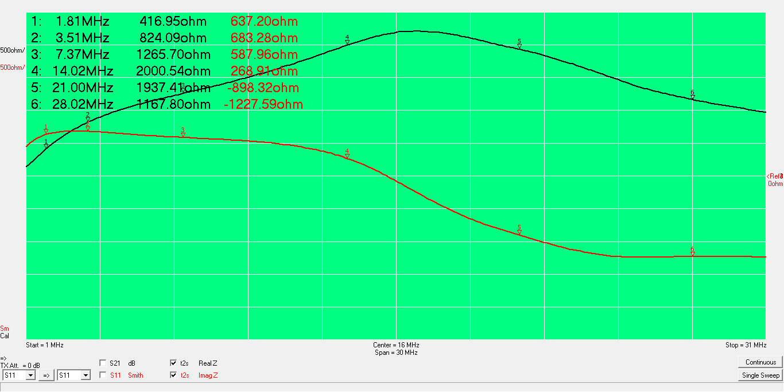
6T thru Type 31 Sample #2

Slide 9
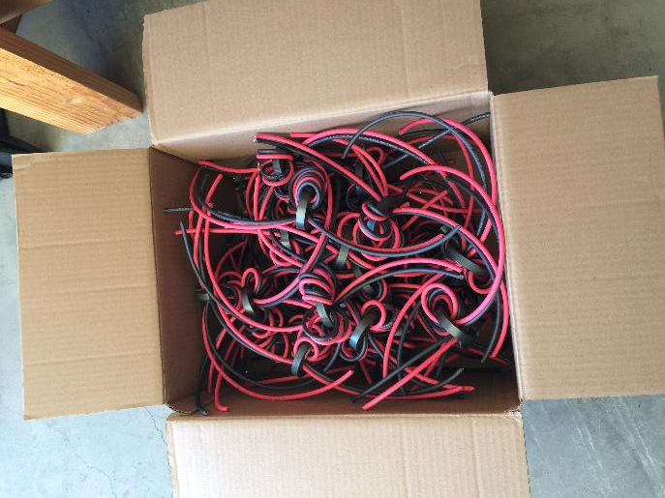
32 suppressors + Spares 6 turns on Type 31 Cores

Slide 10
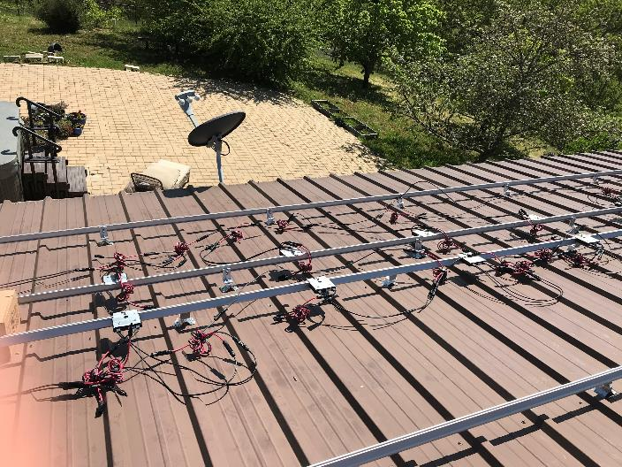
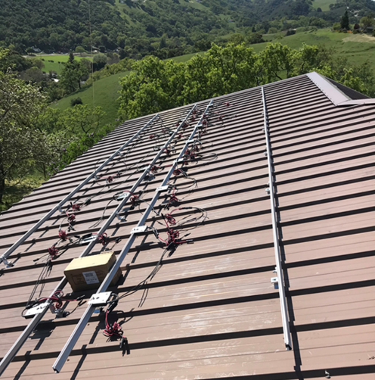
Suppressors on input and output of each optimizer (I wound up on the roof supervising)
Only one dropped (broken) core!

Slide 11
Results
Interference is detectable but not objectionable
160m birdie S6 in RX array that is a 30 feet from inverter, not detectable on TX array 300 feet away.
40 m hash S9 in 160/80m RX array, not detectable on beam 200 feet away
All detectable interference coming from the inverter based on probing with KX3
160m birdie goes away at night
Conclusion- Successful solar install
What effect did the suppressors have? We will never know but $400 was cheap insurance.

