Slide 1
HF Receiving Loops for Direction Finding (Noise Hunting)
Notes on small loops including shielded loops
160 thru 40m tunable multiturn loop
20m loop
6m loop

Slide 2
Small receiving loops ARRL Antenna book gives excellent explanation of directivity and polarization
Circumference < 0.085 wavelength
Length of sides
1.8 MHz 11.6 ft
3.5 MHz 6.0 ft
7 MHz 3.0 ft
14 MHz 1.5 ft
21 MHz 1.0 ft
28 MHz 9 inches
50 MHz 5 inches

Slide 3
Shielded Loop only Helps with Symmetry
Shield is receiving antenna
Inner conductor is part of feed system
Outer loop shield which receives signal is not “broken” by feed
Aides symmetry
No feedline “pickup”
I don’t agree with ARRL Antenna book statements about asymmetric stray capacitance
30 to 40 dB nulls possible for shielded loops
15 to 20dB nulls more typical for “regular” loops (good enough for DF)

Slide 4
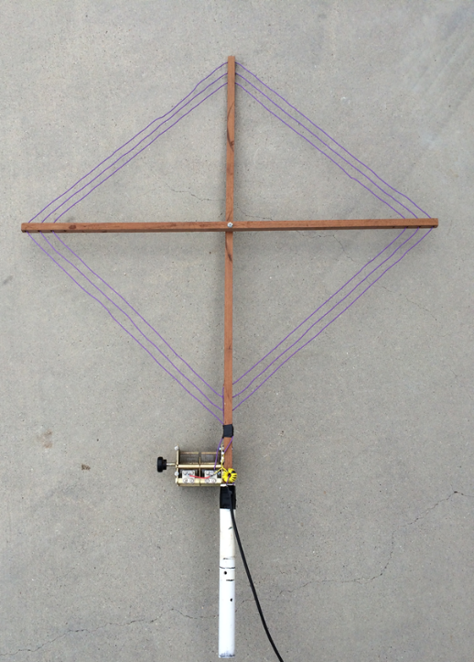
160- 40m direction finding
loop for locating RFI

Slide 5
Design
Determine capacitance range of air variable on hand
Measure inductance of single turn of hand help loop
Determine number of turns required to resonate with available capacitor at 160m
Match with step down transform using Type 61 ferrite core ala N6RK

Slide 6
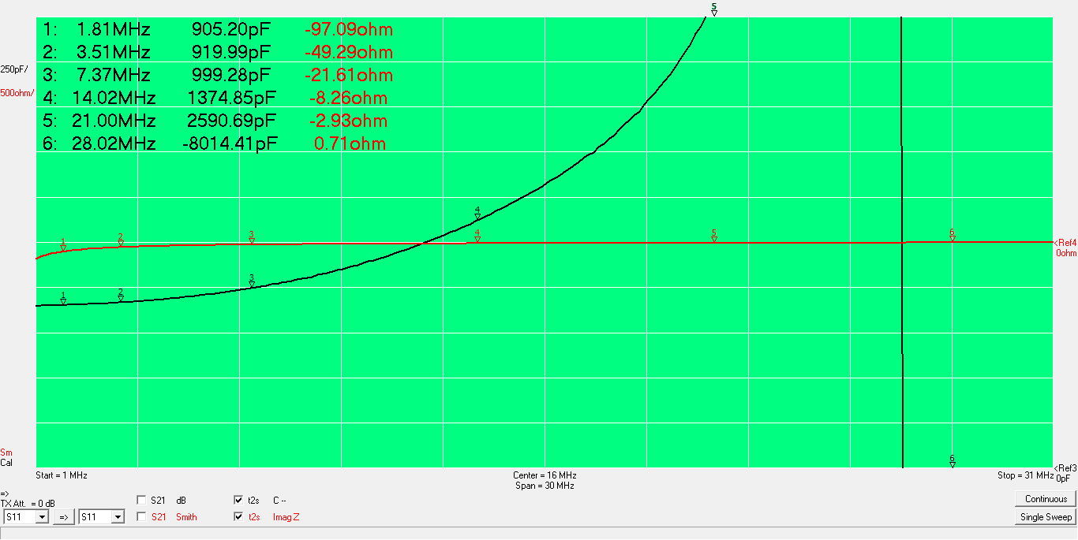
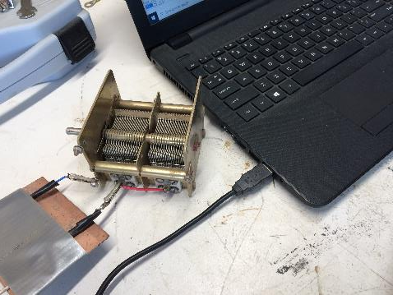
Max cap- 900 pF, -j97 @1.8 MHz Need loop inductance greater than j100 Ohms

Slide 7
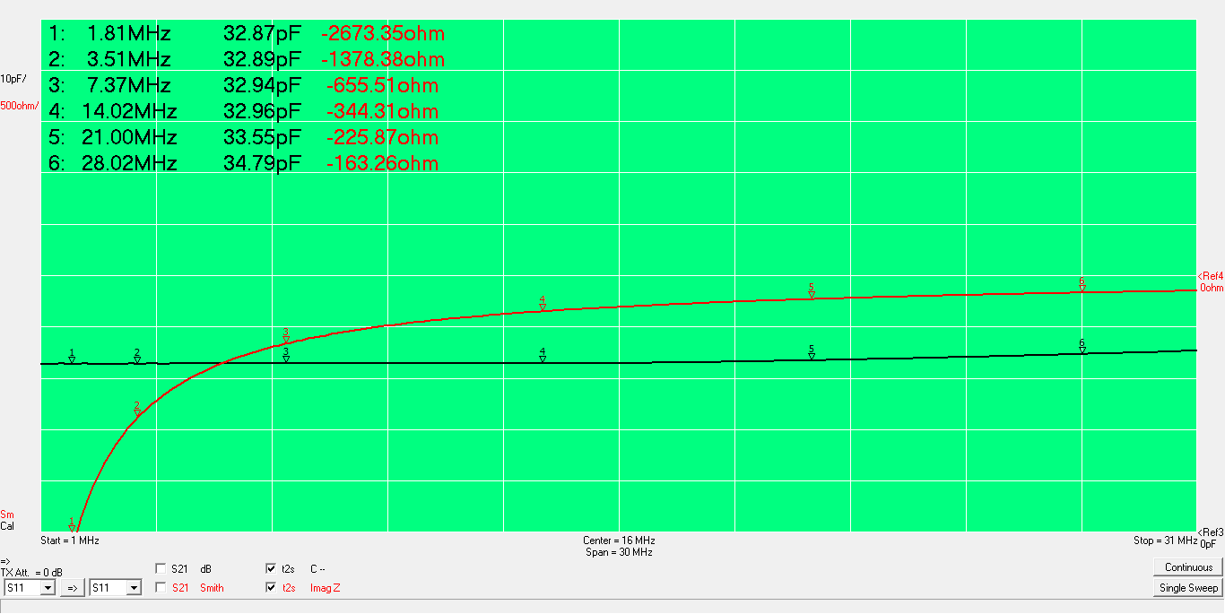
Min cap- 32 pF, -j700@ 7 MHz

Slide 8
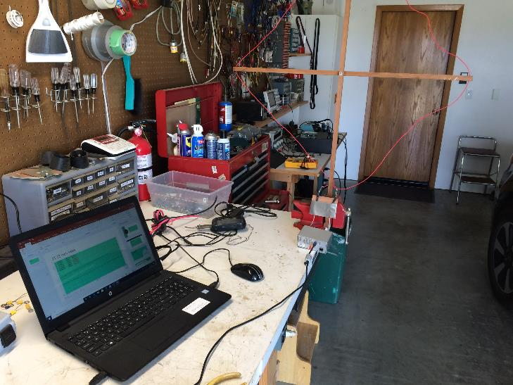
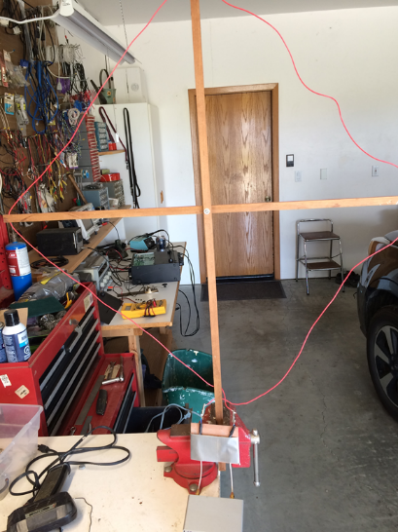
Measuring 1 turn loop

Slide 9
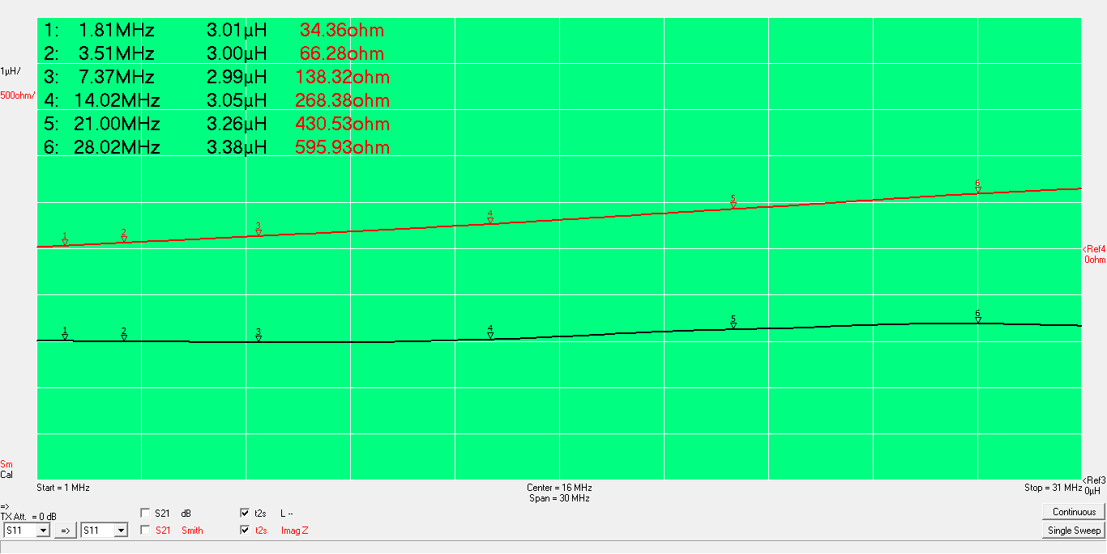
1T 22 inch sides- 3uH, j34 Ohms @ 1.8 MHz Need 3 turns for j100 Ohms

Slide 10
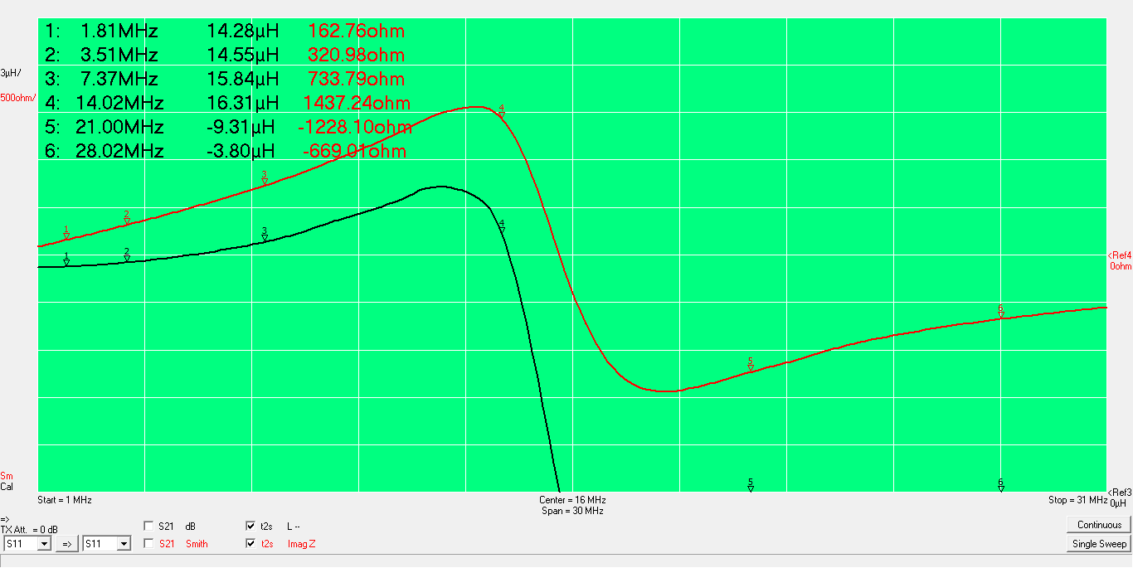
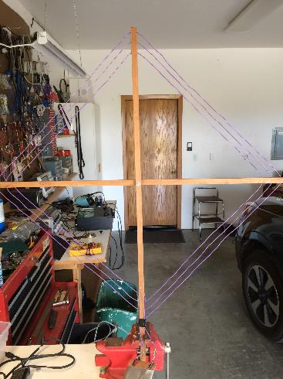
3T required to resonate with air variable

Slide 11
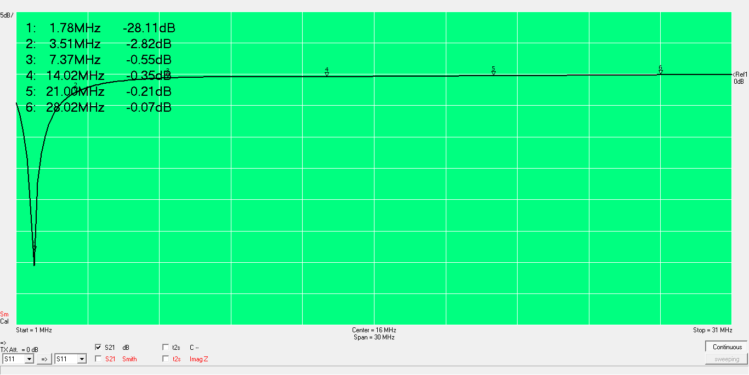
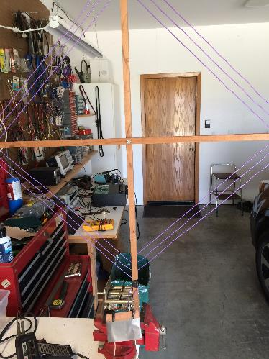
S21 (parallel resonance) loop tuned to 1.8 MHz

Slide 12
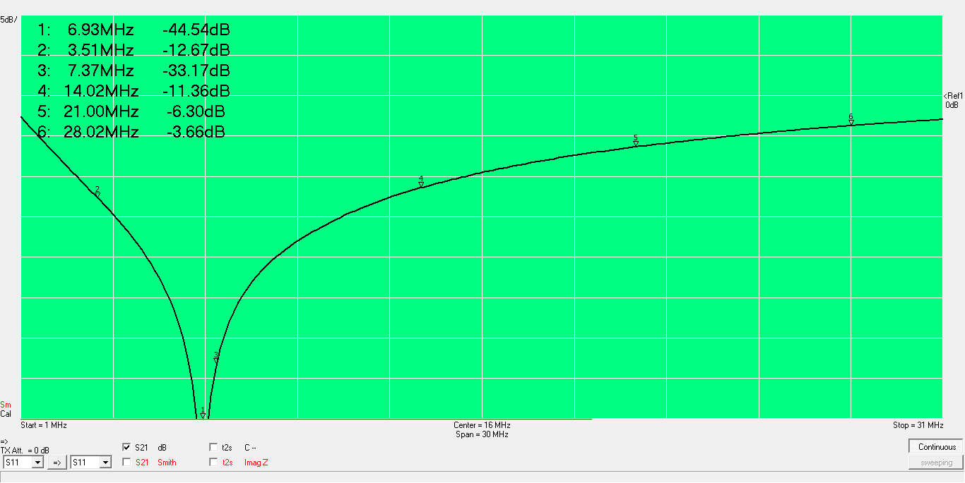
S21 min cap, doesn’t quite reach 40m

Slide 13
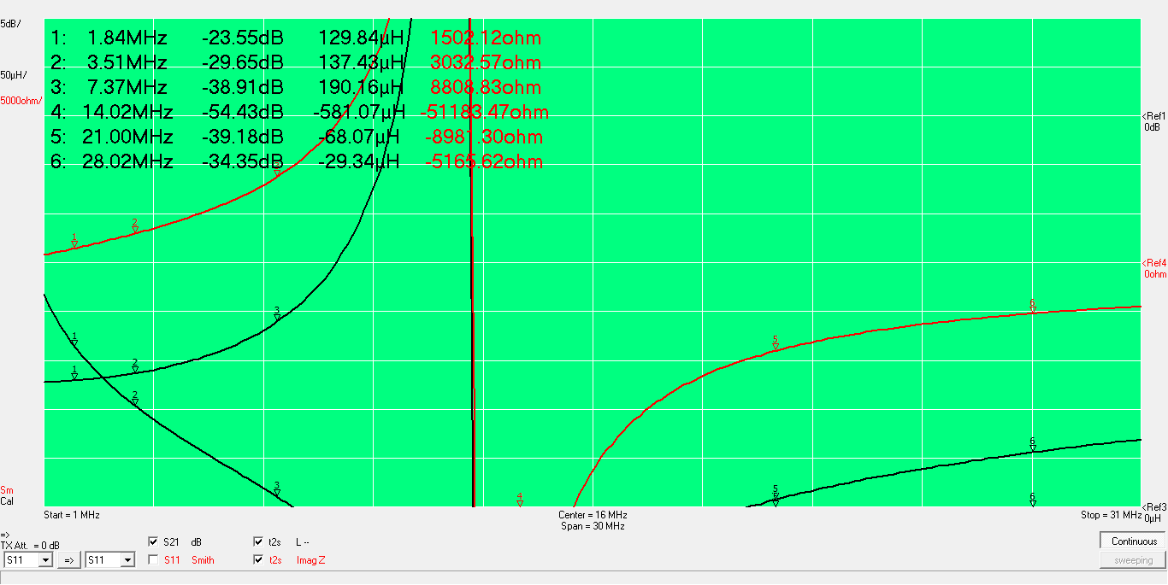
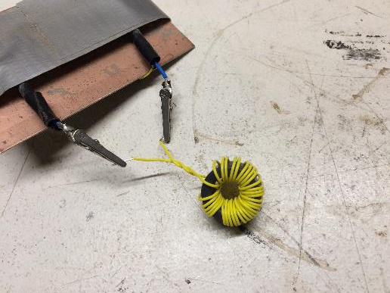
Matching transformer secondary >125 uH, SRF 13 MHz
32T, Type 61 core

Slide 14
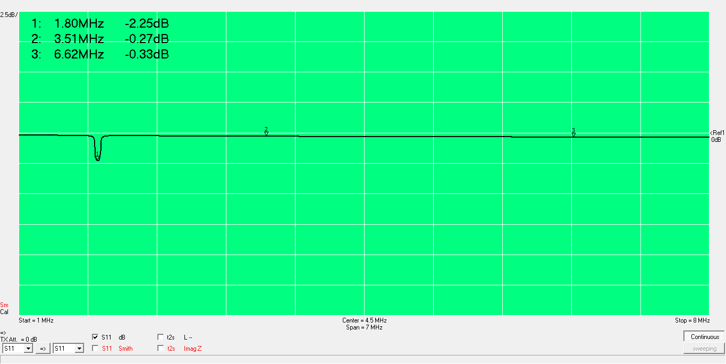
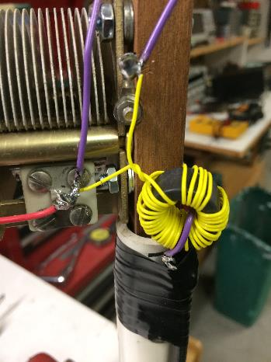
Matching at 1.8 MHz, single turn secondary Could use more turns on primary but this will give good enough efficiency for RX

Slide 15
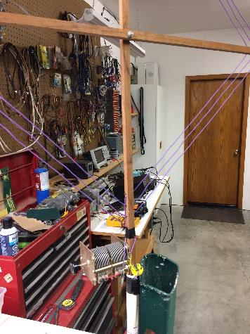
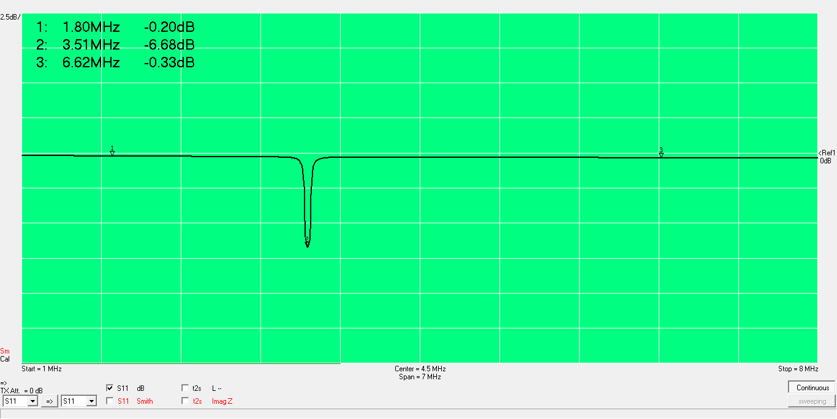
Matching at 3.5 MHz

Slide 16
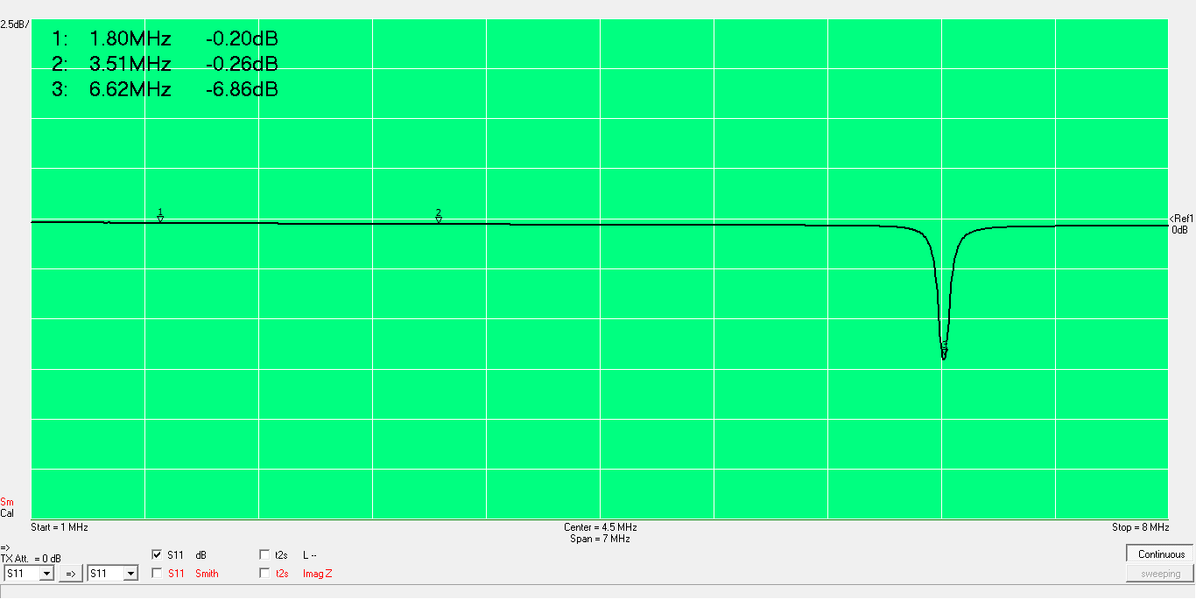
Matching at 6.6 MHz (max tuning frequency)

Slide 17
Conclusions
DF loop gives nulls of >15 dB from 160 to 40 meters
Bandwidth is narrow (tuning is sharp) at 160m
Greater gain at 40m overcomes mismatch loss. Lower Q makes tuning uncritical

Slide 18
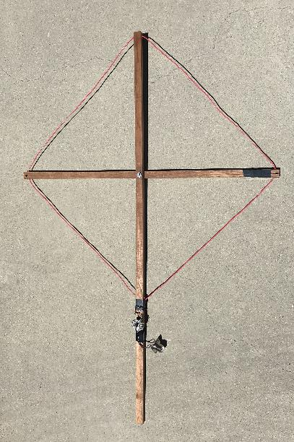
20m DF loop

Slide 19
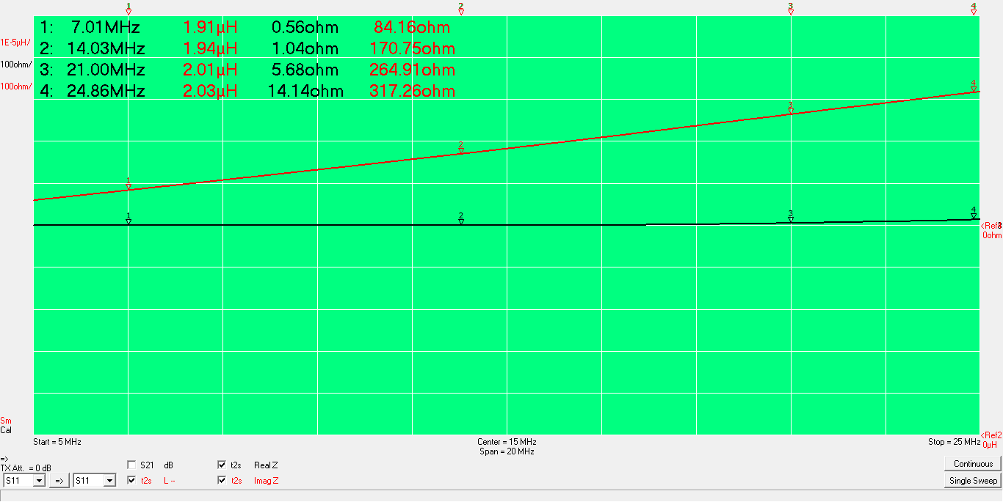
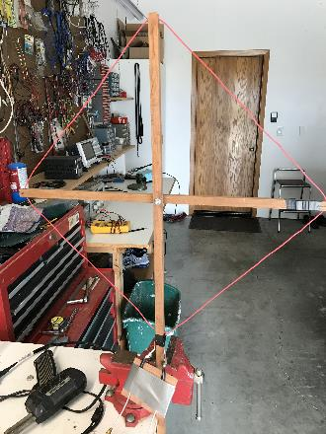
22 inch sides: 2 uH, j170 at 14 MHz

Slide 20
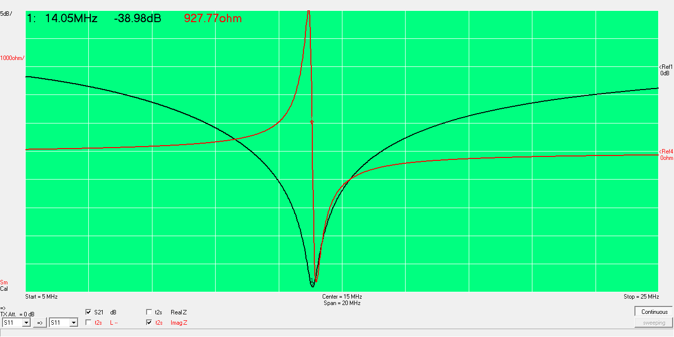
Resonated with 68 pF

Slide 21
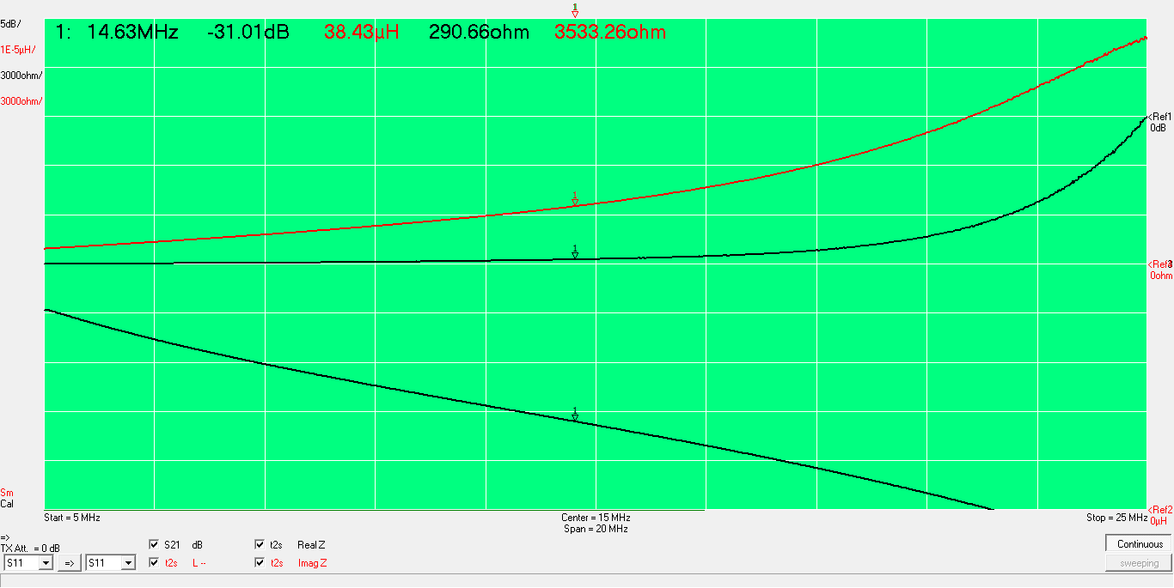
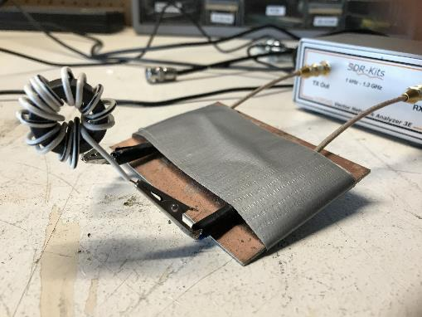
15T primary on FT-82A-61 core 3500 Ohm reactance, SRF= 25 MHz

Slide 22
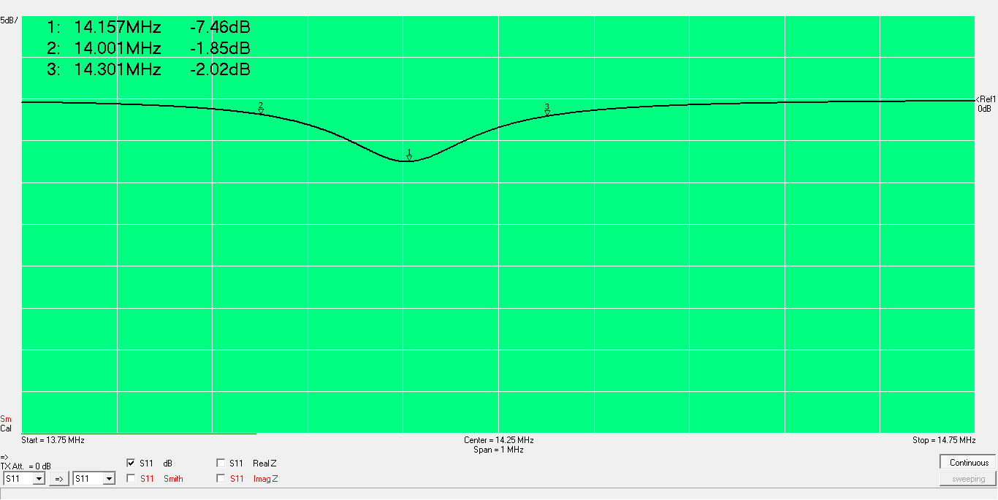
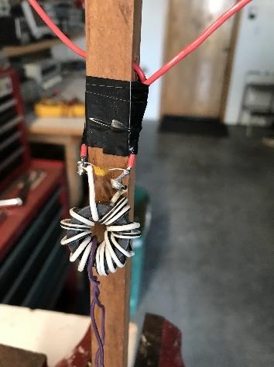
1T secondary

Slide 23
Results
>15 dB nulls

Slide 24
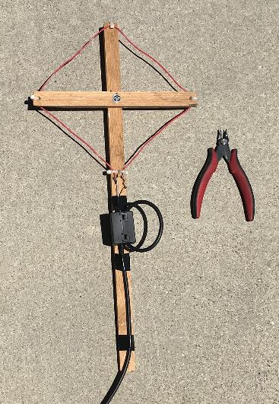
50 MHz Loop

Slide 25
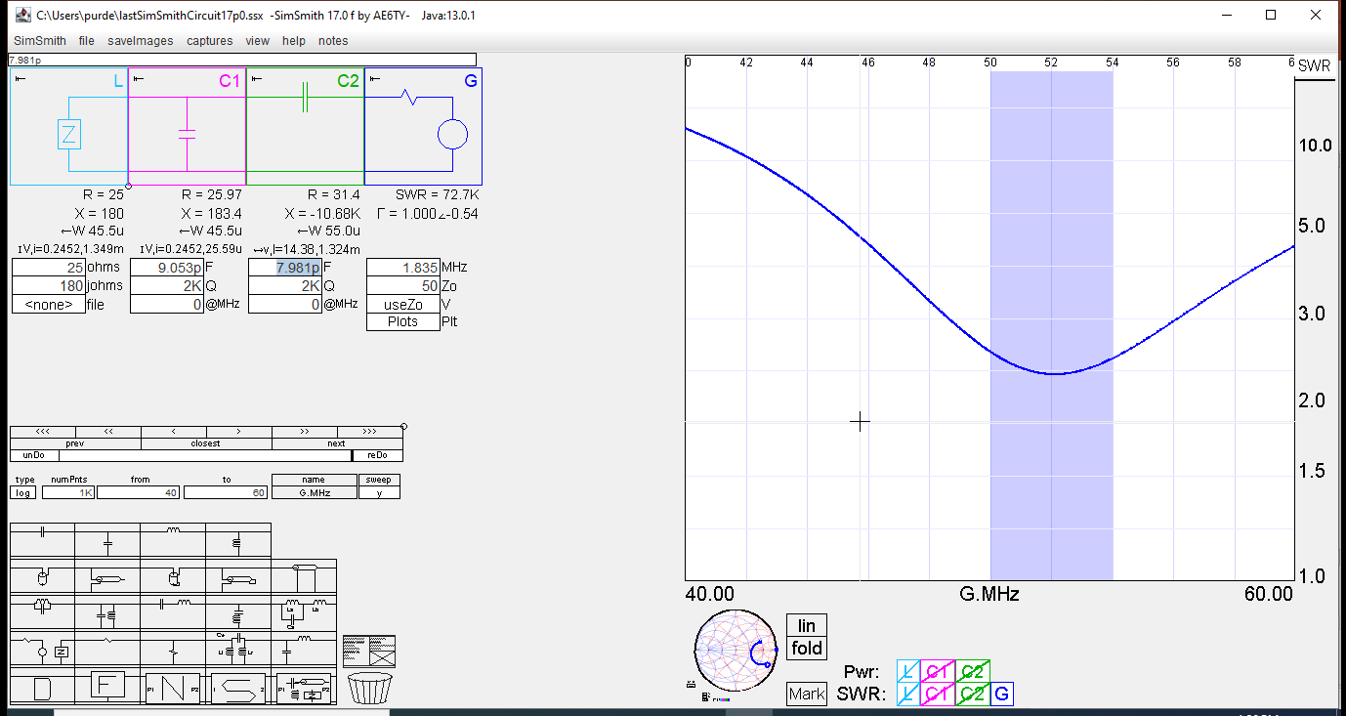
Match using parallel capacitor followed by series capacitor High ratio transformers are difficult at 50 MHz

Slide 26
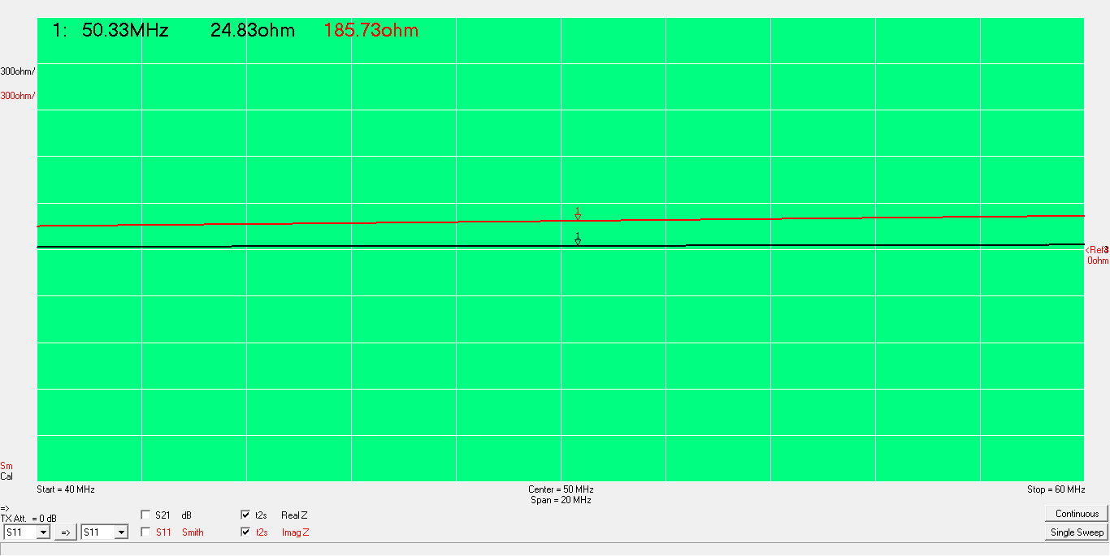
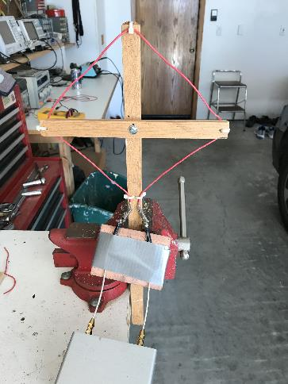
6 inch sides: j180 Ohms at 50 MHz

Slide 27
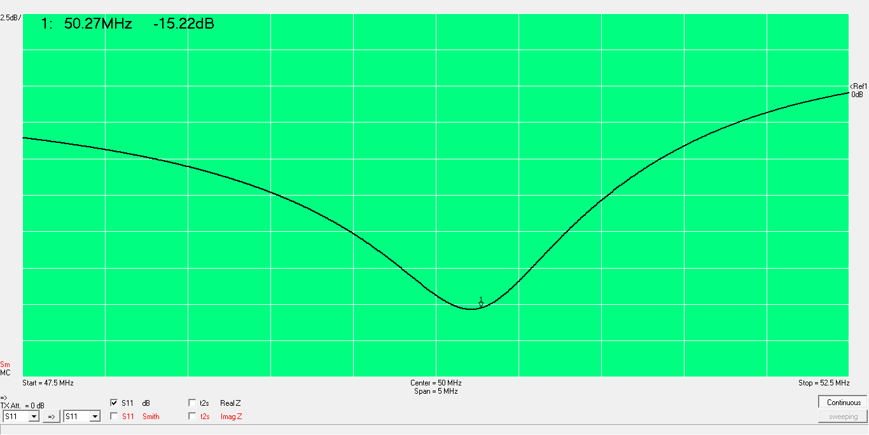
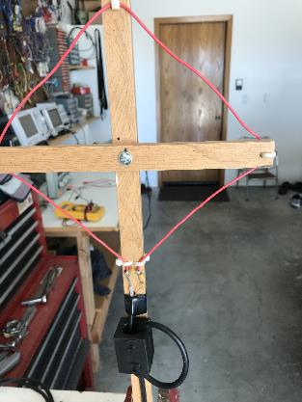
Matching with 10 pF parallel, 5 pF series ceramic caps

Slide 28
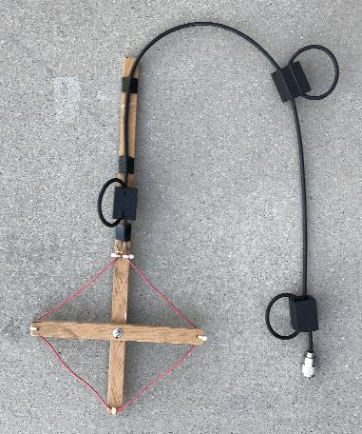
Results
Matching worked well
Sensitive to common mode on coax shield
Poor directivity
Minimizing area of matching network didn’t help
Added two additional Type 31 clamp on ferrites
15 dB nulls, similar to other loops

