Slide 1
High efficiency vertical for 7, 14 and 21 MHz
2nd antenna for SO2R operation
Vertical polarization to increase isolation to primary (beam) antennas
Omni pattern for quick QSO’s without rotating beam
Radiation angles below 15-20 degrees needed (from statistics in HAFTA)
Rather than use a 15m trap, operate as a quasi 5/8 wavelength improving gain by several dB

Slide 2
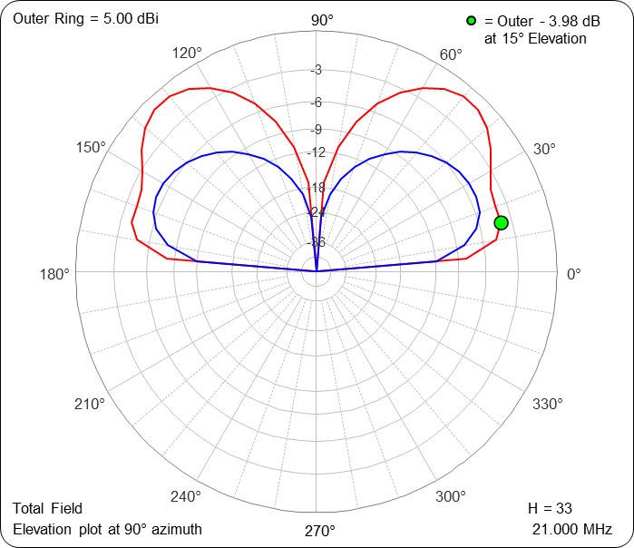
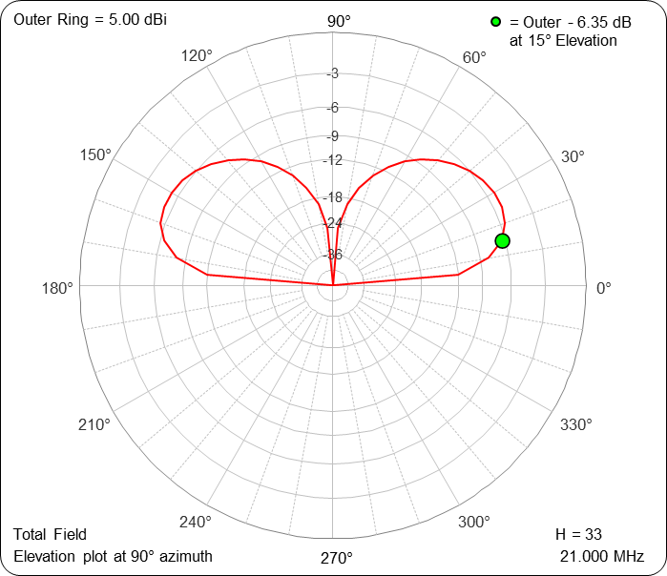
34 foot vertical at 7 and 21 MHz 21 MHz has less ground loss
¼ wavelength vertical for 21 MHz (11.5 ft)
-1.4 dBi gain at 15 degrees
21 MHz
7 MHz
34 ft vertical has 1.0 dBi gain at 15 degrees

Slide 3
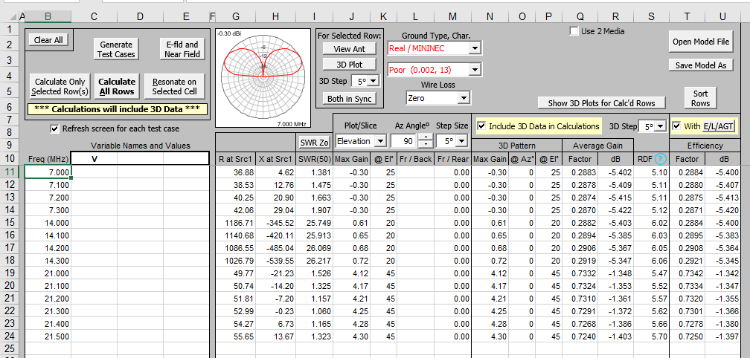
34 foot vertical at 7, 14 and 21 MHz Note increased efficiency at 21 MHz in far right column

Slide 4
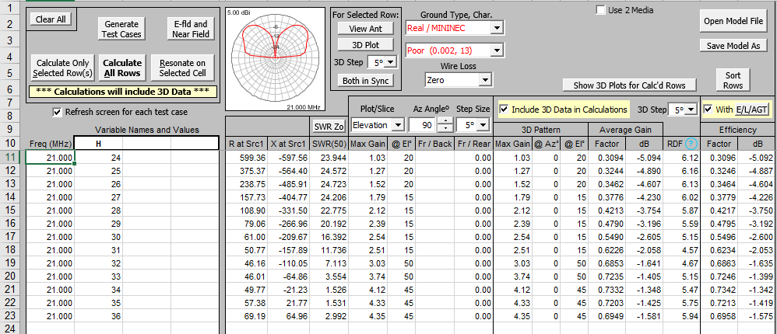
At 21 MHz efficiency of a vertical monopole increases with height from 24 to 34 feet

Slide 5
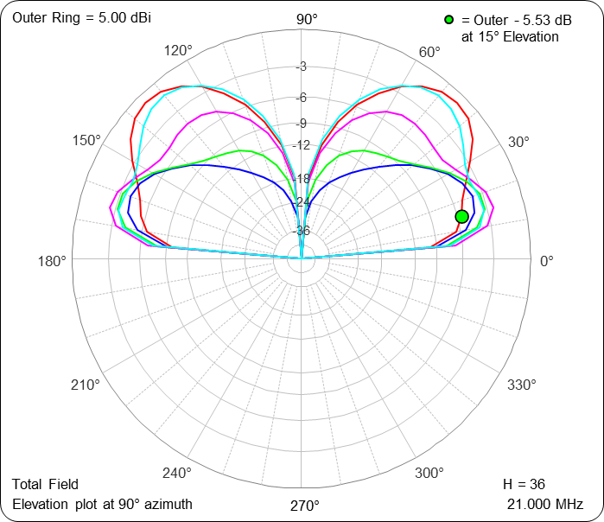
Radiation pattern of vertical monopole at 21 MHz l= 24,27,30, 33 and 36 feet
36 ft
Low angle radiation (15 degrees)peaks
at 2.5 dBi around 30 feet in length and
then decreases rapidly as power shifts
to higher lobes
33 ft
27 ft
30 ft
24 ft

Slide 6
Design
Challenge: Make 15 meter radiation pattern more like a 5/8 wave antenna by lowering physical height of current maximum while maintaining low enough feed-point impedance to match antenna on all three bands with one matching network
Solution: Single 20m trap. Adding top loading below trap lowers height of 15m current peak while lowering feed-point impedance. Top loading is highly efficient for 20m radiator and has minimal effect on 40m.

Slide 7
27.5 foot high efficiency vertical for 7, 14 and 21 MHz
27.5 ft
20m trap
9.0 ft
7.5 ft
20m top loading stubs
(5.5 ft long)
0 ft
Feedpoint

Slide 8
Design methodology and constraints
Recycle tee bar from old Force 12 vertical dipole for first section to loading stubs (7.4 feet long)
Design for 30 to 70 Ohms capacitive reactance at resonance on 20 and 40m. Use hairpin matching of the approximately 30 Ohm real part
Test antenna affixed to a ground stake allowing ease of tuning
Account for 20 to 30 Ohm ground loss
Resonances will be unaffected
Install on roof with hairpin and final tune

Slide 9
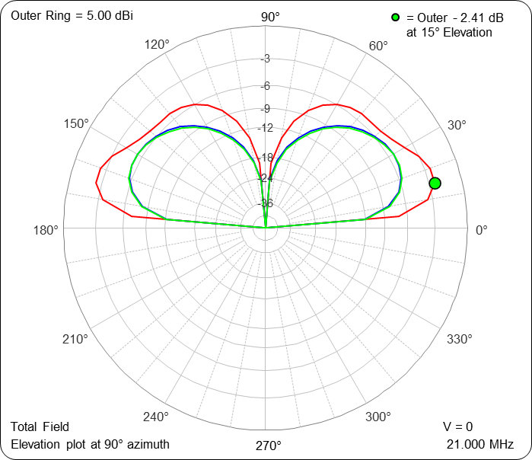
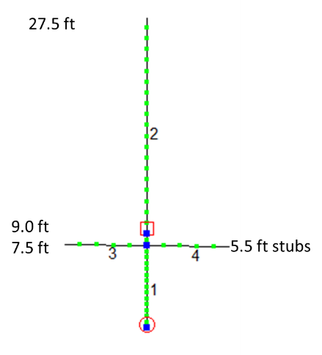
7 and 14 MHz gain is -1.4 dBi, 21 MHz gain is +2.6 dBi at 15 degrees elevation over poor ground
21 MHz
7, 14 MHz

Slide 10
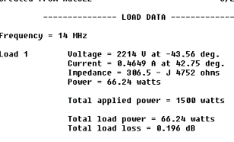
Simulation details

Slide 11
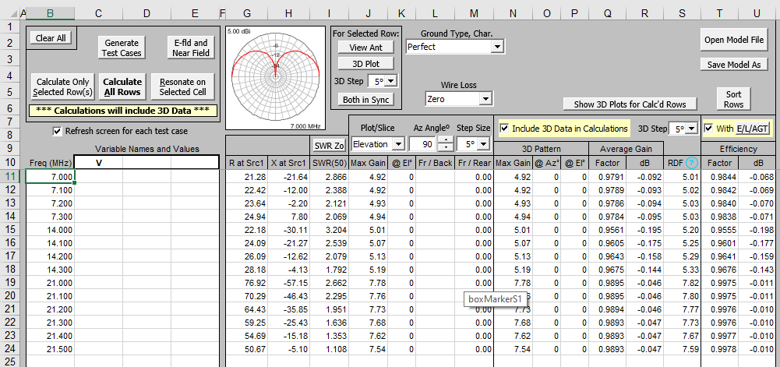
Simulation with perfect ground shows trap loss <0.2 dB for Q= 200 inductor

Slide 12
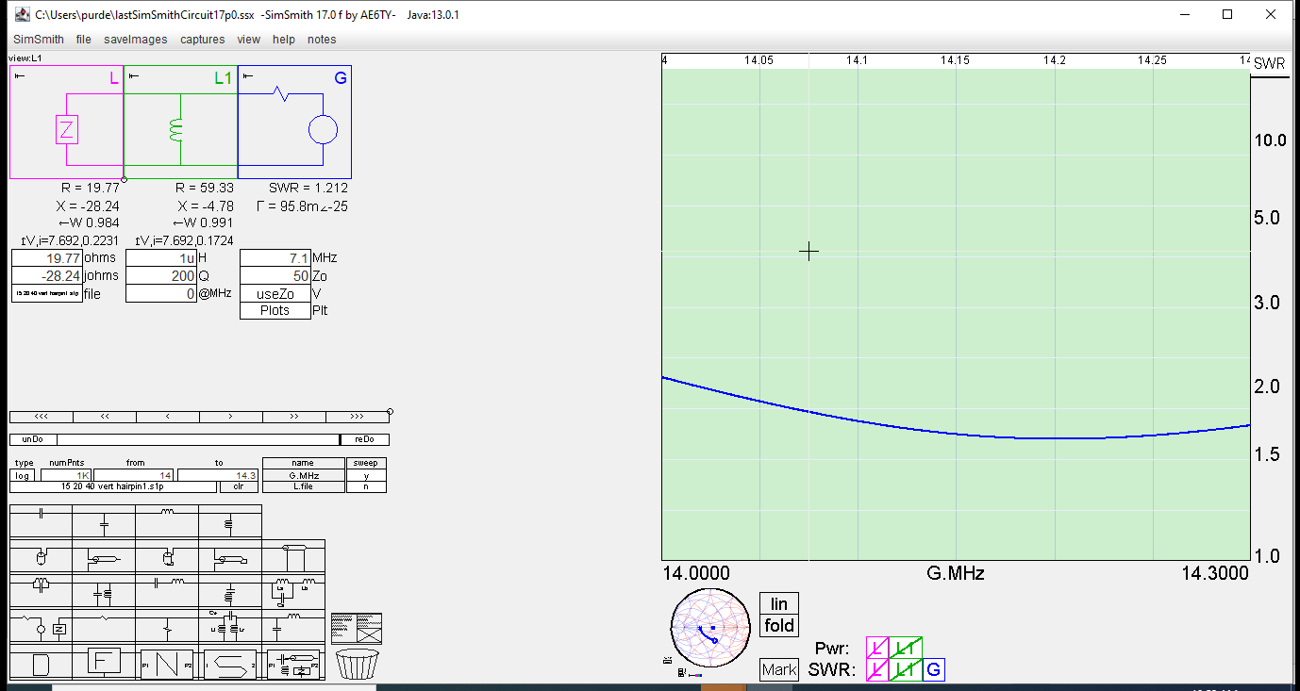
Simulated result using a 1 uH Hairpin (20m)

Slide 13
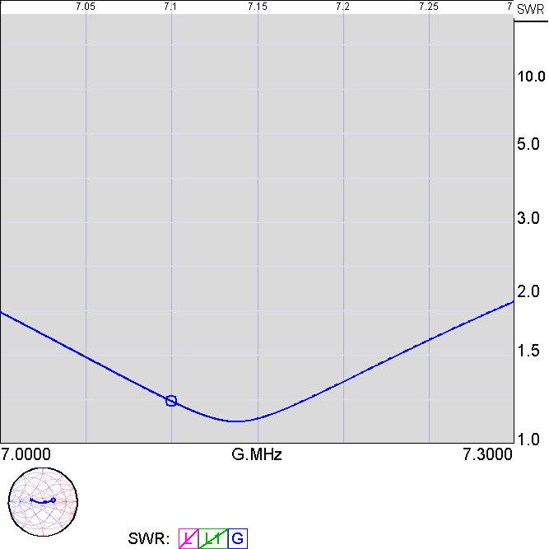
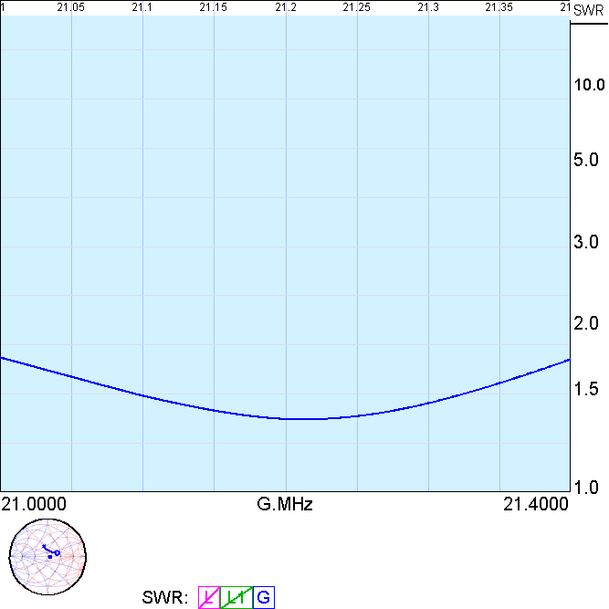
40 and 15m simulated result with 1 uH Hairpin

Slide 14
As built
7’ 4” to tee
Tee to coil 20”
Length 27.5’ adjustable to 31’

Slide 15
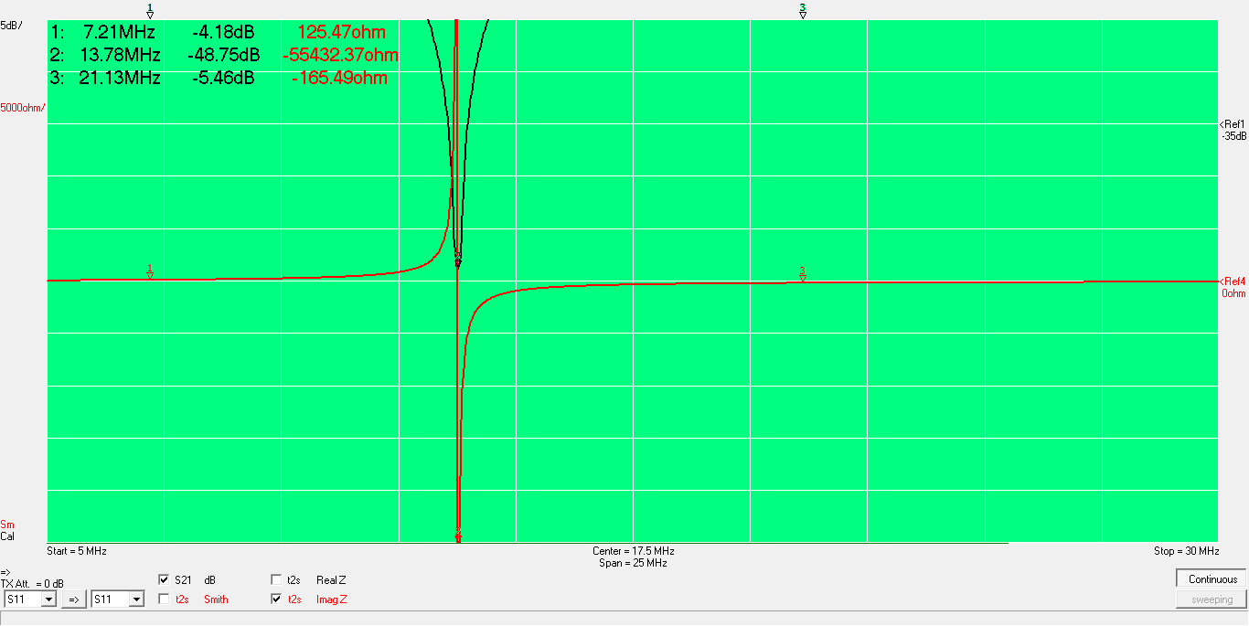
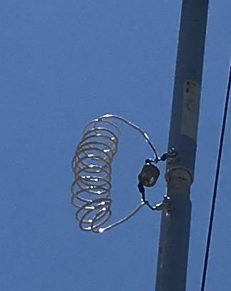
Trap adjusted for 13.78 MHz (2.0 uH, 67 pF) Resonance below band minimizes losses

Slide 16
Tuning rules
Shortening stubs raises 15m impedance and primarily 20m frequency
5.5 to 6 foot optimum stub length
Length= 27 feet, longer lowers 21 MHz real part but becomes inductive

Slide 17
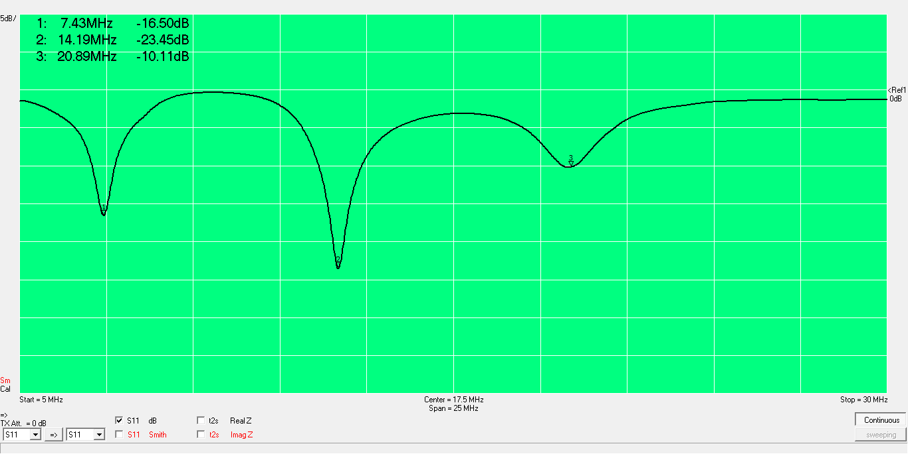
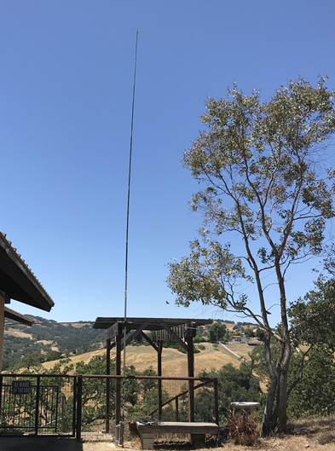
Antenna mounted to ground stake for initial tuning 68 inch stubs, 15 to 25 Ohm ground loss

Slide 18
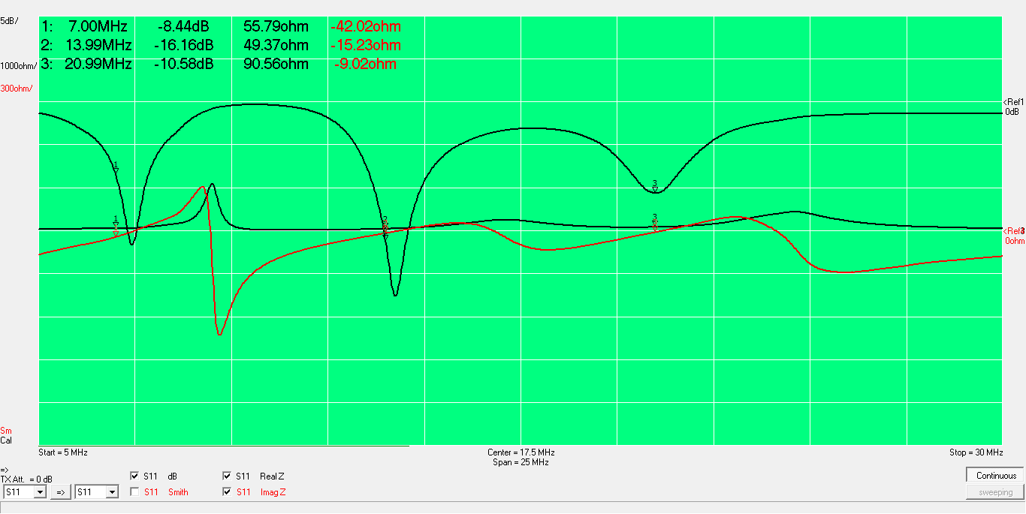
68 inch stubs- should hairpin match OK with lower ground losses of roof mounting

Slide 19
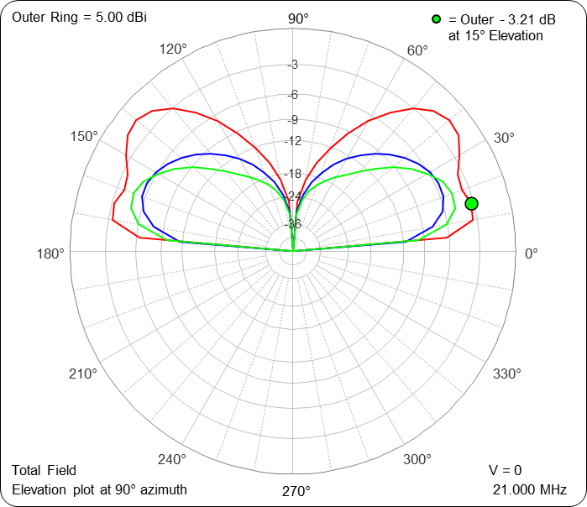
Will roof mounting affect low angle lobes? Vertical raised to 15 feet improves 20m slightly while 15m degrades slightly
See K9YC’s study of raising HF verticals
above ground

Slide 20
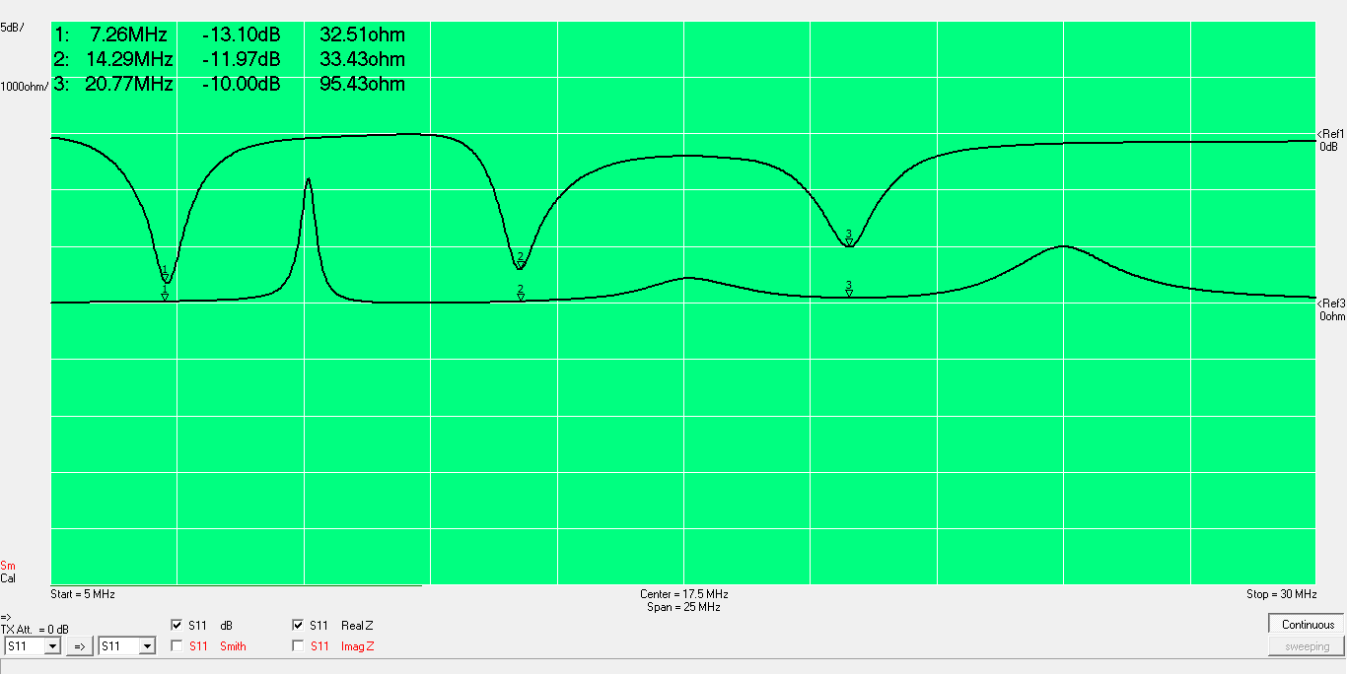
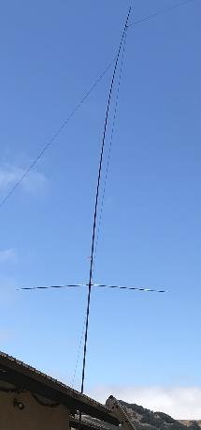
Roof mounted antenna Real part is 33 Ohms on 40 and 20m (measured at feed point)

Slide 21
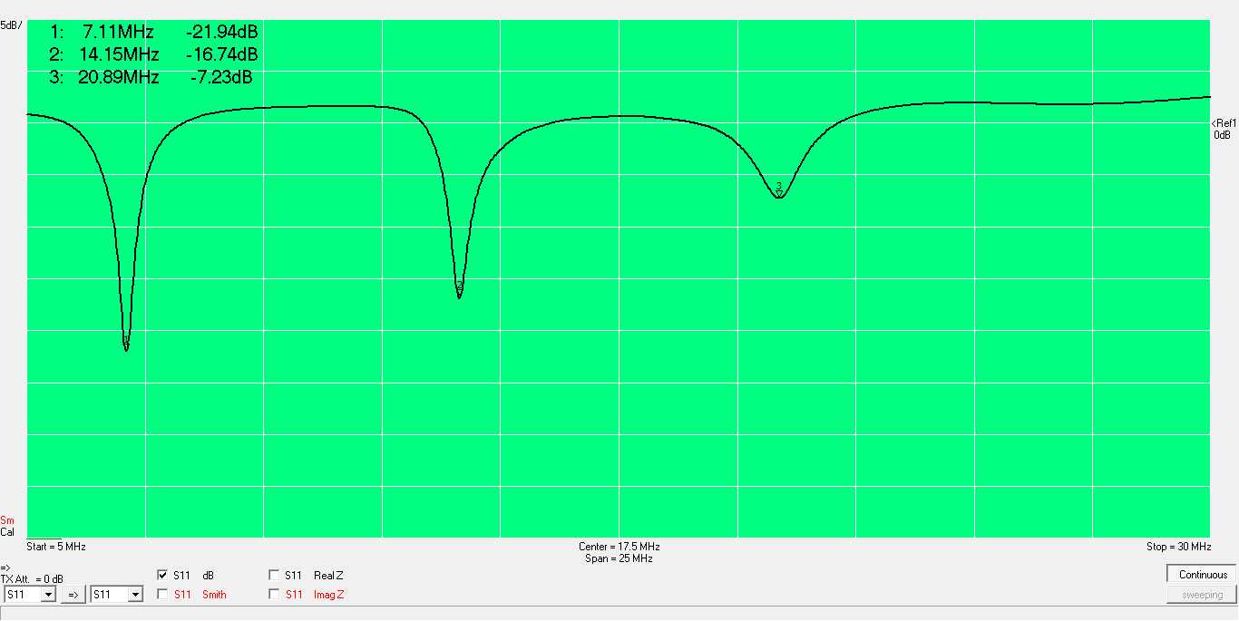
1.5 uH Hairpin added

Slide 22
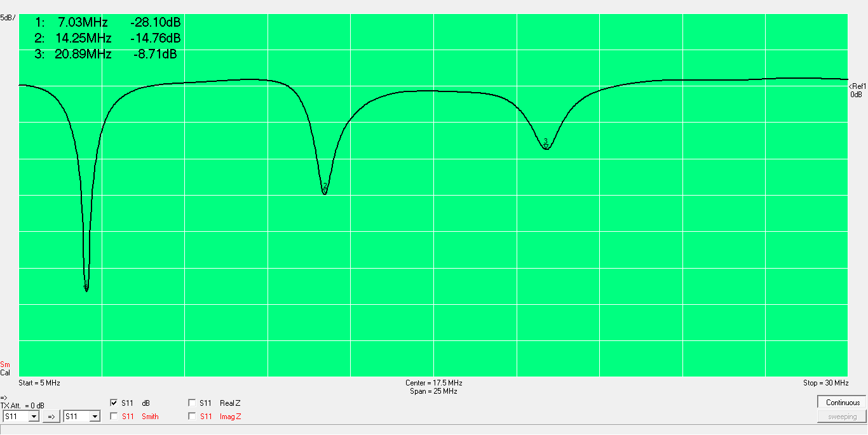
Return loss measured in shack

Slide 23
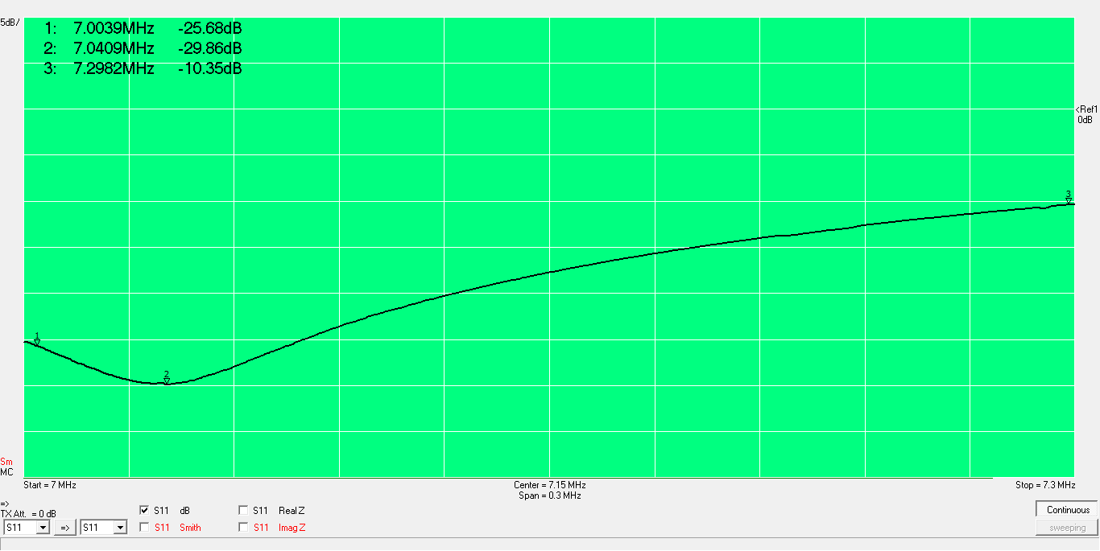
40m return loss

Slide 24
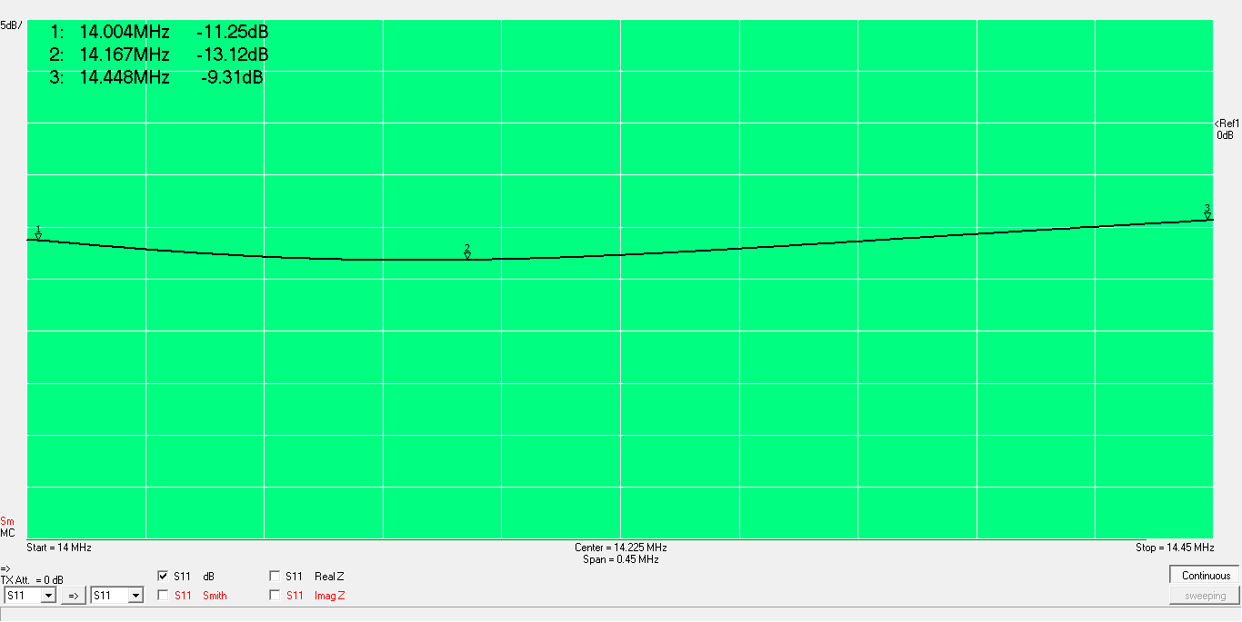
20m return loss

Slide 25
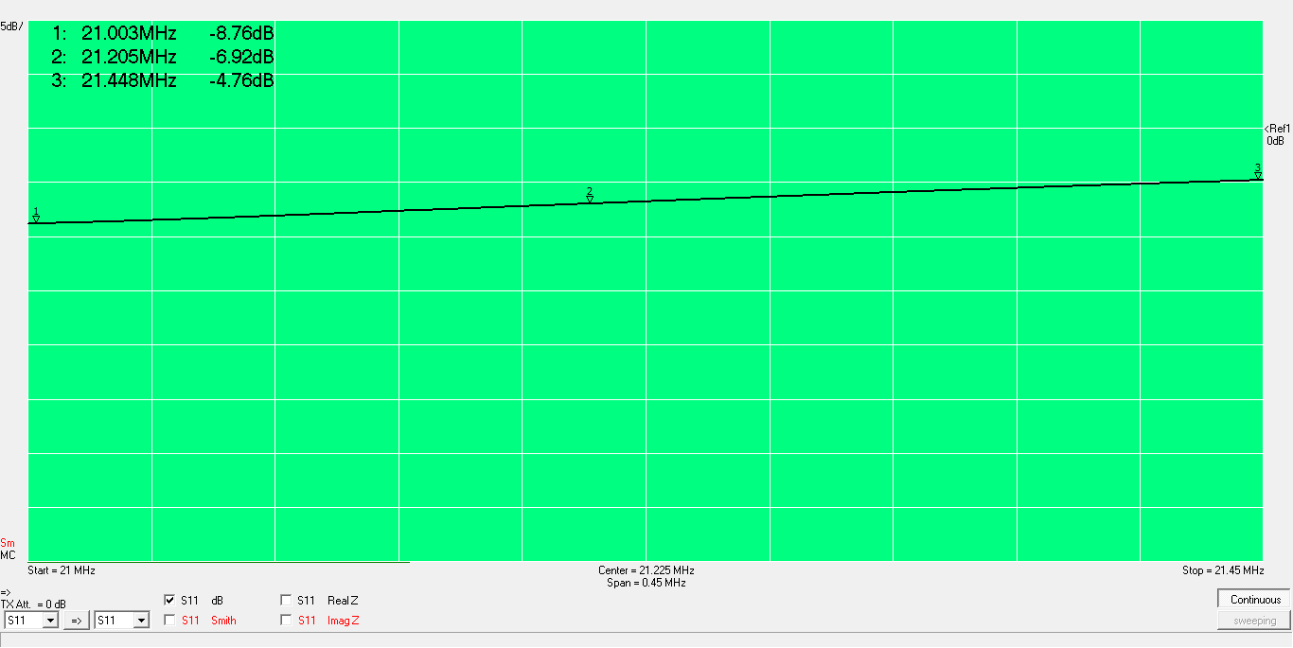
15m return loss

Slide 26
Conclusions
Antenna is easy to match on 40 and 20m
It’s a struggle to get 21 MHz real part less than 100 Ohms
VSWR=2 is easily handled by radio and amplifier antenna tuners
Additional loss due to VSWR in 75 feet of RG-8 is about 0.1 dB
On-air performance seems fine
Typically 1 to 2 S-units down from beam at 60 feet
Less than 1 S-unit at low angles on 40m (Europe)
Always better than operating off back or sides of beam

Slide 27
Appendix
Coil measurements

Slide 28
Notes on measuring coils with VNA
Three measurement methods using VNA
S21 method is more accurate for high impedances
S11 method is better for impedances around 50 Ohms
Shunt-thru method is better for low impedances
S11 and S22 methods give similar results for inductance measurement
Q measurement is best done with shunt-thru resonator method due to low resistance (ESR)

Slide 29
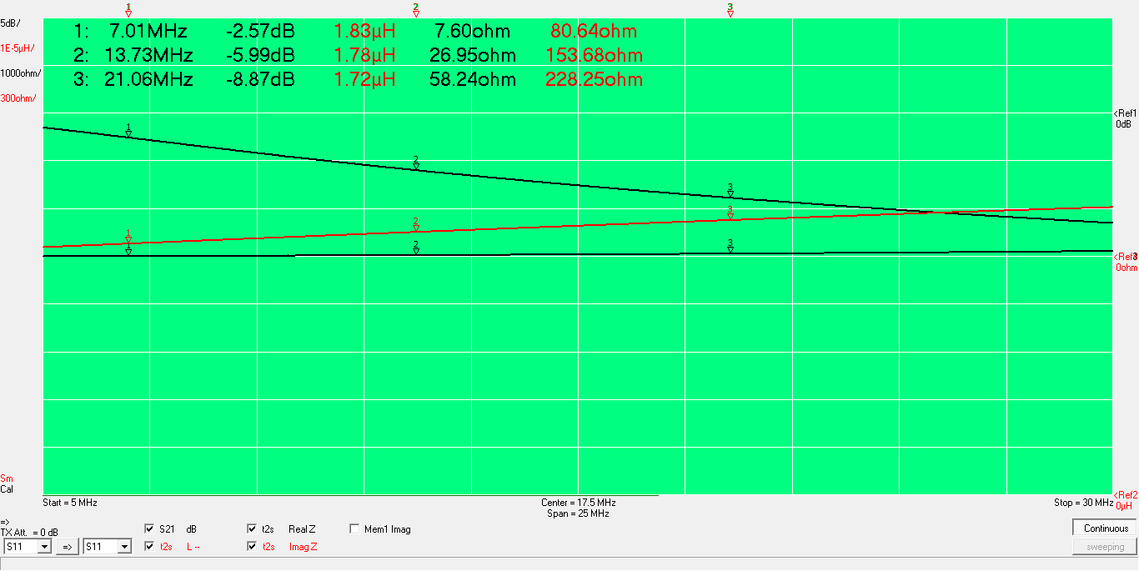
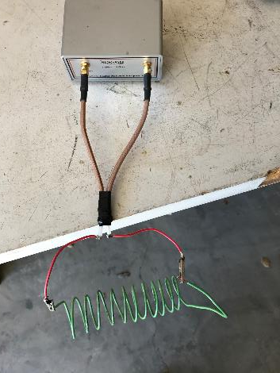
Coil measured using S21 method

Slide 30
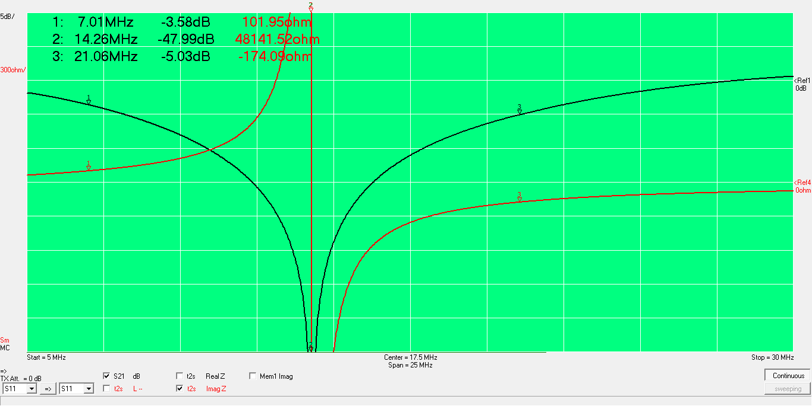
Resonated with 67 pF, S21method

Slide 31
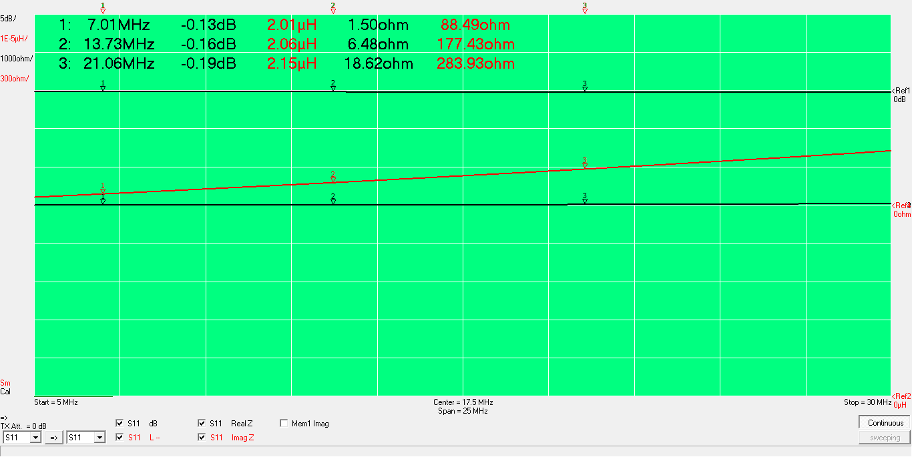
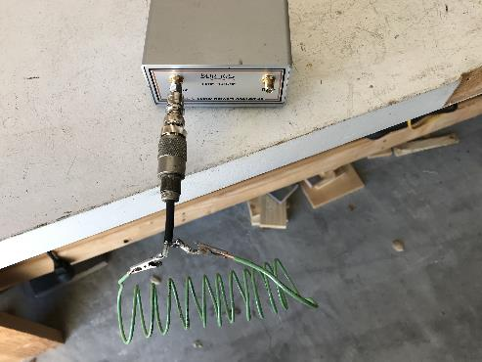
Coil measured using S11 method

Slide 32
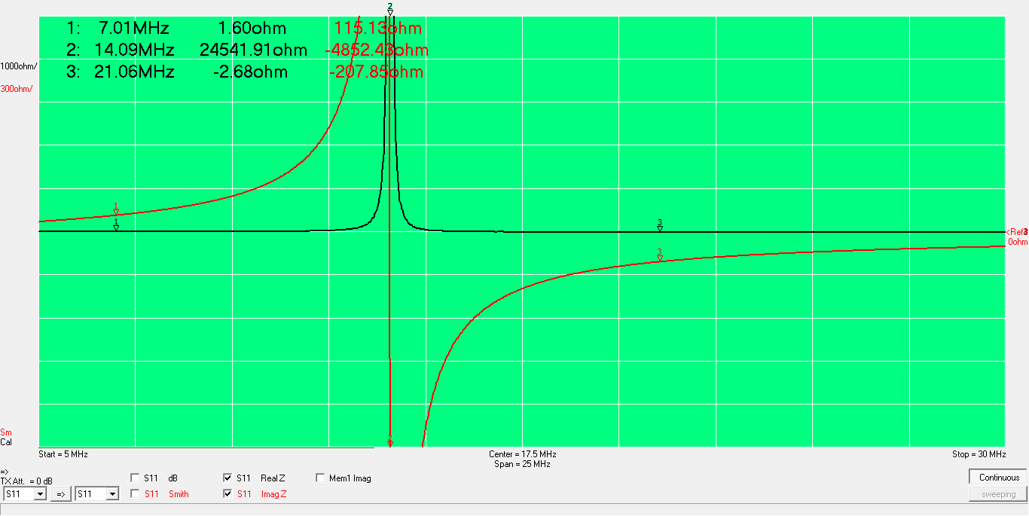
Resonated with 67 pF, S11 method

Slide 33
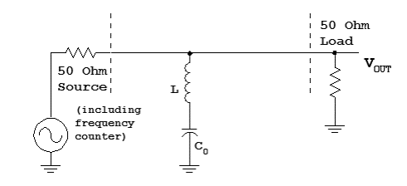
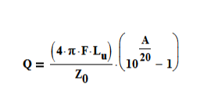
Measurement of resonator Q

Slide 34
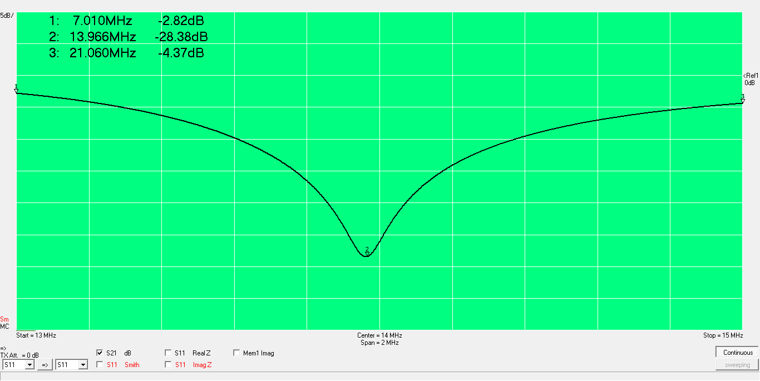
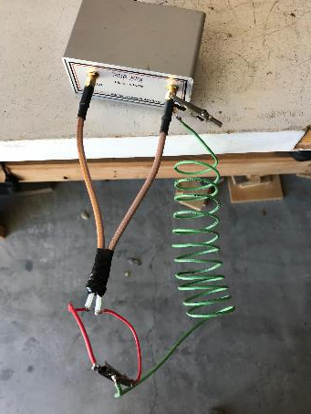
Q= 175 (assuming Q of ceramic capacitor is >> than Q of inductor

