Slide 1
Objective: Evaluate XM240 loading coil
Method
Fabricate test coil with same characteristics as XM240 coil
Better test measurement accuracy without aluminum tubes
Measure Q at 7 MHz and SRF
Add capacitive hat
Evaluate effect on loading coil (is SRF lower affecting performance?)
XM240 loading coil
68T
12 Ga enamel wire
¾ inch fiberglass rod
5.57 inch long

Slide 2
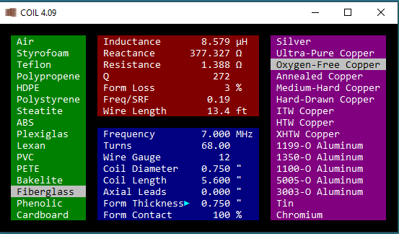
Brian Beezley’s Coil 4.09 predicts L= 8.6 uH, Q=272

Slide 3
Test coil fabricated using fiberglass rod from Max Gain Systems
62.5T, 12 Ga Enamel wire
Hand wound coil is not quite as tightly wound as commercial version but should still be representative

Slide 4
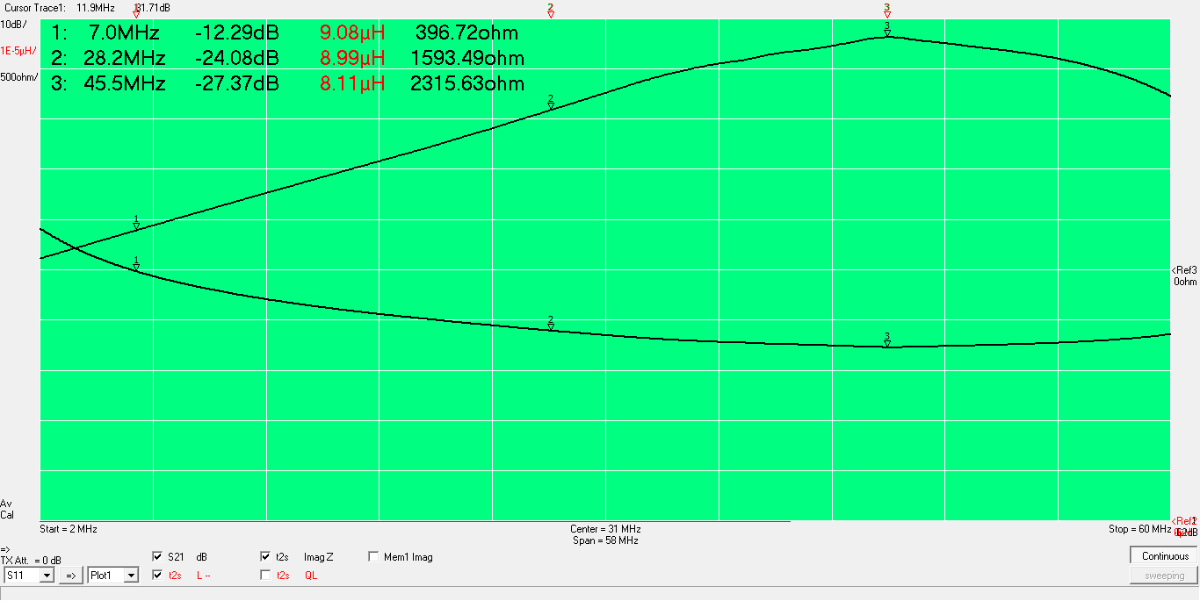
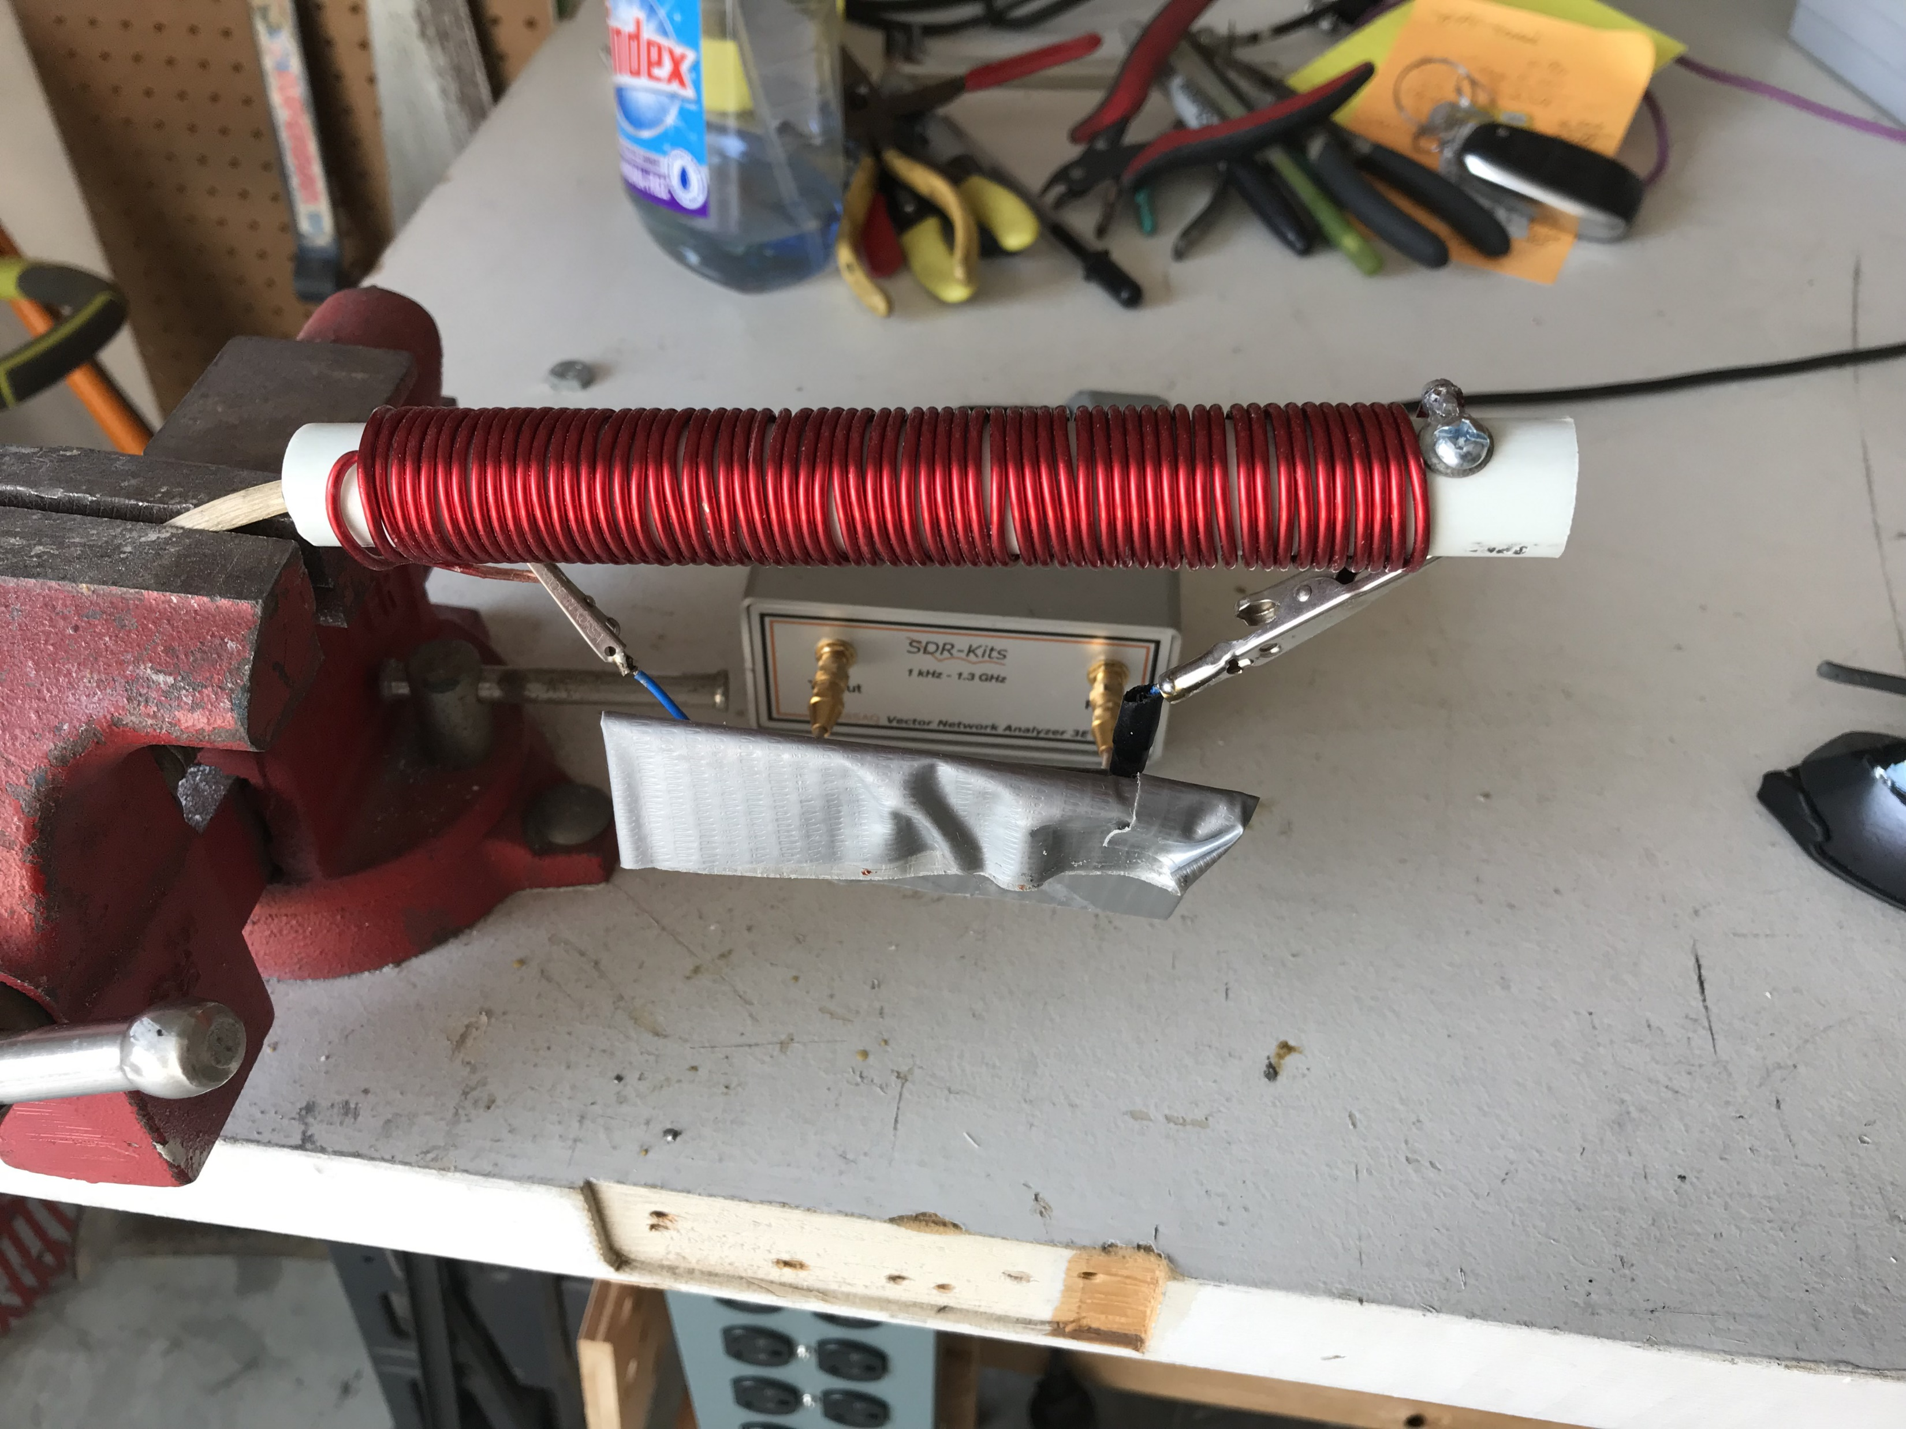
Measurements made using two port VNA Thru (S21) measurement is more accurate for high impedances
L= 9.1 uH, SRF= 45 MHz

Slide 5
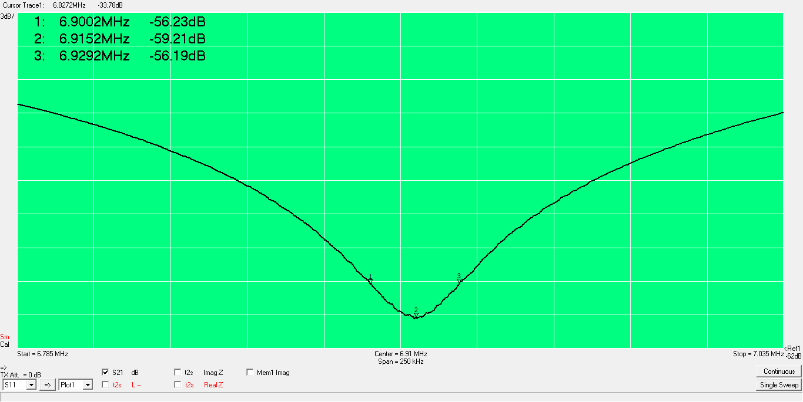
To measure Q, the coil is resonated at 7 MHz with a ceramic capacitor and the insertion loss of the parallel resonant circuit measured Q= center frequency divided by the 3 dB bandwidth
Measured Q= 240
56 pF ceramic capacitor

Slide 6
Add heatshrink tubing

Slide 7
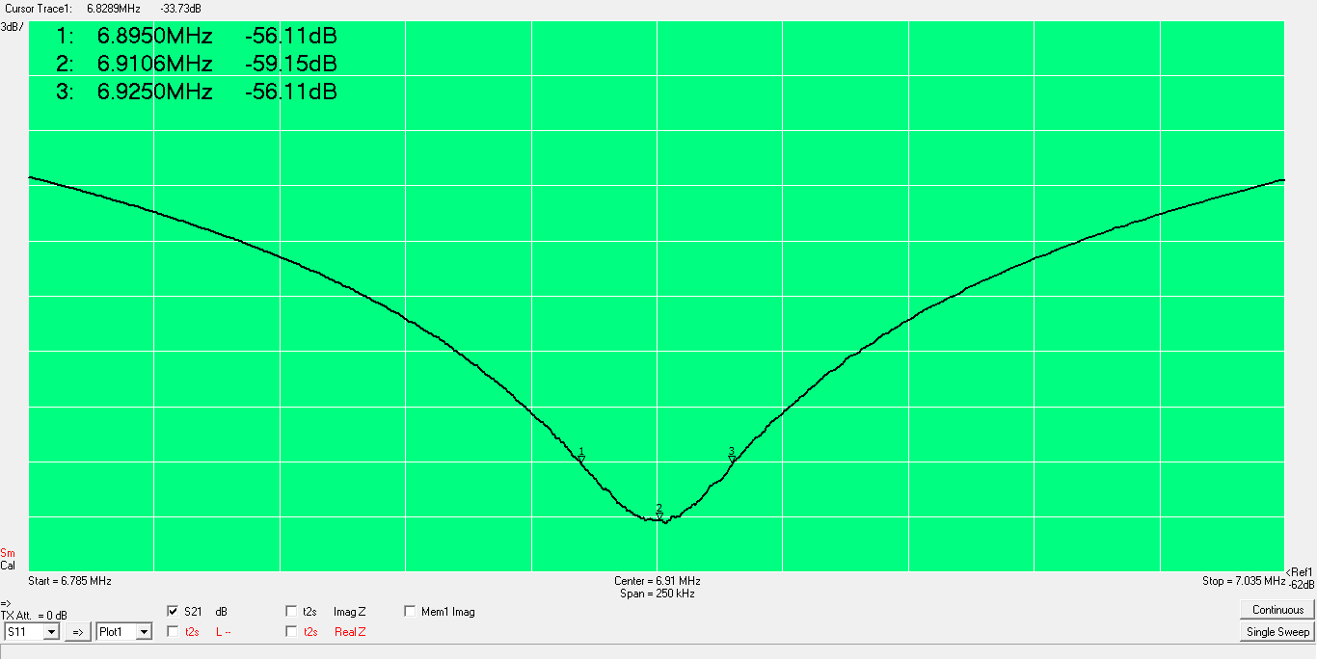
Heatshrink tubing has little effect
Measured Q= 230

Slide 8
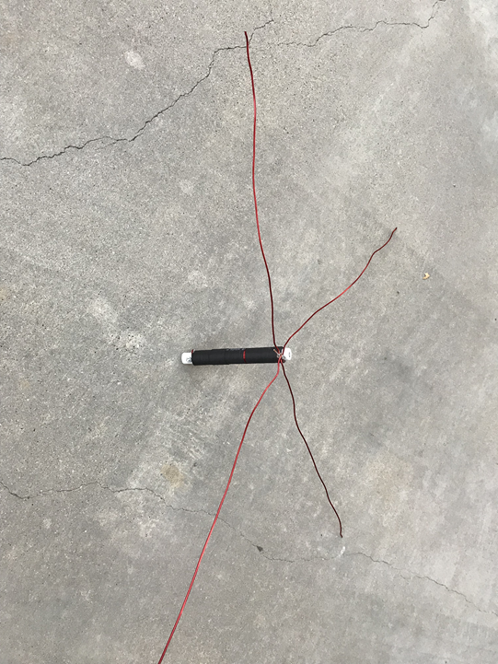
Capacitive hat added using 34.5 inch lengths of enamel wire

Slide 9
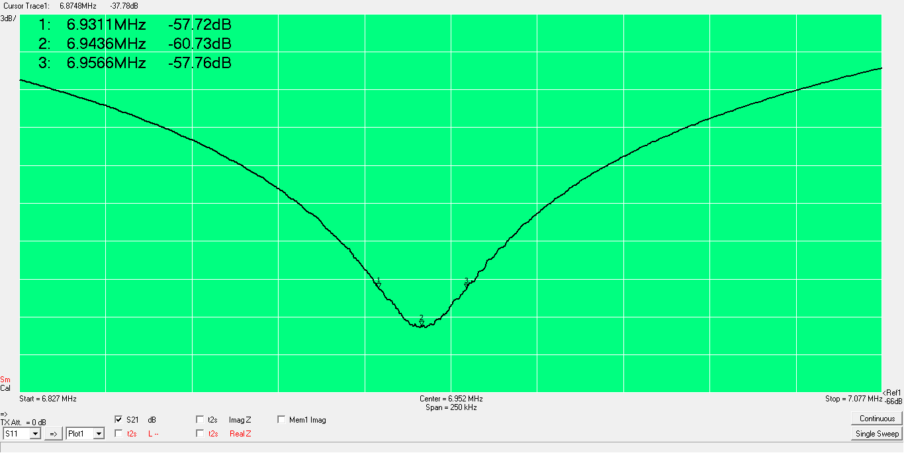
Measured Q=267 with capacitive hat

Slide 10
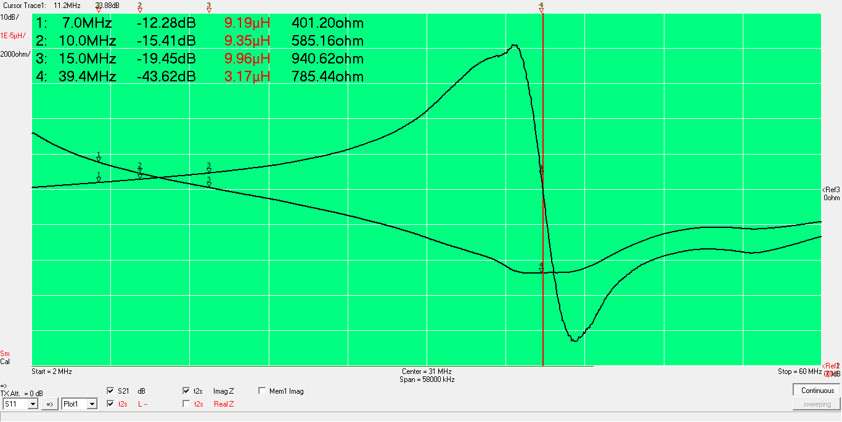
With capacitive hat, the coil is well behaved to 20 MHz SRF is still about 40 MHz

Slide 11
Conclusions
Q of loading coil used in XM-240 is around 250
The capacitive hat does not appear to affect coil performance at 7 MHz
Heatshrink has no effect on performance
NEC simulations by others indicate that a maximum gain of 0.5 db can be achieved by replacing these coils with airwound inductors having Q’s near 900

